Slide 1
EWG Working Group Update
Bob Woodruff, Software Engineering Manager
Intel
[ April 4, 2016 ]

Slide 2
Agenda
EWG Charter
OFA Process and Possible Changes
EWG – OFED releases last year
EWG Roadmap
How to contribute

Slide 3
EWG General Goals and Charter
The charter of the EWG working group is to provide enterprise ready distributions of the Open Fabrics code for Linux.
That can be used (in whole or in part) to help enable in-box support of OFA S/W in Linux distros
That can be used directly by customers on various Linux distro kernels that want the latest bleeding edge code that is not yet in the Linux distros
That can be used as a basis for vendor provided OFED derivatives
That is used for interoperability testing and OFA logo program

Slide 4
OFED Process
No major process changes over the last year.
Current Process for OFED
OFA developers develop code and submit it upstream to kernel.org and the OFA user-space package maintainers.
OFED kernel code is based on the released upstream kernel code.
Add backport patches for various Linux distro kernels.
Add any new experimental features that are not yet upstream but people want/need to test or use with the rest of OFED.
Cherrie pick bug fixes from newer kernels to fix bugs discovered after the upstream kernel was released.
Package with all of the individual maintainer user-space packages, with install scripts and release notes.
Test the OFED RCs; Done by both the individual vendors and also by the OFA IWG.
Once all the critical bugs are resolved, release the OFED package for use by customers and the IWG to use for interop testing

Slide 5
Possible future OFA Process changes under consideration
Currently, OFED waits for a final kernel.org release before starting backports and testing with the user-space code.
If we started the early package testing “during” the kernel.org RC stage, issues found could be sent to kernel.org before the kernel.org release.
Pros and Cons of this approach:
Pro: OFA would help with upstream kernel testing and fixing bugs.
Cons: More work to do updating the OFED kernel code multiple times for newer kernel.org RCs.
Cons: Can OFA keep up with the kernel.org pace
OFA EWG typically operates at a slower pace than kernel.org (major OFED releases take ~6 months or more, kernel.org releases are about every 2 months)
Can OFED backports be done fast enough to allow testing before the kernel release

Slide 6
OFED Releases since last year
OFED-3.18
Moved kernel base to kernel.org 3.18
Added support for new distros, RHEL EL 7.1
Added OFI 1.0 (libfabric) from the OFIWG
Mellanox ConnectX4 ready
Updated user-space packages and cherry picked bug-fixes from later upstream kernel.org
Add list of specific package versions

Slide 7
OFED Releases since last year
OFED-3.18-1
Moved kernel base to kernel.org 3.18
Added support for new distros, RHEL EL 6.7, SLES 11 SP4
Added OFI 1.1 (libfabric) from the OFIWG
Updated user-space packages and cherry picked bug-fixes from later upstream kernel.org
Add list of specific package versions

Slide 8
OFED Releases since last year
OFED-3.18-2 (in process)
Added support for new distros, RHEL EL 7.2, SLES 12 SP 1
Added OFI 1.2 (libfabric) from the OFIWG
Updated user-space packages and cherry picked bug-fixes from later upstream kernel.org
Add list of specific package versions

Slide 9
What’s next ? OFED-4.6
Lots of upstream activity in progress.
RoCE V2
Omni-path driver
New Intel iWarp (i40) driver
Many kernel updates to isert, NFS/RDMA
Most of this is likely for kernel.org 4.6
Thus, next major OFED will likely target 4.6
Assuming most of this stuff gets upstream
Proposed distro support for latest RHEL EL 7.x (7.1 and 7.2) and SLES 12 and SLES 12 SP 1
Drop support for RHEL EL 6 and SLES 11 kernels
Start testing during the kernel.org RC stage ?

Slide 10
If You Want to Help….
Developing code:
Including back-ports in Linux
Reviewing code submitted to Linux kernel/libs
Doing QA and testing
Performance tuning
Sending patches and comments to the mailing lists:
OFED for Linux: ewg@lists.openfabrics.org
General Linux development: linux-rdma@vger.kernel.org
OFIWG Working Group: ofiwg@lists.openfabrics.org
OFVWG Working Group: ofvwg@lists.openfabrics.org
Maintainers and git trees: http://www.openfabrics.org/downloads/MAINTAINERS
Participate in EWG meetings
Opening bugs in Bugzilla (http://bugs.openfabrics.org/)
When opening a new bug you can choose OpenFabrics Linux

Slide 11
THANK YOU
John Smith, President and CEO
COMPANY XYZ
[ LOGO HERE ]

Slide 12
Backup Slides

Slide 13
OFED – SW & HW validation
OpenFabrics Interoperability Logo Group (OFILG)
Purpose: validate OFED functionality, test ULPs and verify interoperability in a heterogeneous environment
Members: Chelsio, DDN, Emulex, IBM, Intel, Mellanox and NetApp
OFA Cluster at UNH-IOL
Servers: iWARP 12 hosts, InfiniBand 18 hosts, RoCE 10 hosts
InfiniBand HW : 12 HCAs, 5 switches, 5 SRP targets, 1 gateway
iWARP HW: 6 RNICs, 2 switches
RoCE HW: 8 RCA, 2 switches
OFED versions Tested
1.5.x, 3.5.x, 3.12, 3.12-1 and 3.18
PXE Boot environment available
RHEL 5.x, 6.x, 7.x, SLES 11, Ubuntu 10.04 and 12.04
OFED 1.4.x, 1.5.x, 3.5.x, 3.12, 3.12-1
Protocols Tested
Fabric Init, IPoIB, Link Init, NFSoRDMA, Open MPI, RDMA Utilities, RSockets, SM failover, SRP, uDAPL
Tests executed – approximately 8,049
Notes:
RSD: Added 3.12-1 and 3.18
RSD: I would like to double check the hardware status. I will check with UNH-IOL

Slide 14
InfiniBand – transport
Notes:
RSD- updated the footer for 2015 dates

Slide 15
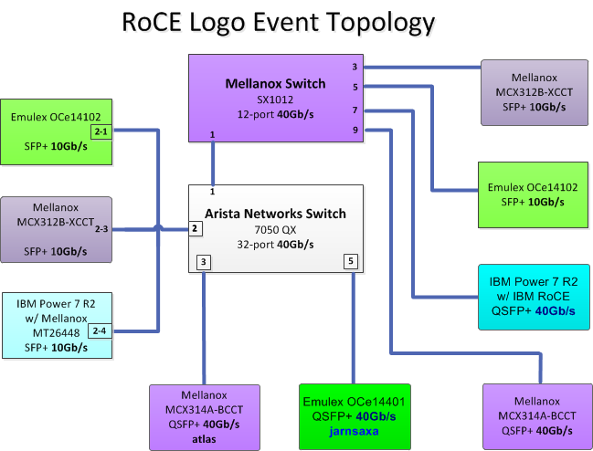
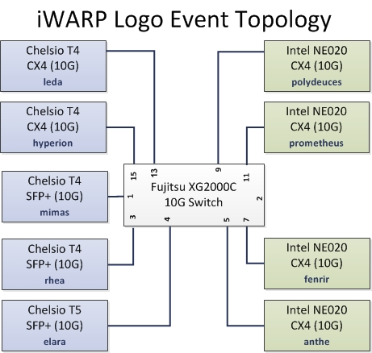
Ethernet – transport
Notes:
RSD- updated the footer for 2015 dates

