Slide 1
EWG Working Group Update
Bob Woodruff, Software Engineering Manager
Intel
[ April 6, 2016 ]

Slide 2
Agenda
EWG Charter
OFA Process
EWG – OFED releases last year
EWG Roadmap
How to contribute

Slide 3
EWG Charter
The charter of the EWG working group is to provide enterprise ready distributions of the Open Fabrics code (OFED) for Linux.
That can be used (in whole or in part) to help enable in-box support of OFA S/W in Linux distros
That can be used directly by customers on various Linux distro kernels that want the latest upstream code that is not yet in the Linux distros
That can be used as a basis for vendor provided value-add OFED derivatives
That is used for interoperability testing and OFA logo program
That is used for IBTA interoperability testing

Slide 4
OFED Process
No major process changes over the last year.
Current Process for OFED development
OFA developers develop code and submit it upstream to kernel.org and the OFA user-space package maintainers via the linux-rdma list.
OFED kernel code is based on the upstream kernel code, with testing starting during the RC stage of kernel development.
OFED user-space packages are based on up-stream OFA user-space packages.
EWG adds backport patches to allow the upstream kernel code to run on various Linux distro kernels.
EWG adds any new experimental features that are not yet upstream but people want to test or use with the rest of OFED.
EWG adds cherry picked bug fixes from newer kernels to fix bugs discovered after the upstream kernel is released.
Package with all of the individual maintainer user-space packages, build and install scripts, and release notes.
Test the OFED RCs; Done by both the individual HW vendors and also by the OFA IWG.
Once all the critical bugs are resolved, release the OFED package via the OFA website.

Slide 5
OFED Releases since last year
OFED-3.18
Moved kernel base to kernel.org 3.18
Added support for new distros, RHEL EL 7.1
Added OFI 1.0 (libfabric) from the OFIWG
Mellanox ConnectX4 ready
Updated user-space packages and cherry picked bug-fixes from later upstream kernel.org
- dapl-2.1.5
- fabtests-1.0.0
- libfabric-1.0.0
- librdmacm-1.0.21
- mstflint-4.0.1-1.42.g0d3b372
- infiniband-diags-1.6.5
- libibmad-1.3.12
- libibumad-1.3.10.2
- libiwpm-1.0.1
- libmlx5-1.0.2
- libocrdma-1.0.5
- mstflint-3.8.0-1.27.gf3d39b6
- opensm-3.3.19
- perftest-2.4-0.8.gd3c2b22
- srptools-1.0.3

Slide 6
OFED Releases since last year
OFED-3.18-1
Added support for new distros, RHEL EL 6.7, SLES 11 SP4
Added OFI 1.1 (libfabric) from the OFIWG
Updated user-space packages and cherry picked bug-fixes from later upstream kernel.org
-libocrdma-1.0.6
- perftest-3.0-0.1
- dapl-2.1.7
- infiniband-diags-1.6.6
- infinipath-psm-3.3-7_g05f6f14_open
- libiwpm-1.0.3
- libfabric-1.1.1
- fabtests-1.1.1
- ibacm-1.1.0
- libiwpm-1.0.3rc1
- mstflint-4.1.0-1.45.g1d75d01

Slide 7
OFED Releases since last year
OFED-3.18-2 (in process)
Added support for new distros, RHEL EL 7.2, SLES 12 SP 1
Added OFI 1.2 (libfabric) from the OFIWG
Updated user-space packages and cherry picked bug-fixes from later upstream kernel.org

Slide 8
What’s next ? OFED-4.6 or 4.7
Lots of upstream activity in progress on the linux-rdma list.
RoCE V2
Intel® OmniPath (Intel® OP) driver
New Intel® iWarp (i40) driver
Many kernel updates to isert, srpt, NFS/RDMA
Better virtualization support in IPoIB
And more…..
Most of this is likely for kernel.org 4.6 and/or 4.7
Thus, next major OFED will likely target 4.6 or 4.7
Depending on when most of this stuff gets upstream
Proposed distro support for latest RHEL EL 7.x (7.1 and 7.2) and SLES 12 and SLES 12 SP 1
Can we drop support for RHEL EL 6 and SLES 11 kernels ?

Slide 9
If You Want to Help….
Developing code:
Including back-ports in Linux
Reviewing code submitted to Linux kernel/libs
Doing QA and testing
Performance tuning
Sending patches and comments to the mailing lists:
OFED for Linux: ewg@lists.openfabrics.org
General Linux development: linux-rdma@vger.kernel.org
OFIWG Working Group: ofiwg@lists.openfabrics.org
OFVWG Working Group: ofvwg@lists.openfabrics.org
Maintainers and git trees: http://www.openfabrics.org/downloads/MAINTAINERS
Participate in EWG meetings
Opening bugs in Bugzilla (http://bugs.openfabrics.org/)
When opening a new bug you can choose OpenFabrics Linux

Slide 10
THANK YOU
Bob Woodruff, Software Engineering Manager
Intel

Slide 11
Backup Slides

Slide 12
OFED – SW & HW validation
OpenFabrics Interoperability Logo Group (OFILG)
Purpose: validate OFED functionality, test ULPs and verify interoperability in a heterogeneous environment
Members: Chelsio, DDN, Emulex, IBM, Intel, Mellanox and NetApp
OFA Cluster at UNH-IOL
Servers: iWARP 12 hosts, InfiniBand 18 hosts, RoCE 10 hosts
InfiniBand HW : 12 HCAs, 5 switches, 5 SRP targets, 1 gateway
iWARP HW: 6 RNICs, 2 switches
RoCE HW: 8 RCA, 2 switches
OFED versions Tested
1.5.x, 3.5.x, 3.12, 3.12-1 and 3.18
PXE Boot environment available
RHEL 5.x, 6.x, 7.x, SLES 11, Ubuntu 10.04 and 12.04
OFED 1.4.x, 1.5.x, 3.5.x, 3.12, 3.12-1
Protocols Tested
Fabric Init, IPoIB, Link Init, NFSoRDMA, Open MPI, RDMA Utilities, RSockets, SM failover, SRP, uDAPL
Tests executed – approximately 8,049
Notes:
RSD: Added 3.12-1 and 3.18
RSD: I would like to double check the hardware status. I will check with UNH-IOL

Slide 13
InfiniBand – transport
Notes:
RSD- updated the footer for 2015 dates

Slide 14
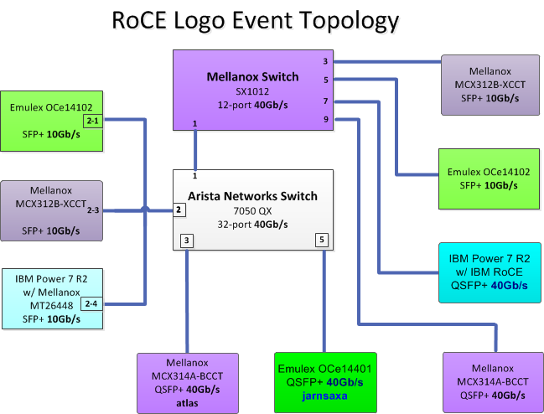
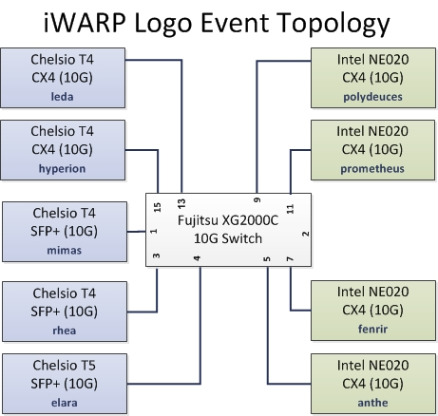
Ethernet – transport
Notes:
RSD- updated the footer for 2015 dates

