Slide 1
OFA Workshop 2020
Session Topic Development
[ July 2019 ]

Slide 2
Goal / Agenda
Objective: Deliver a Workshop that is highly relevant to our target audience by ensuring the Workshop covers topics that are current, significant, and forward-looking
Tap OpenFabric Alliance and its members to help drive topic development for the upcoming OFA Workshop 2020
Support the Technical Program Committee in shaping an interesting, relevant Workshop program
Expand interest areas and/or applications that relate to Advanced Network Software developers/users
Today’s Agenda
Review past workshop topic areas, categorize those that should be repeated or discarded
Identify new topics that should be included

Slide 3
Past Workshop topics

Slide 4
2018-2019 CFS Topics
2018
Accelerators, FPGAs, GPUs
AI and Machine Learning
Cloud Deployments over Fabrics
Commoditization of RDMA
Competitive Landscape in Fabric Technologies
Data Analytics
Future Directions in Networking
Network APIs, Libraries and Software
Persistent and Non-Volatile Memory
Topics in System Administration
Topics in the Kernel
2019
Administration, Management and Deployment
Fabric technology
Traffic policy, engineering and control
Diverse fabrics
Interoperability
Goals
Objective
Methods
The OFA and the Open Community
OSs and I/O subsystem support
Security, namespaces
File systems, protocols, DAX
Remote Persistent Memory
Programming interfaces
Protocols
Devices

Slide 5
New 2020 Topics

Slide 6
New topics for 2020
What’s been missing?

Slide 7
Back UP

Slide 8
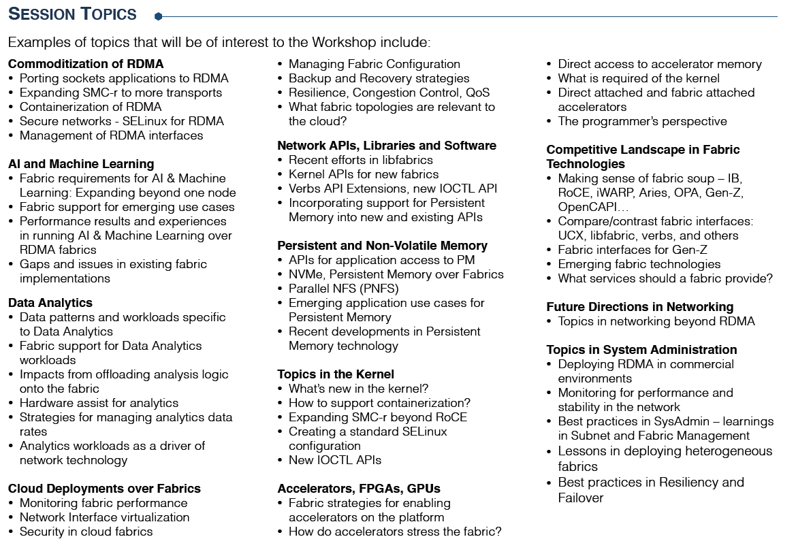
2018 Topics expanded

