Slide 1
Interoperability Working group IWG and CANDI update
Bob Noseworthy, UNH-IOL Chief Engineer Presenting on behalf of IWG co-chairs Paul Bowden, Intel and Gilad Margalit, Mellanox
Paul Grun, OFA Vice Chair & Cray
[ Date, 2017 ]
[ LOGO HERE ]

Slide 2
Overview
OFA-IWG Overview
Presented by Bob Noseworthy
OFA Interoperability Logo Program Update
OS DISTRO / ON-DEMAND TESTING
Test Plan expansion
Co-Existence
RoCEv2
Opportunities with NVMe Over Fabrics
Compliance and Interoperability (CANDI)
Presented by Paul Grun
CANDI Update

Slide 3
Interoperability Working Group (OFA-IWG)
Original Purpose
To deliver on the promise of end-user readiness, the OFA software running on servers or hosts needs to support interoperability in many ways – between different supported transports that run the same OFA software, and with switches, gateways, servers, and storage targets that contain external (e.g., OEM provided) software elements that work in conjunction with OFA software to provide fabric wide functionality.
Enable confidential 3rd-party testing in a multi-vendor environment
Identify interoperability issues
Conduct a neutral Interoperability Logo Program (OFILP)
Add value to the networking community through testing and validation
The OFA-IWG was formed to address the interoperability requirements above.
Notes:
To define, develop & execute a comprehensive suite of tests for establishing the interoperability of ULPs through OFA Software.
To coordinate resources to enable thorough testing in a multi-vendor RDMA environment, executing OFA Software and ULPs
To confidentially perform interoperability tests and grant logos for the OFA Interoperability Logo Program (OFILP)
To investigate interoperability issues related to the OFA software over RDMA transports.

Slide 4
OFA-IWG
OFA IWG
Open to participation by all
IWG oversees the Interop program via the Test Plan
Test Plan
Emerging Opportunities
OFILP
Distro testing
NVMe
CANDI
OFA Interop Logo Program
Funded by OFILP members
Confidential
Programs include
biannual Debug Events
Logo events
Logo Events
Debug Events
On-Demand
IWG Objective: Bring greater value to the Open Source networking community

Slide 5
improving the logo program
Driven by members to address current and emerging needs
Co-Existence Coverage
Co-Existence of multiple adapters within the same system
Call to action: Is this Logo Program expansion important to you?
RoCE v2 Coverage
RoCE v2 support needs member interest and definition for test coverage
Call to action: Is this Logo Program expansion important to you?
Are there other expansion areas important to you?
Interoperability Test plan The OFA recognizes the need for the interoperability test effort to be industry-wide, where testing is conducted under the auspices of the appropriate networking organizations.
IBTA is responsible for InfiniBand compliance & interoperability testing on cables & devices. NVMe Org for NVMe storage devices. UNH-IOL provides DCB Switch testing.
The OFA IWG is responsible for Interoperability testing on InfiniBand, iWARP and RoCE products based on OFA Software (OFED).

Slide 6
Proposal - OS DISTRO TESTING
Goal - improve upstream kernel and distro validation
OS DISTRO TESTING
Working to address the needs of the Linux Distros
Driven by requests from leading Distros, including SuSE and RedHat
Apply the diverse multi-vendor OFA Cluster housed at UNH-IOL
Enables inter-distro heterogeneous testing
Address requests for more rapid testing
Increase automation of testing (eg: Jenkins)
Expand test robustness and speed reporting
Delivering on the promise of end-user readiness

Slide 7
Proposal - oN-DEMAND TESTING
Goal – Improve Responsiveness of the Testing Program
ON-DEMAND TESTING
OS Distro testing enables a pathway for On-Demand testing year-round utilizing the OFA Cluster
Customized test cycles for members & expanded types of testing
Avoid the need to wait for bi-annual interop/logo events
Allows Distros to test alpha/beta or GA releases on their schedule
Vendors can test their solutions when ready and still receive Logo
Opportunity for greater upstream testing for ULPs and OFA software (RCs and GAs)
Path forward still in discussion within IWG
Focus is on meeting Linux Distro needs first and foremost
Get involved with the IWG and help enable distro and upstream testing in the OFA Logo Program!

Slide 8
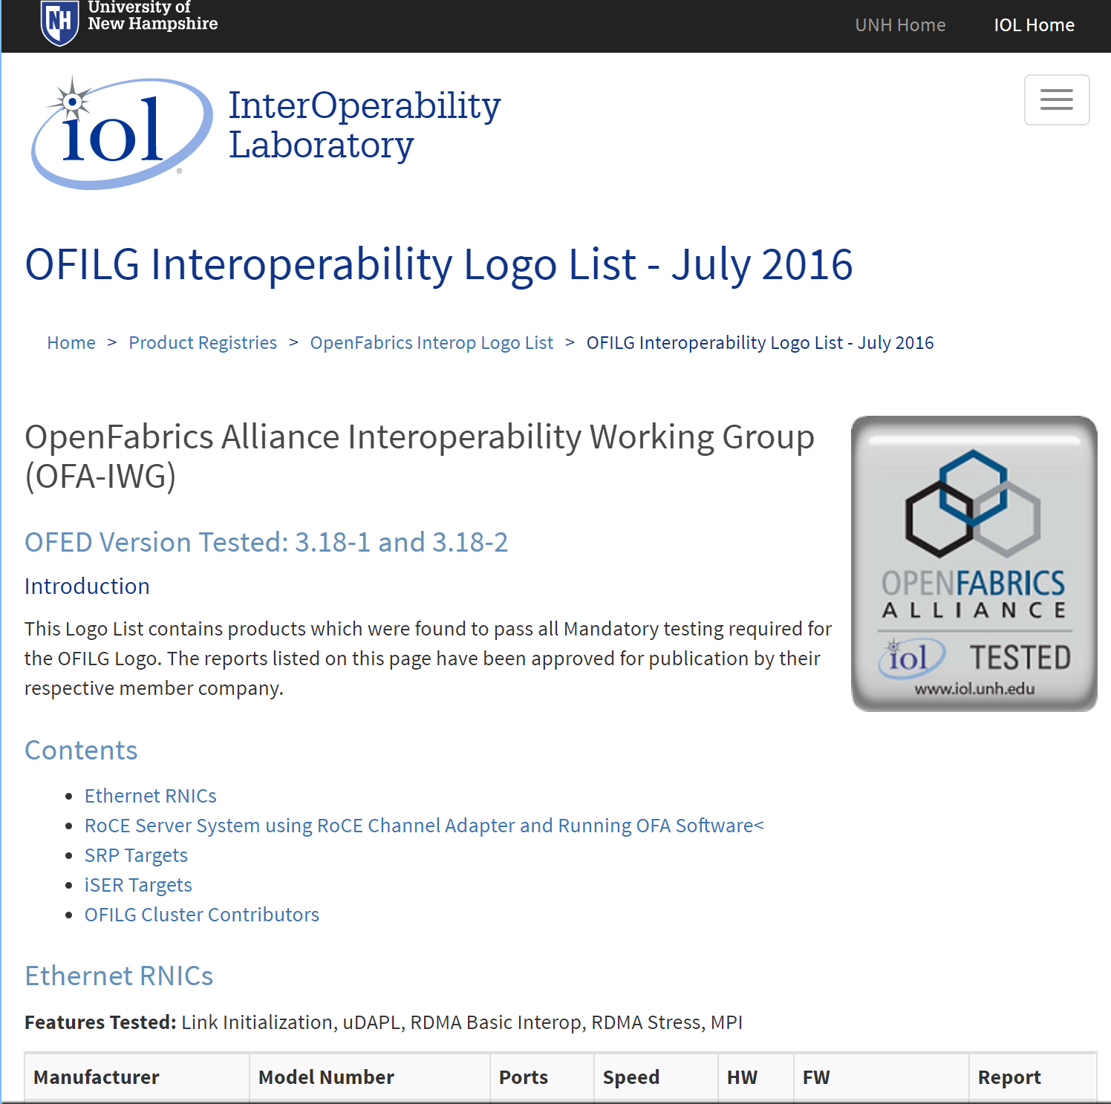
OFILG Next Interop/Debug Event
Play well with others!
OFA-IWG defined Test Plan
Incremental updates always welcome
Contribution welcome from all OFA members in the IWG.
Target: OFED 4.8 RC1 (or latest)
Get involved !!
Join the OFILG
Look to the OFILG Interoperbility Logo List
Next Event:
OFILG Interop/Debug Event #22
May 1-5, 2017 at UNH-IOL
Register for the next OFA Interop/Debug Event at: https://www.iol.unh.edu/testing/hpc/ofa/grouptest

Slide 9
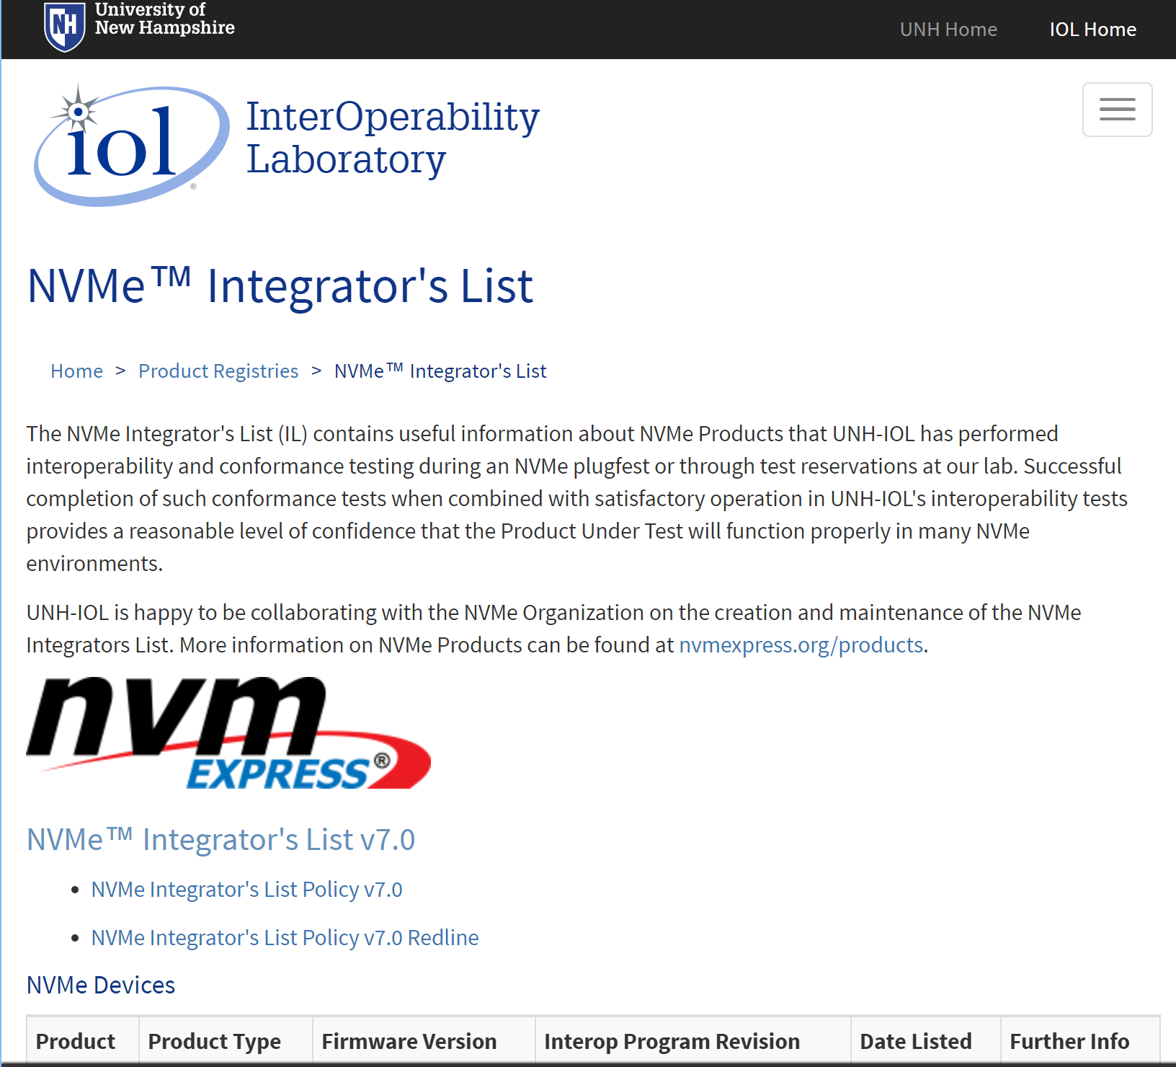
OFA and NVMe over fabrics
Opportunities ahead !
NVMe over Fabrics is an emerging technology
UNH-IOL performs testing on behalf of NVMexpress.org
For OFILG members: UNH-IOL is providing access for RNIC, HCA and RCAs, to the next NVMe Plugfest, where initial exploration of testing for NVMe over Fabrics will occur.
Future events may be handled differently
Contact kerry.munson@iol.unh.edu
Next Event:
NVMe Plugfest #7 with NVMe-MI + Fabrics
May 22-25, 2017 at UNH-IOL
Register for the next NVMe Plugfest at: https://www.iol.unh.edu/event/2017/01/nvme-plugfest-7-nvme-mi-fabrics

Slide 10
CANDI update (Compliance and interoperability)
Paul Bowden, Paul Grun, Sean Hefty, Bob Russell, Jim Ryan, Jerome Berryhill, Alexia Ingerson
[ Date, 2017 ]
[ LOGO HERE ]

Slide 11
RE-cap from last year – a five part proposal
A small team began meeting in 2016 to assess the potential for creating more value add on top of the existing Interop program
Intended to meet a wide variety of needs, ranging from provider vendors to consumers and deployers

Slide 12
RE-cap from last year – a five part proposal
Starting with Provider Compliance Validation is logical

Slide 13
RE-cap from last year – a five part proposal
Developing a training program for OFI is also on the TODO list, but that task belongs to the XWG/BoD

Slide 14
Last Year we identified a need for a compliance program
Augments, but does not replace, the current Interop program
We concluded that ‘compliance’ and ‘interoperability’ are different things
OFI architecture doesn’t require interoperability, (but also doesn’t prohibit it)
wire protocols are different!

Slide 15
Compliance? Interoperability?
Interoperability:
A device is interoperable if it works “correctly” with other devices – e.g. does this HCA work with other HCAs? Switches?
Interoperability is established through a series of exhaustive tests, usually focusing on a matrix of components
Compliance:
An object is in compliance if it conforms to a set of requirements as measured by some objective criteria
Typically, requirements are conveyed in an industry standard
Compliance is determined by testing against each requirement
Today, devices are not tested for compliance
Compliance testing is left to the standards bodies e.g. IBTA, IEEE…

Slide 16
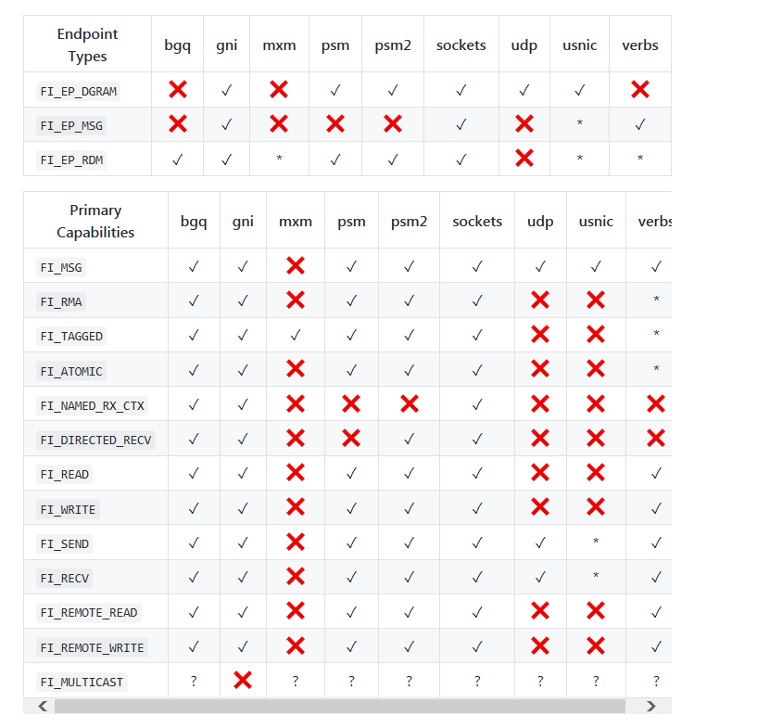
Compliance objective
The OFI architecture is designed to support
Multiple providers
Each delivering a unique feature set
Compliance Objective: if a provider supports a feature, is that feature implemented correctly?

Slide 17
Fabtests – a good place to start
The OFIWG project has developed a set of FABTESTS
Designed to help Provider developers ensure their code works with the libfabric API
Our objective is to leverage FABTESTS to validate the coverage of features and options by any given provider
Naturally, several issues arose:
The existing FABTESTS may not be sufficient to test the complete set of endpoints
Even if tests exist, there’s no guarantee today that all options for that endpoint type are exercised
Once the set of FABTESTS is complete, still need to validate a given provider works properly with its defined set

Slide 18
Here’s what we’re doing
Catalog all features and options described in the existing MAN pages – (done)
Augment the portfolio of Fabtests to cover any existing gaps
Call to action – help is needed to round out the library of fabtests
Statically analyze existing Fabtests code paths – which features of a libfabric provider could theoretically be exercised? (in process today)
Dynamically analyze Fabtests code paths – which features are actually testable using available command line options?
Call to action – help is needed to develop tools and methods to accomplish this
Decide how to certify any given Provider against the resulting set of FABTESTS
Call to action – decide what level of certification is desired

Slide 19
man3 function/struct | field/param value | Active MSG EP | Passive MSG EP | RDM EP | DGRAM EP | Active STREAM EP | Passive STREAM EP | SOCK DGRAM EP
fi_getinfo
fi_getinfo()
 | flags
 | FI_NUMERICHOST
 | FI_SOURCE
 | FI_PROV_ATTR_ONLY
fi_freeinfo()
fi_allocinfo()
fi_dupinfo()
struct fi_info
 | next
 | caps
 | primary
 | FI_MSG
 | FI_TAGGED
 | FI_RMA
 | FI_ATOMIC
 | FI_SEND
 | FI_RECV
 | FI_MULTICAST
 | FI_DIRECTED_RECV
 | FI_NAMED_RX_CTX
 | FI_READ
 | FI_REMOTE_READ
 | FI_WRITE
 | FI_REMOTE_WRITE
A snippet of the canonical list of libfabric’s functions and structures
As the program proceeds, the cells are filled in with a value to indicate if that combination is testable via one or more Fabtests
This becomes the basis for defining the set of FABTESTS to be run to verify compliance with the MAN pages
We plan to post this reference to github shortly

Slide 20
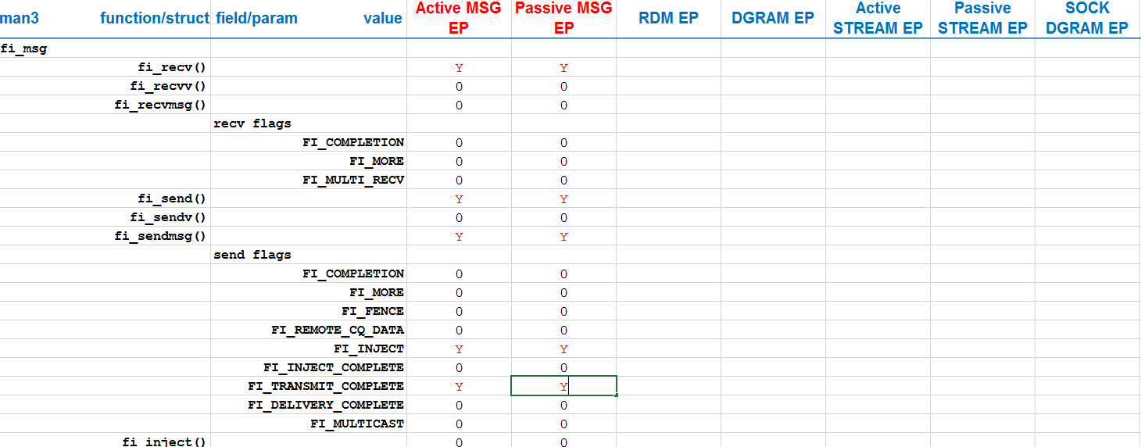
Results of the static path analysis for one FABTEST – this happens to be for a ping-pong test.
A ‘Y’ indicates that this FABTEST contains a code path that exercises that function.
Static analysis does not tell us if that path is actually exercised or not. That falls to the dynamic analysis
Note that none of the other endpoint types are exercised, because the ping-pong test only uses the Active MSG and Passive MSG EPs

Slide 21
Beyond Compliance testing
We need to hear from application developers and users – What do you want to get out of this emerging program?

Slide 22
THANK YOU
Bob Noseworthy, UNH-IOL
Paul Grun, Cray

