Slide 1
Bylaws and Board Working Group
January 30, 2019
Jim Ryan
OFA Executive Director

Slide 2
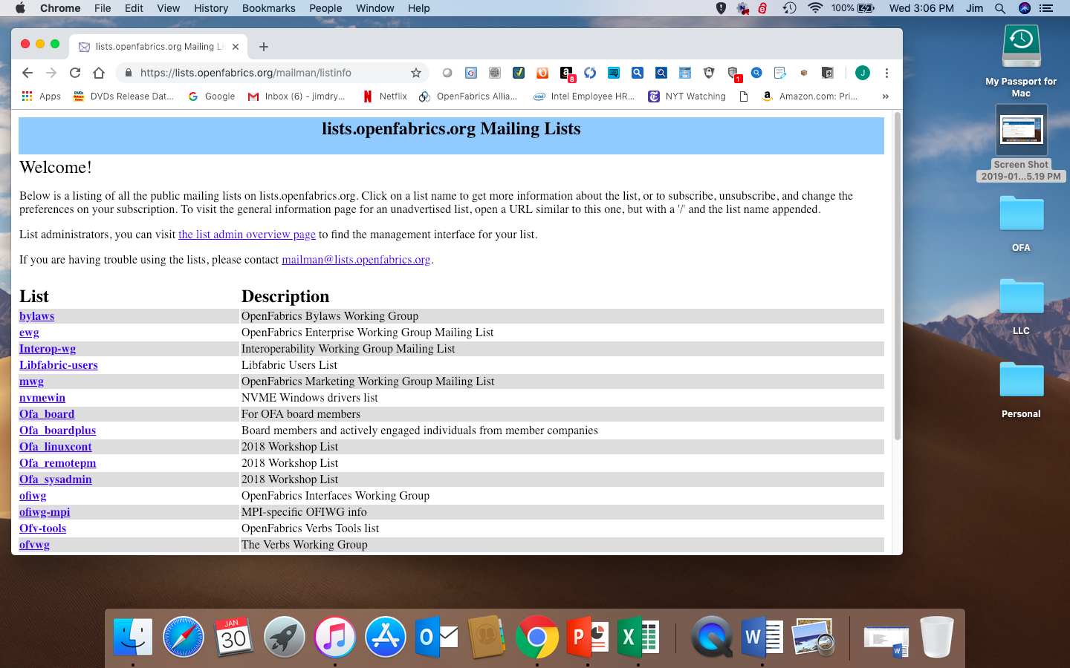
The Bylaws Reflector

Slide 3
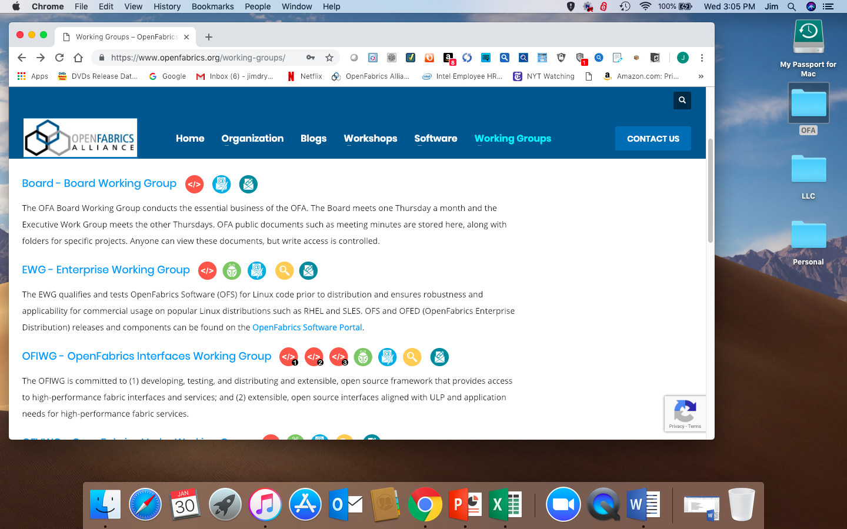
The New Board Working Group

