Slide 1
Post Mortem
OFA Workshop 2019
[ April, 2019 ]

Slide 2
Post Mortem Agenda
Location
Co-Locating
Alternative Venue
Program
Length
Collaborative Activities / Networking
Agenda
A/V
F&B
Misc.

Slide 3
Location
Co-Locating
Motivations
Potential increase in Workshop attendance, audience pool
Drawbacks
Potentially increases costs
Removes flexibility regarding Workshop timing, location
Requires aggressive promotional campaign to reach unfamiliar attendees
Workshop program should be finalized much further in advance to adequately promote
Difficult to coordinate – requires solid contact involved with other event that is willing to help
Target focus/audience considerations
Fabrics focused
Added benefit of co-promotion / joint activities with similar technical program
Attendees likely already familiar with OpenFabrics, existing interest in Workshop program
Applications, user focused
Expands audience to include users, application developers that are likely unaware of OpenFabrics
Search parameters
≤3 Days
Q1-Q2 timeframe
MWG Recommendation: Await results from new co-location exploratory effort.
Potential Events:
HPC Asia*
Linux Community Events
Cloud Foundry Summit
The Linux Kernel Summit
LUG
MPI Event
ModSim World*
NSDI*
NetDev*
Nvidia GTC*
OCP Summit
Open Networking Summit*
Open Source Leadership Summit*
OpenStack Summit*
SNIA Events*
Stanford HPC Event
*Co-location Survey Entry

Slide 4
Location
Alternative Venue
Motivations
Achieves significant Workshop cost reduction (ex. OFA Workshop 2019)
Drawbacks
Potential decrease in Workshop attendance, audience pool
Some complaints about lodging being separate from Workshop venue
Additional transportation costs
Internal travel approval requirements for lodging/venue co-location
Venue considerations
Connection to fabrics or target user
Recommend having an internal contact at venue to facilitate introductions
Close proximity to airport / technology hub / members
California (Bay Area, San Diego), Mass. (Boston), Oregon (Portland), Texas (Austin), Washington (Seattle)
MWG Recommendation: Pursue other viable alternative venue options with emphasis on cost reduction, while also vetting options with UT-Austin.
Potential Venues:
National Laboratories/Institutions
Argonne
Sandia
Lawrence Livermore
NCAR – Boulder
Universities
Indiana University
University of Texas – Austin
TACC
Ohio State University
University of California – Berkeley
Member Facilities
Intel Corp.

Slide 5
Program
Length
Overall Workshop length earned high marks in survey (4.31 / 5), with applause during the Town Hall and some comments to go even shorter.
Pros
Reduced costs (logistic expenses and registration fee)
Less of an ask for attendees
Less arduous on attendees
More flexibility for location search
Allows TPC to be more selective with session submissions
Shorter Workshop could result in higher quality program
MWG Recommendation: Keep workshop length at 2.5 days or shorten further to 2 days.

Slide 6
Program
Collaborative Activities / Networking
Collaborative activities were again well received (scored 4.36 / 5 average in survey)
RDMA Tutorial Series
Very popular (4.71 / 5)
Many positive comments on the introduction of hands-on activities
Meet the Experts
Popular (4.3 / 5)
Holding during Networking Reception was again well received, fostered lots of good conversation
Bird of a Feather
Popular (4 / 5)
Both well attended (at capacity), made good use of additional half hour
Lightning Talks
Positive (3.8 / 5)
Only two sign-ups in 2019 – need to promote / solicit LT sign-ups more aggressively for 2020
Town Hall
Positive (3.7 / 5)
MWG Recommendation: Plan to repeat collaborative activities for 2020.

Slide 7
Program
Agenda
Publish Agenda / Schedule Earlier
Many inquiries and a survey comment about publishing the agenda much earlier
Could boost interest in collaborative activities (RDMA Tutorial, Lightning Talks, Meet the Experts)
Topic Categories
Suggestion to separate HPC sessions from non-HPC sessions
Allows for attendees to pick certain days/ half-days that are of specific interest
MWG Recommendation: Set an earlier agenda publication deadline, jump start TPC a month earlier, keep topic category tracks/separate days top-of-mind during agenda creation.

Slide 8
A/V
Overall A/V setup was well received (scored 4.27 / 5 average in survey)
Consider securing full-time A/V support to assist with mic setup, issues in real-time
Slides
DropBox slide uploading/downloading process work very well, especially with the last minute slide updates from speaker
Posting slides to website prior to session was leveraged by most attendees
Some requests for making the PowerPoint versions available online so animations can be viewed
Reached out to individual speakers to request permission to post PPT version
MWG Recommendation: Continue with existing A/V setup and slide management regime, consider full-time A/V support in 2020 (if cost effective).

Slide 9
Food and Beverage
Overall F&B was okay (scored 3.07 / 5 average in survey)
Some requests for coffee and tea to be left out all day
Some criticism of beer selection at Networking Reception
Consider using vouchers for all lunches, extend lunch to 1.5 hours
Cost savings for OFA (only paying for what’s used)
Encourages attendees to explore more of the surrounding location, not anchored to the workshop
More opportunity for networking
Many individuals continued their conversations during the end of breaks/lunch, opting to skip the next session
Multiple comments to drop F&B altogether, only offer coffee/tea/light snacks throughout
Reduces overall cost to OFA, may result in flexibility to lower workshop fees
MWG Recommendation: F&B options will be determined by MWG after venue selection.

Slide 10
Miscellaneous Notes
Networking / Ad Hoc Meeting Rooms
Multiple complaints about lack of hallway space / meeting rooms for networking and private conversations
Consider securing all available rooms (if cost effective) to bring back ad hoc meeting rooms
Consider different floor (UT-Austin specific) with more room to spread out, network
Registration Fees
Multiple comments on registration fees being too high
Consider discount registration for members, or lower overall registration fees if 2020 budget estimates allow
Room Blocks
Room blocks for 2019 quickly filled up
Consider higher room occupancy blocks for 2020
MWG Recommendation: Explore additional room/floor options at UT-Austin, keep networking/meeting rooms top-of-mind if moving forward on new location, review possibility to reduce registration fees, slightly increase lodging room block.

Slide 11
Back UP

Slide 12
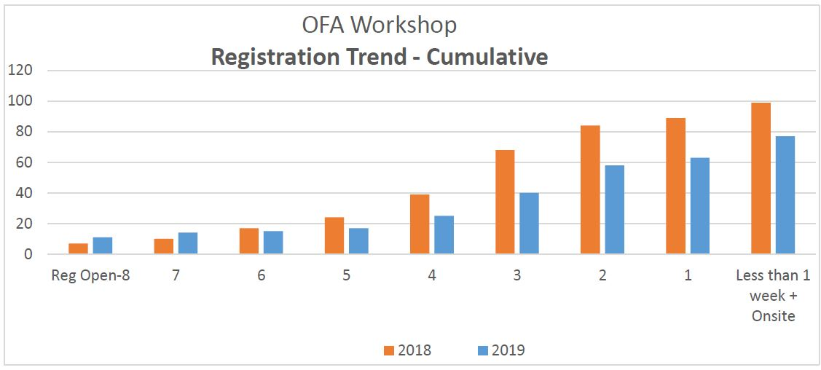
Registration
Cumulative Registration Count
 | 2018 | 2019
# weeks out | Total # registrations | Total # registrations
Reg Open-8 | 7 | 11
7 | 10 | 14
6 | 17 | 15
5 | 24 | 17
4 | 39 | 25
3 | 68 | 40
2 | 84 | 58
1 | 89 | 63
Less than 1 week + Onsite | 99 | 77

Slide 13
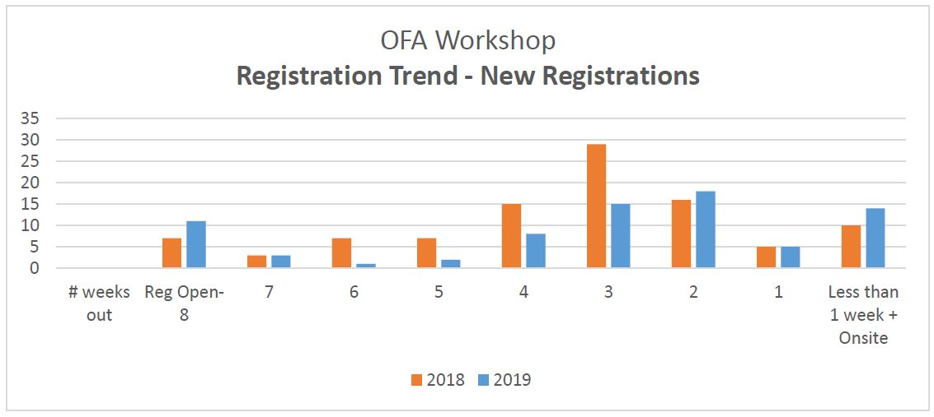
Registration
Weekly Registrations
 | 2018 | 2019
# weeks out | # new registrations | # new registrations
Reg Open-8 | 7 | 11
7 | 3 | 3
6 | 7 | 1
5 | 7 | 2
4 | 15 | 8
3* | 29 | 15
2 | 16 | 18
1 | 5 | 5
Less than 1 week + Onsite | 10 | 14
*Early bird discount ends 3 weeks before event (2/26/19)

Slide 14
Attendee Breakdowns / Room Block Pickup
Registration by Country
Country | # of Attendees
United States | 57
Israel | 6
Canada | 2
Japan | 3
Russian Federation | 1
Poland | 1
Germany | 1
Sri Lanka | 2
China | 2
Switzerland | 1
France | 1
Room Block at DoubleTree
Date | Day | Contracted Room Block* | Rooms Picked Up
3/18/2019 | Monday | 15 | 4
3/19/2019 | Tuesday | 20 | 5
3/20/2019 | Wednesday | 20 | 5
3/21/2019 | Thursday | 10 | 3
*Courtesy block with no contracted minimum required.
Registration by State
Room Block at Sheraton
STATE | # of Attendees
CA | 10
CO | 1
IL | 2
KS | 1
MA | 4
MD | 6
MI | 1
NC | 2
NM | 5
OH | 2
OR | 7
TN | 1
TX | 10
VA | 2
WA | 3
Date | Day | Contracted Room Block | Rooms Picked Up
3/18/2019 | Monday | 10 | 13
3/19/2019 | Tuesday | 15 | 13
3/20/2019 | Wednesday | 15 | 13
3/21/2019 | Thursday | 5 | 3

Slide 15
2019 Survey Results
Please rate the following (1 lowest to 5 highest):
Please rate the following (1 not at all to 5 highly likely):
 | Rating | # of Responses
Workshop Fees | 3.79 | 14
Lodging Cost | 3.54 | 13
Food | 3.02 | 15
Internet | 3.93 | 15
Registration | 4.73 | 15
Audio/PA System | 4.27 | 15
RDMA Tutorial Series | 4.75 | 8
Opening Remarks | 4.25 | 12
Annual General Meeting | 4.2 | 10
BoFs | 4.04 | 12
Networking Opportunities | 4.5 | 15
Networking Reception | 4.38 | 13
Intensity/hours per day/# of days | 4.31 | 13
Location – Austin, Texas | 4.13 | 16
Overall Relevance | 4.6 | 15
Overall Content Quality | 4.4 | 15
Overall Content Delivery | 4.4 | 15
Future Location Suggestions | California, Boulder CO, near HPC center (LANL) | 6
 | Rating | # of Responses
How likely will you return next year? | 4.27 | 15
How likely are you to recommend this Workshop? | 4.47 | 15
How did you hear about the workshop?
OFA mailing communication – (12 / 75%)
OFA technical forums (e.g. working groups) in which I participate – (2 / 12.5%)
Other industry organizations – (1 / 6.25%)
Social media (LinkedIn, Twitter, etc.) – (1 / 6.25%)
Trade publication – (0 / 0%)

Slide 16
TPC
Internal Post Mortem
Solicit the broader community for possible themes early in the planning cycle
MWG could survey past attendees for topic areas of interest that would seed the TPC’s exploration
Better vetting of sessions proposals to reduce specific sessions topic redundancies
Consider requesting more detail or specificity in the abstract, e.g. “what are the top 3 take-aways you expect to come from your session?”
More active TPC participation to drive collaborative activities such as Birds of a Feather
Broaden participation in the TPC to avoid being “stale”
Consider a TPC recognition event or call out during existing activity (Networking Reception, Town Hall, etc.)
Overall, TPC processes and procedures worked well
Continue for 2020

Slide 17
TPC
Topic Category Survey Results
Please rate the following (1 lowest to 5 highest):
Topic | Relevance | Interest for More
Network Consumers and Runtimes | 3.93 | 4.15
Admin, Management and Deployment | 4.3 | 4.33
Fabrics and Technology | 4.18 | 4
Libfabric Design and Implementation | 3.92 | 4.08
Remote Persistent Memory | 4 | 3.83
Interop | 4 | 4
Collaborative Activities | 4.55 | 4.18

