Slide 1
OFA Budget outlook 2021
Jim Ryan, Treasurer
October 2020

Slide 2
Background and going-in assumptions
2020 is playing out largely as expected, but slightly below expectations: This is still a planned loss year. The key point is 2021 will also be a loss year. However:
We are clearly coming to the end of the “planned loss” era, and
We are staying well above our agreed, prudent, required minimums, which we track monthly
There are a number of major events and achievements literally years in the making. Thanks to the leadership of our current Chair, Doug Ledford, and our Chair Emeritus, Paul Grun, we are about to have new Bylaws, IPR Policy and Membership Agreements
This means we can recruit or make it possible for reluctant candidate members to join
We have a genuine, no kidding game changer in the form of the “FSDP” program. More on this on the next slide
Revenue Driver 1: New Members Due to New Bylaws and IPR Policy

Slide 3
FSDP: why a game changer
Assuming you understand what the FSDP program is, this is about why it matters from a budgetary perspective
The fundamental change is from a “pay to participate” program to a “membership benefit” for some levels of membership. Clearly the art is in the establishment of levels, costs and benefits
The Program has essentially no relationship with our earlier program with UNH-IOL
The HW components are a combination of purchases or leases by the OFA and solicited donations. Leasing has allowed us to minimize the cash outlay and, as much as possible, align costs with member benefits, therefore potential dues.
The changes we develop to membership-related issues will be the basis of the new financial foundation of the OFA, nothing less
Revenue Driver 2: New Membership Dues Based on FSDP

Slide 4
Draft 2021 Budget components
We have two major levers WRT expenses:
ED: no changes for ‘21 – this was significantly reduced in ‘20
Marketing costs: looking into this seriously but no reductions are in sight we can bank on
There will be changes in Workshop costs that are being worked – almost certain to be virtual
Legal expenses should decline significantly
Virtually all other basic operating expenses will be unchanged

Slide 5
Budget process
Treasurer is responsible for the budgeting process with close support from the LF
The OFA’s fiscal year is the calendar year. Invoices go out in October and payment is expected starting in January. The budget should be finalized in September
The Treasurer first proposes the budget to elected officials subsequently the Board
Budget is developed at two levels:
“Philosophical” meaning do we plan to have a loss year, breakeven or profit.
Actual budget numbers
The LF reports financial status to the Treasurer monthly who sends out a summary. The Treasurer holds a quarterly budget review

Slide 6
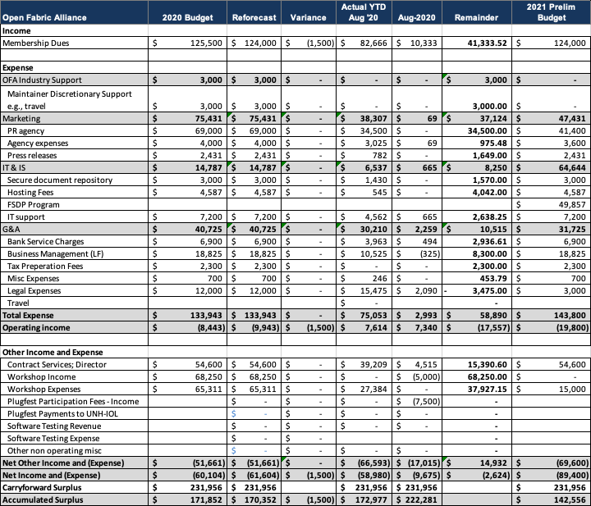
2021 budget

