Slide 1
New Direction Proposal: An OpenFabrics Fabric Manager Framework Proposal
OFA ??, Key drivers:

Slide 2
OFA Board Ask
Create an OFM Framework working group to:
Develop, test, and distribute:
An extensible, open source framework that provides access to high-performance fabric management interfaces and services.
Extensible, open source interfaces aligned with ULP and management application needs for high-performance fabric management services.

Slide 3
Problem Statement
Applications are being scaled to run on increasingly large HPC clusters
Some applications are now running on new compute models e.g. heterogeneous computing (x86 + GPU)
Apps are taking advantage of Many-, multi-core processors
Some apps are designed for message passing, some for shared memory
No Common Fabric Manager Interfaces and Fabric Models
Notes:
This slide is carefully stated in terms of “application requirements”. Here are the more familiar descriptions:
HPC systems are being scaled to very large sizes (exaflops)
There are new compute models emerging, such as x86 + GPUs, or x86 + accelerators.
Many/mult-core processor deployments are growing

Slide 4
The Fabric SW stack
From the Fabric Admin’s View
Orchestration Tools
Composing Tools /
Resource Managers
Fabric Configuration Requirements
Endpoint
Configuration
Requirements
The Fabric Admin view
Each fabric is different, and the configuration requirements are applied to many different components
The Solution Provider / Fabric Admin needs M x N tool stacks
Fabric Management Stack
Route and Topology Management
Addressing / Firewalling / Partitioning
Fabric Services
Low-level Fabric setup / Authentication & Routes
IB
RoCE
Ethernet
OPA
Compute
Device Setup FW
Storage
Fabric HW
Memory
Need a common interface
Notes:
The application developer was careful to write the application on top of a standard library,
But the Solution Provider tools often do not speak ‘fabric configuration’…
So the Solution Provider ends up also serving as the Fabric Admin, and performing setup of a fabric manually via a fabric specific ‘fabric manager’.
Most fabrics share the need of several common Fabric-level configuration and management functions.
Route and topology management
Fabric partitioning, firewalling, and address assignment
Discovery and enumeration of fabric resources
However, each fabric implements these management functions differently.
The orchestration and composing tool ‘applications’ need a common interface to invoke common fabric management functions.
Fortunately, the OFA knows a thing or two about such things.
… next slide

Slide 5
So what do we do?
Application and
Mgmt Application
layer
Examine the classes of management applications that are important to users of OFM.
Let the applications drive the appropriate interface definition.
This, in turn, drives the necessary management features that the fabric plug in should support.
Application Interface
Provider Layer
Hardware Layer
Notes:
For example, an MPI application may require the provider layer to support collectives.

Slide 6
Manipulate Topology
OF
M
D
O
M
A
I
N
MPI, PGAS, Verbs, Libfabric, UCX, etc. applications
Visualize Fabric
User
OS,
Identify Components
Tuning Network Performancec
Security Manager
Add/Remove Components
Fabric Admin Interface
Administrator
Manage switch hardware
Identify Problems
Diagnostics and Metrics

Slide 7
Fabric Administration Workspace
OFM Domain
Tools Domain
Administrator
Domain
Actual fabric
manipulations
abstract
manipulations
Duties
users
Model
Tuning Network Performance
Model and Manipulate Topology
Identify Components
Endpoints
Composing logical Platforms
Add/Remove Components
Visualize Fabric
switches
Security
Manage switch hardware
Diagnostics and Metrics
Ports and connections
Platform, component, infrastructure health
Discovery and Enumeration
Allocation, Binding, and Partitioning
Auditing &
Billing
Notifications &
Events
Notes:
OFM would try to standardize the events and notifications via standardized events with central message registry
What is unique?

Slide 8
Fabric Administration Workspace
Redfish
OFM Domain
Tools Domain
Administrator
Domain
Framework
abstract
manipulations
Duties
Model
Provider
Endpoints
Model and Manipulate Topology
Allocation, Binding, and Partitioning
Composing logical Platforms
Validate permissions via Redfish zone
Create an isolated fabric group (logical collection of resources with access permissions)
Maintaining Inventory
Create Connection
(C1, C2, attr)
Create Platform
switches
Filter possible paths by connection restrictions
Selecting Appropriate Resources: Components, Fabric, QoS
Create connections in Redfish model
Create specific connections between specific elements (shared memory)
Binding and connecting Resources
Ports and connections
Update HW to match Redfish model
Hardware

Slide 9
Fabric Administration Workspace
Redfish
OFM Domain
Tools Domain
Administrator
Domain
Framework
abstract
manipulations
Duties
Model
Provider
Composing logical Platforms
Endpoints
Model and Manipulate Topology
Validatte fabric features
Maintaining Inventory
Validate permissions via Redfish zone
Fabric resourcees are available
Selecting Appropriate Resources: Components, Fabric, QoS
Create Connection
(C1, C2, attr)
Create Platform
switches
Fabric components are stable and operational (Redfish)
Communications exchanges complete without error and quickly as possible
Binding and connecting Resources
Validate component have features
Ports and connections
User Domain
Update HW to match Redfish model
Allocate resources based upon requirement
Hardware
Acquire resources, run job, release resources

Slide 10
Fabric Administration Workspace
Redfish
OFM Domain
Tools Domain
Administrator
Domain
Framework
abstract
manipulations
Duties
Model
Provider
Endpoints
Create Zone
(endpoints, attributes, address pools, managers, ???)
Create Platform
Validate permissions via Redfish zone
Filter possible paths by connection restrictions
Create Connection
(C1, C2, attr)
switches
Configure resources
Create connections in Redfish model
Ports and connections
Update HW to match Redfish model
Hardware

Slide 11
Fabric Interfaces Examples
Framework defines multiple interfaces
Fabric Interfaces (examples only)
Provider
Info
Address Resolution
RDMA
Atomics
CM Services
Active Messaging
Tag Matching
Collective Operations
Fabric Provider Implementation
Address Resolution
RDMA
Atomics
CM Services
Collective Operations
Vendors provide optimized implementations

Slide 12
The Fabric SW stack
From OFA View
The Open Fabrics Alliance View
What OFA did for Application Developers
Created a common library and API to present fabric data plane services to applications and middleware
Developer needs drove library and API requirements
Fabric specific providers convert the standard calls into fabric specific traffic
What OFA can do for Solution Providers
Create a common Fabric Management framework and interface to present fabric control plane services to orchestration and composition applications
Solution Provider needs drive the framework requirements
Fabric specific providers convert the framework calls into fabric specific management traffic
APP
Orchestration
Middleware
Composing & Resource Management
libfabric
Fabric Management
Provider
Provider
Fabric
Data Plane
Services
Fabric
Control Plane
Services
Notes:
Let’s look at the fabric SW stacks from the OFA viewpoint.
On the left:
The OFA provided Application Developers a fabric agnostic MPI / RMA programming interface.
Libfabric provides a common library and API to present fabric data plane services to applications and middleware
Libfabric was defined based on the needs of the developers
Fabric-specific Providers convert the standard interface calls into fabric specific traffic
On the right:
The Solution Provider also needs their ‘tool stack’ to have a similar level of fabric independence.
OFA can provide a common Fabric Management framework and interface to present fabric control plane services to orchestration and composition applications
The framework capabilities will be defined by Solution Provider needs
Fabric specific ‘fabric manager providers’ will generate the appropriate fabric specific management traffic
If the Orchestration and Composing application developers have such a fabric agnostic fabric management interface to program ….
… next slide

Slide 13
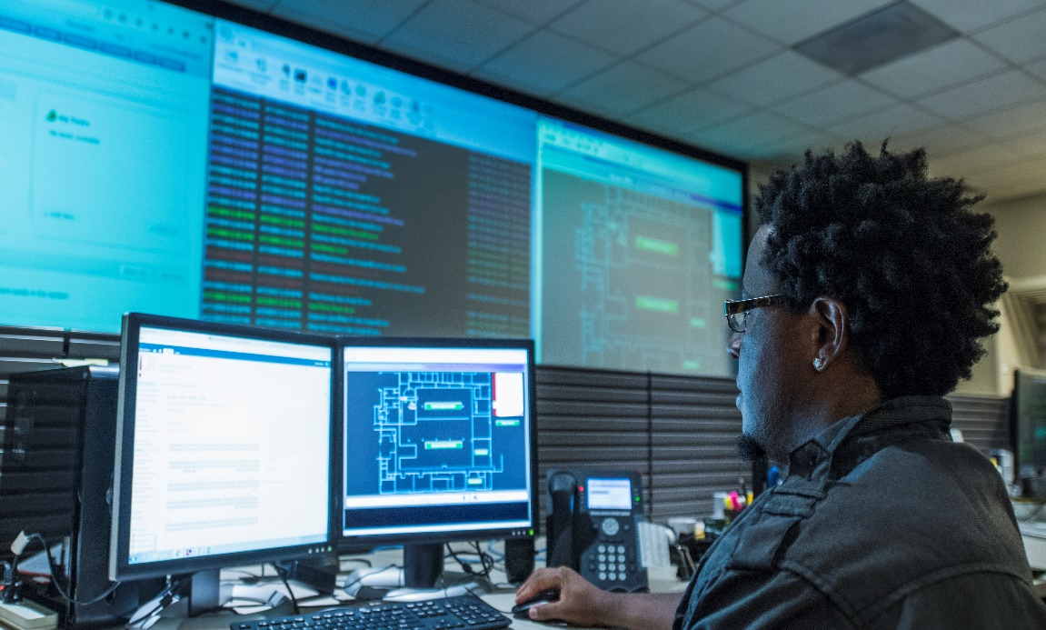
The Desired Fabric SW stack
From Solution Provider View
Orchestration Tools
Composing Tools /
Resource Managers
Fabric Management
Standarized Framework
Provider
Route and Topology Management
Addressing / Firewalling / Partitioning
Solution Provider no longer sees low level fabric details
The fabrics are presented to orchestration and composing applications via a standardized framework / interface
Fabric Specific Providers translate the common function calls into fabric specific traffic to do configuration and management at runtime
Low-level Fabric setup / Authentication & Routes
Fabric
Control Plane
Services
Device Setup FW
Fabric HW
What are the requirements of this framework?
Notes:
Then the Solution Provider no longer has to deal with routine fabric configuration changes.
The developers of the orchestration and compositing applications can affect fabric configuration changes via the fabric specific providers.
So what does this standardized fabric manager framework look like?
What are its requirements?
… next slide

Slide 14
Proposal
Evolve the verbs framework into a more generic open fabrics framework
Merge kernel interfaces under one umbrella
Design extension support into the fabric framework
Export low-level fabric services
Focus on abstracted hardware functionality

Slide 15
Proposed OpenFabrics Framework
Verbs
Fabric Interfaces
IB Verbs
Fabric Framework
Verbs Provider
OFA Provider
Transition from providing verbs API
to providing fabric interfaces

Slide 16
Next Steps
Get moving on developing this Framework!
Recommend starting a WG to focus development efforts
Create an OFS Framework working group to:
Develop, test, and distribute:
An extensible, open source framework that provides access to high-performance fabric interfaces and services.
Extensible, open source interfaces aligned with ULP and application needs for high-performance fabric services.

Slide 17
Thank You

Slide 18
OF
M
D
O
M
A
I
N
Manipulate Topology
Planning the GCID Namespace and Topology
Discovery and Enumeration
Component and Subsystem Integration
Allocating, Binding, and Partitioning of Gen-Z Resources
Resiliency Support
Dynamic Component and Dynamic Fabric Management
Audit Logging, Errors and Events Management
Security
Power Management
Visualize Fabric
User
AccountService
MPI, PGAS, Verbs, Libfabric, UCX, etc. applications
Identify Components
Administrator
SessionService
OS,
Tuning Network Performancec
Security Manager
EventService
Add/Remove Components
UpdateService
Fabric Admin Interface
TelemetryService
Manage switch hardware
Identify Problems
Manager
Diagnostics and Metrics

