Slide 1
Objective (today)
Describe what we’re trying to accomplish, and its rationale
Describe the approach being taken
Ask for your feedback/direction check - Is this an acceptable direction that merits further development?

Slide 2
Pathfinding a Kernel
Storage Fabric
Mid-layer
Scott Atchley, Stan Smith, Paul Grun
April 2016
Notes:
This presentation is the end result of the efforts of the Data Storage/Data Access (DS/DA) working group. I am presenting it on behalf of Stan Smith, who could not be here today. Stan has been at Intel for nearly 25 years. He is a Senior Software Engineer, in which he works on HPC interconnect SW + PGAS runtime development and he has been heavily involved in the OpenFabrics community.

Slide 3
Kernel Fabric Observations
Kernel fabric clients (ULPs) require a fabric device specific bottom edge in order to interface with kernel fabric devices
Each ULP is forced to define a fabric transport abstraction layer and then meld the fabric device specific behavior into their fabric transport abstraction; often 8+ months of development work
Case in point:
    LNET is the fabric transport abstraction
    A Lustre Network Driver (LND) is required for each supported fabric:
    LNDs for IB/iWARP, Cray GNI, ksockets, non-QP based devices…
NVMe over Fabrics (NVMe/F), NFS/RDMA, iSER/SRP have the same ULP-to-fabric device I/F issues as Lustre in order to support new interconnects
Notes:
Kernel storage fabrics; such as iSCSI, iSER and SRP; are written to support a specific interface. iSCSI uses the sockets interface to access reliable streams while iSER and SRP provide distinct solutions to SCSI using the RDMA device driver.
Currently, vendors have two choices: support sockets with its relatively lower performance or kernel Verbs as implemented by the kernel RDMA device driver.

Slide 4
Current Lustre LND Architecture
Vendor
Driver
o
Vendor
Vendor
2
iblnd
OFED
Driver
Driver
Vendor
Driver
LNet
socklnd
Ethernet
Vendor
Vendor
Driver
Driver
gnilnd
Vendor
Vendor
Driver
Driver
Supported by Lustre Community
Supported by HW Vendors
Supported by OpenFabrics Community
Notes:
Lustre’s networking layer, LNET, is a fork of the Portals API, which has simple one-sided PUT/GET semantics. The implementation for a given network, however, is a two-sided or send/receive interface with tag matching. These implementations are Lustre Network Drivers (LNDs). To make matters, even more complicated, some LNDs use one-sided RDMAs so that a PUT is a combination of a send/recv message with a one-sided RDMA. Given this, a one-sided PUT is implemented using a two-sided lower interface on top of a one-sided RDMA.
Each new HPC interconnect needs a LND. Lustre currently supports three LNDs: OpenFabrics which uses the kernel RDMA verbs driver, sockets using SOCK_STREAM aka TCP, and Cray’s General Network Interface (GNI) for its Gemini and Aries networks.
In the past, Lustre supported many other interconnects including Cray’s Portals, Myricom’s GM and MX, Quadrics’ Elan, and many others. Each had a distinct LND, with much duplicated code. This same duplication was mirrored in user-space for MPI libraries, for example. To avoid duplicate efforts, HPC interconnect vendors are starting to coalesce around two new user-space interfaces, libfabric (Intel, Cray, Cisco, and others) and UCX (IBM and Mellanox). The desire of these network abstraction layers is to have an interface that matches the semantics of the upper layer without getting lost in the weeds of a device-specific driver. An upper layer software (e.g. MPI, PGAS, or a caching server) only has to write to libfabric/UCX, while the interconnect vendors only has to write to the abstraction layer.

Slide 5
Pathfinding Conclusions
Reduction in storage ULP fabric device I/F development time for new fabric devices is desirable
Multiple storage ULPs could utilize a common fabric mid-layer
A storage fabric mid-layer would be RMA device agnostic in order to support current and future RMA devices
  Not all fabric devices are Queue-Pair based
  Support diverse fabrics w/o requiring emulation of an existing fabric (i.e not wire compatible)
Fabric mid-layer would present a consumer-oriented message transfer abstraction
  Minimize device specific special cases above message transfer layer
Support emerging fabric use cases – NVMe for remote storage (NVMe/F)
  NVMe is PCIe slot and device [0…255] limited
  NVMe/F gains access to ‘more’ NVMe resources at ‘near local’ speeds
  Sharing NVMe data over the fabric
  Data replication / Mirroring using RMA (multicast+) especially for NVDIMMs
  All RMA writes must reach a durability point before signaling completion
Notes:
The example that Stan uses is SCSI. Initially, there was a single SCSI driver. As more vendors entered the market, they created their own drivers, duplicating code across all of them. The community got together and defined a common mid-layer to eliminate the redundancy and each driver only had to deal with its own device’s specific details.
NVMe devices can be dual-ported for resiliency, but NVDIMMs cannot.

Slide 6

Hold on, it’s not a QP device…

Slide 7
Fabric Mid-layer Objectives
Kernel storage ULP I/F requirements drive fabric mid-layer messaging API design
  File systems, object I/O, block storage, persistent memory (emerging)
Fabric agnostic
  Support for new fabrics should not require emulating an existing one
    Device drivers are typically based on a specific fabric technology
Support for emerging fabrics…
  Allow for innovation from new fabrics as they emerge
While still supporting existing networks
  Must be able to support existing network technologies

Slide 8
kfabric Mid-layer Proposal
kfabric: an abstract, kernel mode API for storage
  API is expressed in terms of message passing operations, not fabric device protocols (e.g. ‘write message’ vs ‘post send request’)
  Fabric provider does address resolution in consumer-provider agreed upon address format
Emerging NVMe/F technology can benefit from a transport neutral, RMA-enabled fabric mid-layer
kfabric designed in ‘spirit’ around libfabric concepts
  RMA device agnostic (consider SCSI mid-layer common code design)
  Reduce/Simplify ULP fabric device specific I/F code
    Device specifics contained in the provider module, not in ULP
    NVMe/F and Lustre LND fabric I/F implementations reap benefits (code reduction/simplification) from kfabric mid-layer
Demand exists for an abstract, fabric mid-layer API based on RMA

Slide 9
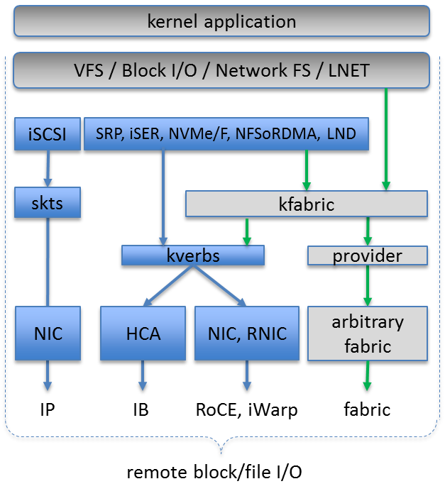
kfabric Mid-layer Stack

Slide 10
kfabric Mid-layer Framework
kfabric API
kfabric API
kfabric Providers
Sockets Provider
Verbs Provider
New Providers**
Kernel Sockets
Kernel Verbs
Device Drivers
NIC
InfiniBand
iWarp
RoCE
New Devices
Red = new kernel components, ** = e.g. NVM

Slide 11
kfabric API
kfabric consumer API module (exports)
fi_getinfo() fi_fabric() fi_domain() fi_endpoint() fi_cq_open() fi_ep_bind()
fi_listen() fi_accept() fi_connect() fi_send() fi_recv() fi_read() fi_write()
fi_mr_reg/v() fi_cq_read() fi_cq_sread() fi_eq_read() fi_eq_sread() fi_close() …
kfabric Provider APIs
Each fabric device type is implemented as a kfabric device provider module.
kfi_provider_register()
During kfabric provider module load, a call to kfi_provider_register() supplies the kgabric API with dispatch vectors for fi_* calls to the provider specific routines.
kfi_provider_deregister()
During kfabric provider module unload, kfi_provider_deregister() destroys the fi_* runtime linkage for the specific provider (ref counted).
kfabric API

Slide 12
Why a Kernel Storage Fabric Mid-Layer
Reliable sockets is a byte streaming interface
  Semantics do not map well to messaging operations (i.e. msg markers required)
    kfabric complements sockets by providing a reliable message service
  And sockets does not scale well in time or space
    Polling connections for progress or memory consumption per connection
Kernel verbs is a low-level device driver I/F
  Not just an complicated interface, but also wire protocols (IB, RoCE, iWarp)
  Lacking stronger completion semantics (i.e. data resides within a persistence domain)
  kfabric is expected to call kverbs for certain networks
An RMA device agnostic fabric mid-layer does not exist today
The semantics desired by current and emerging storage applications are not completely addressed by current APIs

Slide 13
Why a Kernel Storage Fabric Mid-Layer 2
Block and object storage protocols map well to reliable message-based APIs that provide RMA services
kfabric provides reliable and unreliable message services
  Fabric clients do not need to maintain message markers
kfabric does not require implicit buffering
kfabric completion semantics are a semantic match with storage requirements
  e.g. Completions: local, remote, persistent, ordered and out-of-order data delivery…
kfabric endpoints are thread-safe (when requested)
  Multiple threads can make forward progress independently
  Serialization can be done by the provider, not by the application/ULP
kfabric provides one-sided semantics enabling hardware Remote Memory Access without remote CPU intervention

Slide 14
Current Lustre LND Architecture
Vendor
Driver
o
Vendor
Vendor
2
iblnd
OFED
Driver
Driver
Vendor
Driver
LNet
socklnd
Ethernet
Vendor
Vendor
Driver
Driver
gnilnd
Vendor
Vendor
Driver
Driver
Supported by Lustre Community
Supported by HW Vendors
Supported by OpenFabrics Community
Notes:
Lustre’s networking layer, LNET, is a fork of the Portals API, which has simple one-sided PUT/GET semantics. The implementation for a given network, however, is a two-sided or send/receive interface with tag matching. These implementations are Lustre Network Drivers (LNDs). To make matters, even more complicated, some LNDs use one-sided RDMAs so that a PUT is a combination of a send/recv message with a one-sided RDMA. Given this, a one-sided PUT is implemented using a two-sided lower interface on top of a one-sided RDMA.
Each new HPC interconnect needs a LND. Lustre currently supports three LNDs: OpenFabrics which uses the kernel RDMA verbs driver, sockets using SOCK_STREAM aka TCP, and Cray’s General Network Interface (GNI) for its Gemini and Aries networks.
In the past, Lustre supported many other interconnects including Cray’s Portals, Myricom’s GM and MX, Quadrics’ Elan, and many others. Each had a distinct LND, with much duplicated code. This same duplication was mirrored in user-space for MPI libraries, for example. To avoid duplicate efforts, HPC interconnect vendors are starting to coalesce around two new user-space interfaces, libfabric (Intel, Cray, Cisco, and others) and UCX (IBM and Mellanox). The desire of these network abstraction layers is to have an interface that matches the semantics of the upper layer without getting lost in the weeds of a device-specific driver. An upper layer software (e.g. MPI, PGAS, or a caching server) only has to write to libfabric/UCX, while the interconnect vendors only has to write to the abstraction layer.

Slide 15
Future Lustre LND Architecture

Slide 16
THANK YOU
OFIWG – DS/DA

