Slide 1
Universal Fabric Management For Tomorrow’s Data Centers

Slide 2
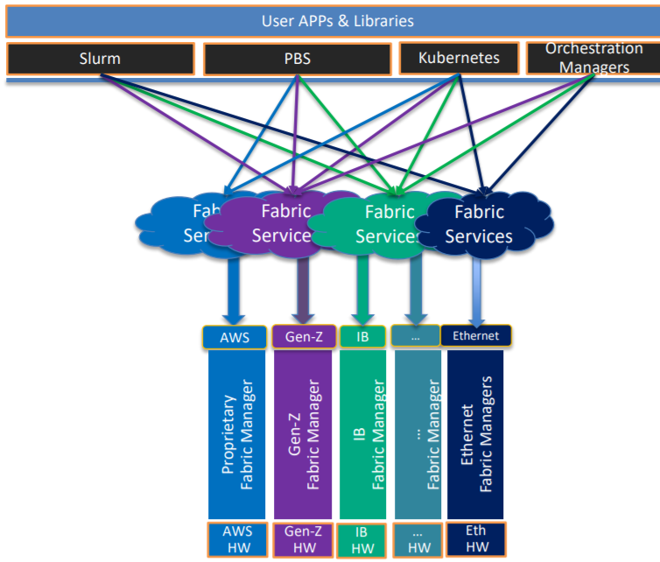
The Ecosystem for Fabrics in Datacenters is Changing
Fabric Landscape is Changing
Rapidly increasing types of fabric interconnects
Each fabric has its strengths, features, and management tools
Each fabric has its own configuration mechanisms and interfaces
Workload and Resource Ecosystem is changing
New compute and storage resources are becoming available
HPC Clusters and Cloud Computing environments
  running increasingly diverse and dynamic workloads
  incorporating both distributed computing capabilities and heterogeneous hardware

Slide 3
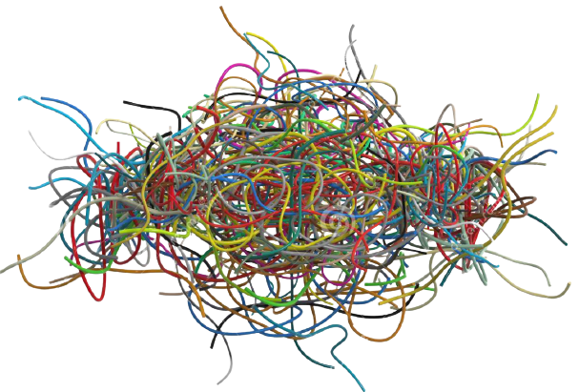

This Creates Problems in Manageability
Administrative Management Challenges
No common fabric manager interface or fabric model available to link applications with remote resources
Workload management and optimization is different for each type of fabric
Administrators are being asked to manage an increasing heterogenous fabrics infrastructure, each with its own management standard and model`
User APPs & Libraries
…
…
…
Slurm
PBS
Kubernetes
Orchestration Managers
Fabric Services
Fabric Services
Fabric Services
Fabric Services
Fabric Services
Fabric Services
AWS
Gen-Z
IB
…
Ethernet
Ethernet
TBD
Fabric Managers
Proprietary
Fabric Manager
Gen-Z
Fabric Manager
IB
Fabric Manager
…
Fabric Manager
Ethernet
Fabric Managers
TBD
HW
AWS
HW
Gen-Z
HW
IB
HW
…
HW
Eth
HW

Slide 4
We Can Fix These Management Problems
Need interoperability through common interfaces to enable managers to efficiently connect workloads with resources
Need to Integrate an Open Fabrics Management Framework (OFMF) with standards-based Ecosystem management
Without an Open Fabric Management Framework:
    Every tool and every middleware library provider needs a unique call to a specific fabric management stack for each available fabric
With an Open Fabric Management Framework:
    Everyone calls common fabric services to manipulate the Redfish fabric model
    Open Fabrics Management Framework triggers fabric specific providers to make the actual changes in the fabric
User APPs & Libraries
TBD
Slurm
PBS
Kubernetes
Orchestration Managers
Open Fabric Management Interface
Fabric Services
Fabric Services
Fabric Services
Fabric Services
Fabric Services
AWS
Gen-Z
IB
…
Ethernet
Proprietary
Fabric Manager
Gen-Z
Fabric Manager
IB
Fabric Manager
…
Fabric Manager
Ethernet
Fabric Managers
AWS
HW
Gen-Z
HW
IB
HW
…
HW
Eth
HW

Slide 5
Examples of Fabric Admin Services Offered by OFMF
The Open Fabrics Management Framework
Control Services
  Discovery
  Inventory
Communication Services
  Connection Management
  Address vectors
Partition Services
  Zones
  Connections
Messaging Services
  Queues and Contexts
  Events and Errors
  Atomics and other synchronizations
Security
  Sub-fabrics which provide exclusionary access security
User APPs & Libraries
TBD
Slurm
PBS
Kubernetes
Orchestration Managers
Open Fabric Management Interface
Fabric Services
Fabric Services
Fabric Services
Fabric Services
Fabric Services
AWS
Gen-Z
IB
…
Ethernet
Proprietary
Fabric Manager
Gen-Z
Fabric Manager
IB
Fabric Manager
…
Fabric Manager
Ethernet
Fabric Managers
AWS
HW
Gen-Z
HW
IB
HW
…
HW
Eth
HW

Slide 6
Open Fabric Management Framework Architecture
Clients
OFMF Services
Actual Fabric
Application Domain
Administration Domain
OFMF Domain
Framework
abstract manipulations
Providers
Peer Address Lookup
libfabric
Gen-Z
attach shared memory region
Resource Inventory
openFAM
Create Zone
Slingshot
Partition Mgmt
create shared memory region
Create Partition
Authentication
Hardware
FAM Resource
Manager
Create Partition
IB
Events & Logs
Create zone
Kubernetes
Native
Model
Redfish
/
Swordfish
Model
SLURM
Notes:
This slide builds the block diagram architecture of the OFMF:
1)Left side is the user/admin/orchestration/automation domain(s)
2)Right side is the hardware that makes up the fabric and the resources that are accessed thereon
3)The middle is a representation of the functional blocks making up the OpenFabrics Management Framework
4)On the left, various workload managers, app/ libraries, and resource managers are represented. They are all clients of the Framework
5)Inside the OFMF the state of all the fabrics being represented to the clients are represented using a Redfish fabric model
6) At the right border of the OFMF there are fabric specific providers for each of the fabrics which the OFMF is supplying common services for, and each provider may have its own native model of its specific fabric
7)Any entity (SW tool, admin GUI, shell script via CLI) may need to create a virtual platform, pod, cluster, partition, vLan, job queue, subnet or other name for a set of resources that are connected together to enable some workload(s) to execute while being isolated from other jobs.
Such an entity needs a common taxonomy for describing the resources needed in the set and how the connections among them are to behave.
We are proposing to use the DMTF’s Redfish standards to model the fabric and its resources, and to provide the RESTful interfaces through which the entities on the left can learn of the modelled resources and create such a set of fabric resources.
8)Redfish currently has an object called a ‘zone’ that contains a list of the fabric endpoints which may be connected to each other. Zones can be used to enumerate the members of a vLAN, or the resources of a virtual platform.
9)The framework will update the Redfish model for the given fabric(s) and exchange the appropriate details with the fabric specific provider(s)
The Providers are responsible for updating any native models they maintain of their fabric and to issue the appropriate traffic to the fabric hardware
10) It is important to note that ‘admin tools’ are not the only clients of the OFMF services.
Applications and Resource Managers will need runtime support in the form of creating, registering, attaching, and freeing shared memory regions
OS and virtual machine managers will need an interface to request initial (boot time) resource allocations and runtime changes, as well as authentication and events and logging services.

Slide 7
Integrating Open Fabrics Management Framework into a Standards-based Enterprise and Datacenter Management Ecosystem

Slide 8
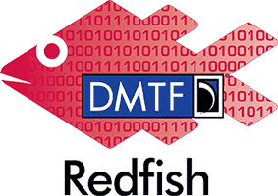
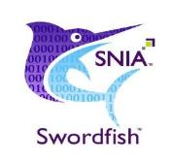
What are Redfish and Swordfish?
DMTF Redfish™ covers server, data center, fabric management
  REST API with JSON payloads; choice of CSDL, JSON and YAML schema for development
SNIA Swordfish™: Storage Management Specification with REST Based API
  Extends DMTF’s Redfish Specification
Swordfish adds storage management to all of these use cases, plus storage fabric management:
  Covers block, file, and object storage
  Extend traditional storage domain coverage to include converged environments (servers, storage and fabric together)
  Provides the option for implementation to utilize Class of Service (intent or service level) based provisioning, management, and monitoring
  Through Alliance partnerships with NVM Express®, RF/SF (Redfish and Swordfish) have added NVMe / NVMe oF manageability

Slide 9
Redfish Hierarchy
Subordinate
Resource
Collections
Singleton
Resource
Service
Root
Collection
Resource
Singleton
Resource
Processors
/redfish/v1
“Logical View”
Systems/<id>
Volumes
Processors/<id>
./Systems
Storage
Volumes
Storage/<id>
./TaskService
EthernetInterface
Volumes
EthernetInterface/<id>
Drives contained in chassis, managed in storage.
Redfish services for account management, events, logs, tasks, session / certificates, etc.
./EventService
./AccountService
./SessionService
Drives
…
Volumes
Drives/<id>
Power
“Physical View”
Chassis/<id>
Volumes
Power/<id>
./Chassis
Thermal
Volumes
Thermal/<id>
LogService
“Management”
Volumes
LogServices/<id>
./Managers
Managers/<id>
NetworkProtocol
Volumes

Slide 10

Redfish Hierarchy: Adding Swordfish Advanced Storage
Subordinate
Resource
Collections
Swordfish schema (Controllers, Volumes, StoragePools, etc) attach to storage.
Service
Root
Collection
Resource
Singleton
Resource
Singleton
Resource
Volumes
Volumes
Reference (link) to Volume
/redfish/v1
Storage
Collection
Storage/<id>
Volumes/<id>
./Storage
StoragePool
Collection
StoragePool
Collection
Volume (Namespace) Instance
Redfish services for account management, events, logs, tasks, session / certificates, etc.
./EventService
./StoragePools
StoragePools/<id>
./AllocatedVolumes
AllocatedVolumes/<id>
./AccountService
./SessionService
StorageControllers
Collection
…
./Controllers
Controllers/<id>
Drives contained in chassis, managed in storage pools.
NVMe Device Usage:
Subsystem == Storage
Controller == StorageController
Volume == Namespace
StoragePool == Endurance Group / NVM Set
Chassis / Drive == Physical Entity Information
Chassis
Collection
Chassis/<id>
./Chassis
Drives
Volumes
Drive Instance
Drives/<id>
./Registries
SwordfishNVMeDrive, v1.0.0
Features Registry contains the published supported Features.
/redfish/v1/Registries/AdvertisedFeatures

Slide 11
Redfish/Swordfish Hierarchy: Adding Fabrics
Subordinate
Resource
Collections
Singleton
Resource
Service
Root
Collection
Resource
Singleton
Resource
Volumes
Volumes
Reference (link) to Volume
/redfish/v1
Collection
Storage/<id>
Volumes/<id>
./Storage
Collection
Collection
Volume (Namespace) Instance
./StoragePools
StoragePools/<id>
./AllocatedVolumes
AllocatedVolumes/<id>
StorageControllers
Collection
./Controllers
Controllers/<id>
Collection
./Connections
Connections/<id>
NVMe oF:
Adds Fabric and access rights
Collection
Fabrics/<id>
./Fabrics
Collection
./Endpoints
Endpoints/<id>
Collection
./Zones
Zones/<id>

Slide 12
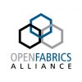
Redfish/Swordfish Hierarchy: Extending Fabric Management
Service
Root
Collection
Resource
Singleton
Resource
Singleton
Resource
Volumes
Volumes
Reference (link) to Volume
/redfish/v1
Collection
Storage/<id>
Volumes/<id>
./Storage
Collection
Collection
Volume (Namespace) Instance
./StoragePools
StoragePools/<id>
./AllocatedVolumes
AllocatedVolumes/<id>
StorageControllers
Collection
./Controllers
Controllers/<id>
Collection
./Switches
Connections/<id>
NVMe oF:
Adds Fabric and access rights
Collection
Fabrics/<id>
./Fabrics
Collection
./Endpoints
Endpoints/<id>
Collection
./Zones
Zones/<id>
OpenFabrics Management Framework

Slide 13
Managing Tomorrow’s Fabrics
Orchestration Tools
Composing Tools / Resource Managers
Ecosystem Management
Fabric
Configuration Requirements
Endpoint
Configuration Requirements
Open Fabric Management Framework
Fabric Management Stack
Fabric Services
Route & Topology Management
IB
RoCE
Ethernet
Compute
Addressing / Firewalling / Partitioning
Storage
Low-level Fabric setup / Authentication & Routes
Memory

Slide 14
Expanding Standardized
Fabric Management Through Alliances

Slide 15
SNIA and OFA Working Together
Through Alliance Agreements
Bring the technical teams from the organizations together to align existing work
  SNIA brings storage and storage fabric management and domain expertise
  OFA helps accelerate the development and adoption of advanced fabrics for the benefit of advanced fabrics ecosystems
Create new content in each area as needed
Fabric Management
Open Fabric Management
Storage Fabric Management

Slide 16
Planned Work Items
Gather more client-driven use-cases
  Use OFA identified Use Case Descriptions and Flow Diagrams to confirm property / object completeness
Map together RF/SF management interface with OFA Open Fabric Manager functionality
  Redfish and Swordfish provide the OFA Fabric Manager with NVMe-oF instantiation for current fabric conditions
  Step through use-cases to validate RF/SF extensions
Ensure wide fabric management coverage e.g.,
Client
End user of solutions package
Applications Developer
Creates application, ties into hardware
Solutions Provider
Integrating application with infrastructure
OFMF
Interoperability
    Gen Z
    Slingshot
    InfiniBand
    OmniPath
    RoCE
    iWarp
    Ethernet
    FC
    Future unknown fabrics

Slide 17
Thank you for watching
Join the OFMF Working Group to learn more and to contribute
SNIA Swordfish™
Swordfish Standards
  Schemas, Specs, Mockups, User and Practical Guide`s, … https://www.snia.org/swordfish
Swordfish Specification Forum
  Ask and answer questions about Swordfish
  http://swordfishforum.com/
Scalable Storage Management (SSM) TWG
  Technical Work Group that defines Swordfish
  Influence the next generation of the Swordfish standard
  Join SNIA & participate: https://www.snia.org/member_com/join-SNIA
Join the SNIA Storage Management Initiative
  Unifies the storage industry to develop and standardize interoperable storage management technologies
  https://www.snia.org/forums/smi/about/join
Open Fabric Management Framework
OFMF Working Group (OFMFWG)
  Description & Links
  https://www.openfabrics.org/working-groups/
OFMFWG mailing list subscription
  https://lists.openfabrics.org/mailman/listinfo/ofmfwg
Join the Open Fabrics Alliance
  https://www.openfabrics.org/membership-how-to-join/
DMTF Redfish™
Redfish Standards
  Specifications, whitepapers, guides,… https://www.dmtf.org/standards/redfish

