Slide 1
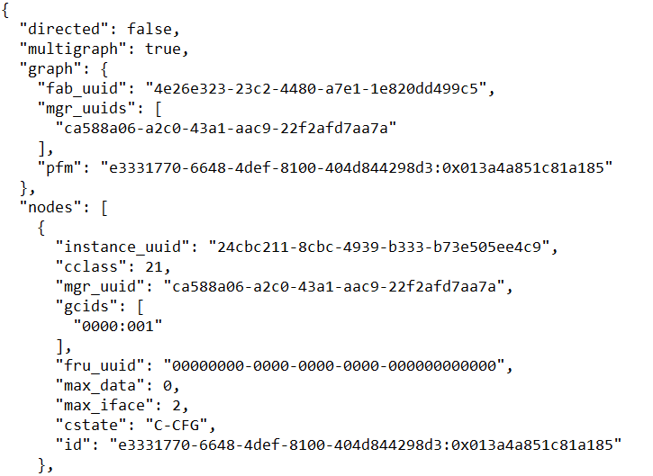
NetworkX JSON output decoding
JSON list of key:value pairs
Key:Value pairs of NetworkX flags
Key:Value pairs of NetworkX details within the graph
Fabric UUID : value created by FM
Array of MGR_UUIDs per Gen-Z [
128-bit UUID created by FM(s) per Gen-Z
Array in case there are more than one FM
PFM: C-UUID:SN of primary FM
Array of nodes:
Nodes also consist of Key:Value pairs
instance UUID: unique node UUID (assigned by FM)
cclass: component_class value per Gen-Z control structure
manager UUID: MGR_UUID assigned by primary manager
gcids: Array of global CIDs (HEX digits as TEXT)
SID:CID #an array because up to 4 GCIDs/component
fru_uuid: value per Gen-Z control structure
max_data: memory storage capacity in bytes
max_iface: max number of Gen-Z interfaces on node
cstate: C-UP|C-CFG component state per Gen-Z
id: globally unique Gen-Z ID (based on concatenating)
C-UUID : component SN
# C-UUID and SN are from Gen-Z control structure

Slide 2
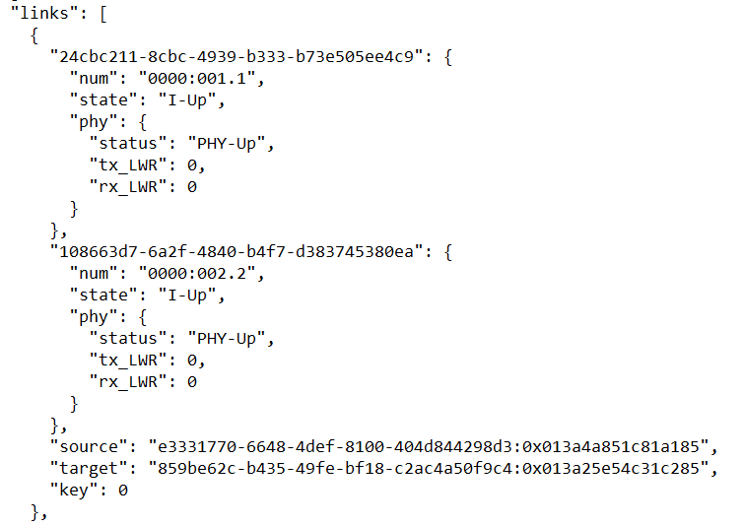
NetworkX JSON output decoding
Array of links between nodes
Each link
Each endpoint of a link has a dictionary of Key:Value pairs bound to the instance_uuid of the node:
num: GCID. port number for this end of the link
State: I-Up | I-Dn et. al. from Gen-Z spec for interface state
State of the PHY associated with this interface is contained in another sub-dictionary containing
PHY Status, and Link Width Reduction flags
Other endpoint description
Key:Value pairs identifying the Gen-Z resources at both ends of the link by their globally unique ID crafted from C-UUID and device SN
“source”: id using C-UUID:Serial Number
“target” : id using C-UUID:Serial Number
NetworkX defines source and target labels, but they mean nothing to Gen-Z and Redfish
Key:Value pair defined by NetworkX and by NetworkX to track number of extra links between same endpoints. No significance to Gen-Z and Redfish, though values >0 may imply redundant links are present.

Slide 3
Zephyr Config File Decoding
fabric_uuid of fabric being described
Add_resources: really an action that creates a ‘connection’ between the producer node (a memory module in this case) and one or more consumer nodes (servers?).
{
"fabric_uuid": "4e26e323-23c2-4480-a7e1-1e820dd499c5",
"add_resources": [
{
"producer": "859be62c-b435-49fe-bf18-c2ac4a50f9c4:0x0000000000012345",
"consumers": ["e3331770-6648-4def-8100-404d844298d3:0x00000000000abcde"],
"resources": [
{
"class_uuid": "3cb8d3bd-51ba-4586-835f-3548789dd906",
"instance_uuid": "???“
"flags": "0",
"class": 17,
"memory": [
{
"start": 0,
"length": 21474836480,
"type": 1,
"ro_rkey": 0,
"rw_rkey": 0
} ] } ] } ] }
Array of ‘resources and a relationship between them’
Producer: id # FM assigned id using vendor C-UUID:SN
Consumers: [array of id values of consumers]
Resources: [array of Key:Value pairs] that describe the ‘producer’ resources
Class_uuid: SW/ FM assigns this based on how resource is to be used, IE, if memory module & is block_mode, it has this ‘class_uuid’.
Instance_uuid: UUID assigned (by RM?) of this memory chunk
Flags: values specific to class type (driver type)
Class: cClass value from Gen-Z spec, ‘17’ = block mode memory
Memory: [array of memory attributes as key:value pairs] # associated within a specific ‘resource’
Length: in bytes
Type: 0 = control space, 1 = data space, 2 = interleaved data space
ro_rkey: 32 bit read-only RKEY value for this memory chunk
rw_rkey: 32 bit read-write RKEY value for memory chunk

Slide 4
Structure of the OpenFabrics Management Framework
Clients locate the OFMF services via SSDP M-search
Clients may use any representation of fabric resources internally, but speak Redfish to OFMF
admin
Apps
FAM Manager
FM
GUI / CLI
Composition Manager
Storage
Manager
Image Manager
Redfish
OFMF Services listens for clients and responds to M-search requests
OFMF locates Agents by responding to SSDP M-search requests issued by Agents
OFMF
Services
Redfish
model
ServiceRoot
Redfish
Systems
Switches
<FabricType>
1
3
SW1
3
3
Endpoints
Fabric Adapters
b
6
6
1
a
Ports
8
2
2
4
3
9
Ports
1
1
5
2
1
Ports
1
Agents issues M-search looking for OFMF – (or issues NOTIFY??)
Agent polls (what protocol?) every 5 seconds for Zephyr
agent
FM API
config
Fabric Manager
Fabric specific
SW
Zephyr receives Flask endpoint from Agent ??
Zephyr responds to Agent requests sent via HTTP
Fabric Hardware

Slide 5
Structure of the OpenFabrics Management Framework
admin
Apps
Clients use HTTP CRUD protocols to converse with OFMF Services and manipulate Redfish fabric objects
FAM Manager
FM
GUI / CLI
Composition Manager
Storage
Manager
Image Manager
Redfish
OFMF sends relevant Redfish requests to fabric Agent, also via HTTP
OFMF
Services
Redfish
model
ServiceRoot
Redfish
Systems
Switches
<FabricType>
1
3
SW1
3
3
Endpoints
Fabric Adapters
b
6
6
1
a
Ports
8
2
2
4
3
9
Ports
1
1
5
2
Agent and Zephyr FM exchange messages via proprietary (application/JSON) RESTful interface
HTTP transport
JSON data payload but ...
not a Redfish data schema
Not a Redfish URI
1
Ports
1
agent
FM API
config
Linux
Gen-Z FM
Fabric specific
SW
Gen-Z Fabric Hardware

