Slide 1
Open Fabrics Management Framework
September 30, 2021 OFA/Gen-Z Webinar
By Michael Aguilar, OpenFabrics Alliance
Notes:
The following slides are not intended to be a tutorial on the OFMF, the Redfish fabric model, or use case analysis. Many, many details are lacking, and we aren’t going to attempt to fill in all the details in this BoF session.
The following slides are simply a very quick overview of the goals of the OFMF project and its basic architectural assumptions, the working strategy of the OFMF work group, and how Redfish is a major cog of the final solution.

Slide 2
Table of Contents
Why create a new Fabric Manager Framework?
Who is involved in the project?
How?
Short-term task-related time frames
Next steps?
Questions?

Slide 3
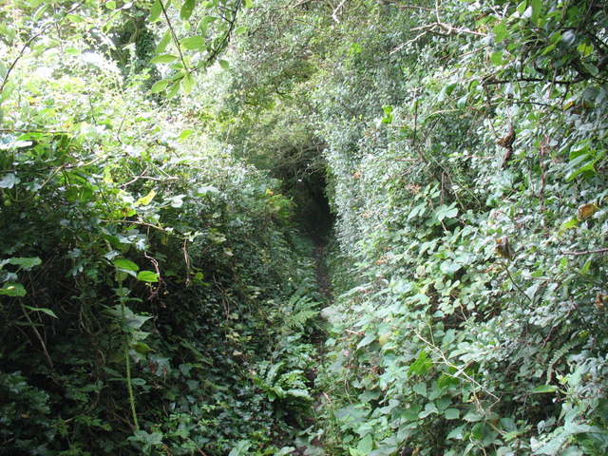
Why create a new Fabric Manager Framework?
New HPC and Cloud computing designs are becoming more heterogeneous to be able to handle more and different types of computing tasks
More granular types of HPC applications and tools
Machine Learning
Deep Learning
New alternative network fabrics, new ways to deploy memory, and custom accelerators are being dreamed up to maximize performance, for use-cases, for these tasks.

Slide 4
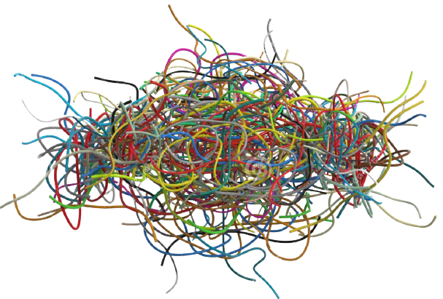
This Creates Problems in Manageability
Administrative Management Challenges
No common fabric manager interface or fabric model available to link applications with remote resources
Workload management and optimization is different for each type of fabric
Administrators are being asked to manage an increasing heterogenous fabrics infrastructure, each with its own management standard and model`
User APPs & Libraries
…
…
…
Slurm
PBS
Kubernetes
Orchestration Managers
Fabric Services
Fabric Services
Fabric Services
Fabric Services
Fabric Services
Fabric Services
AWS
Gen-Z
IB
…
Ethernet
Ethernet
TBD
Fabric Managers
Proprietary
Fabric Manager
Gen-Z
Fabric Manager
IB
Fabric Manager
…
Fabric Manager
Ethernet
Fabric Managers
TBD
HW
AWS
HW
Gen-Z
HW
IB
HW
…
HW
Eth
HW

Slide 5
We Can Fix These Management Problems
Need interoperability through common interfaces to enable managers to efficiently connect workloads with resources
Need to Integrate an Open Fabrics Management Framework (OFMF) with standards-based Ecosystem management
Without an Open Fabric Management Framework:
Every tool and every middleware library provider needs a unique call to a specific fabric management stack for each available fabric
With an Open Fabric Management Framework:
Everyone calls common fabric services to manipulate the Redfish fabric model
Open Fabrics Management Framework triggers fabric specific providers to make the actual changes in the fabric
User APPs & Libraries
TBD
Slurm
PBS
Kubernetes
Orchestration Managers
Open Fabric Management Interface
Fabric Services
Fabric Services
Fabric Services
Fabric Services
Fabric Services
AWS
Gen-Z
IB
…
Ethernet
Proprietary
Fabric Manager
Gen-Z
Fabric Manager
IB
Fabric Manager
…
Fabric Manager
Ethernet
Fabric Managers
AWS
HW
Gen-Z
HW
IB
HW
…
HW
Eth
HW

Slide 6
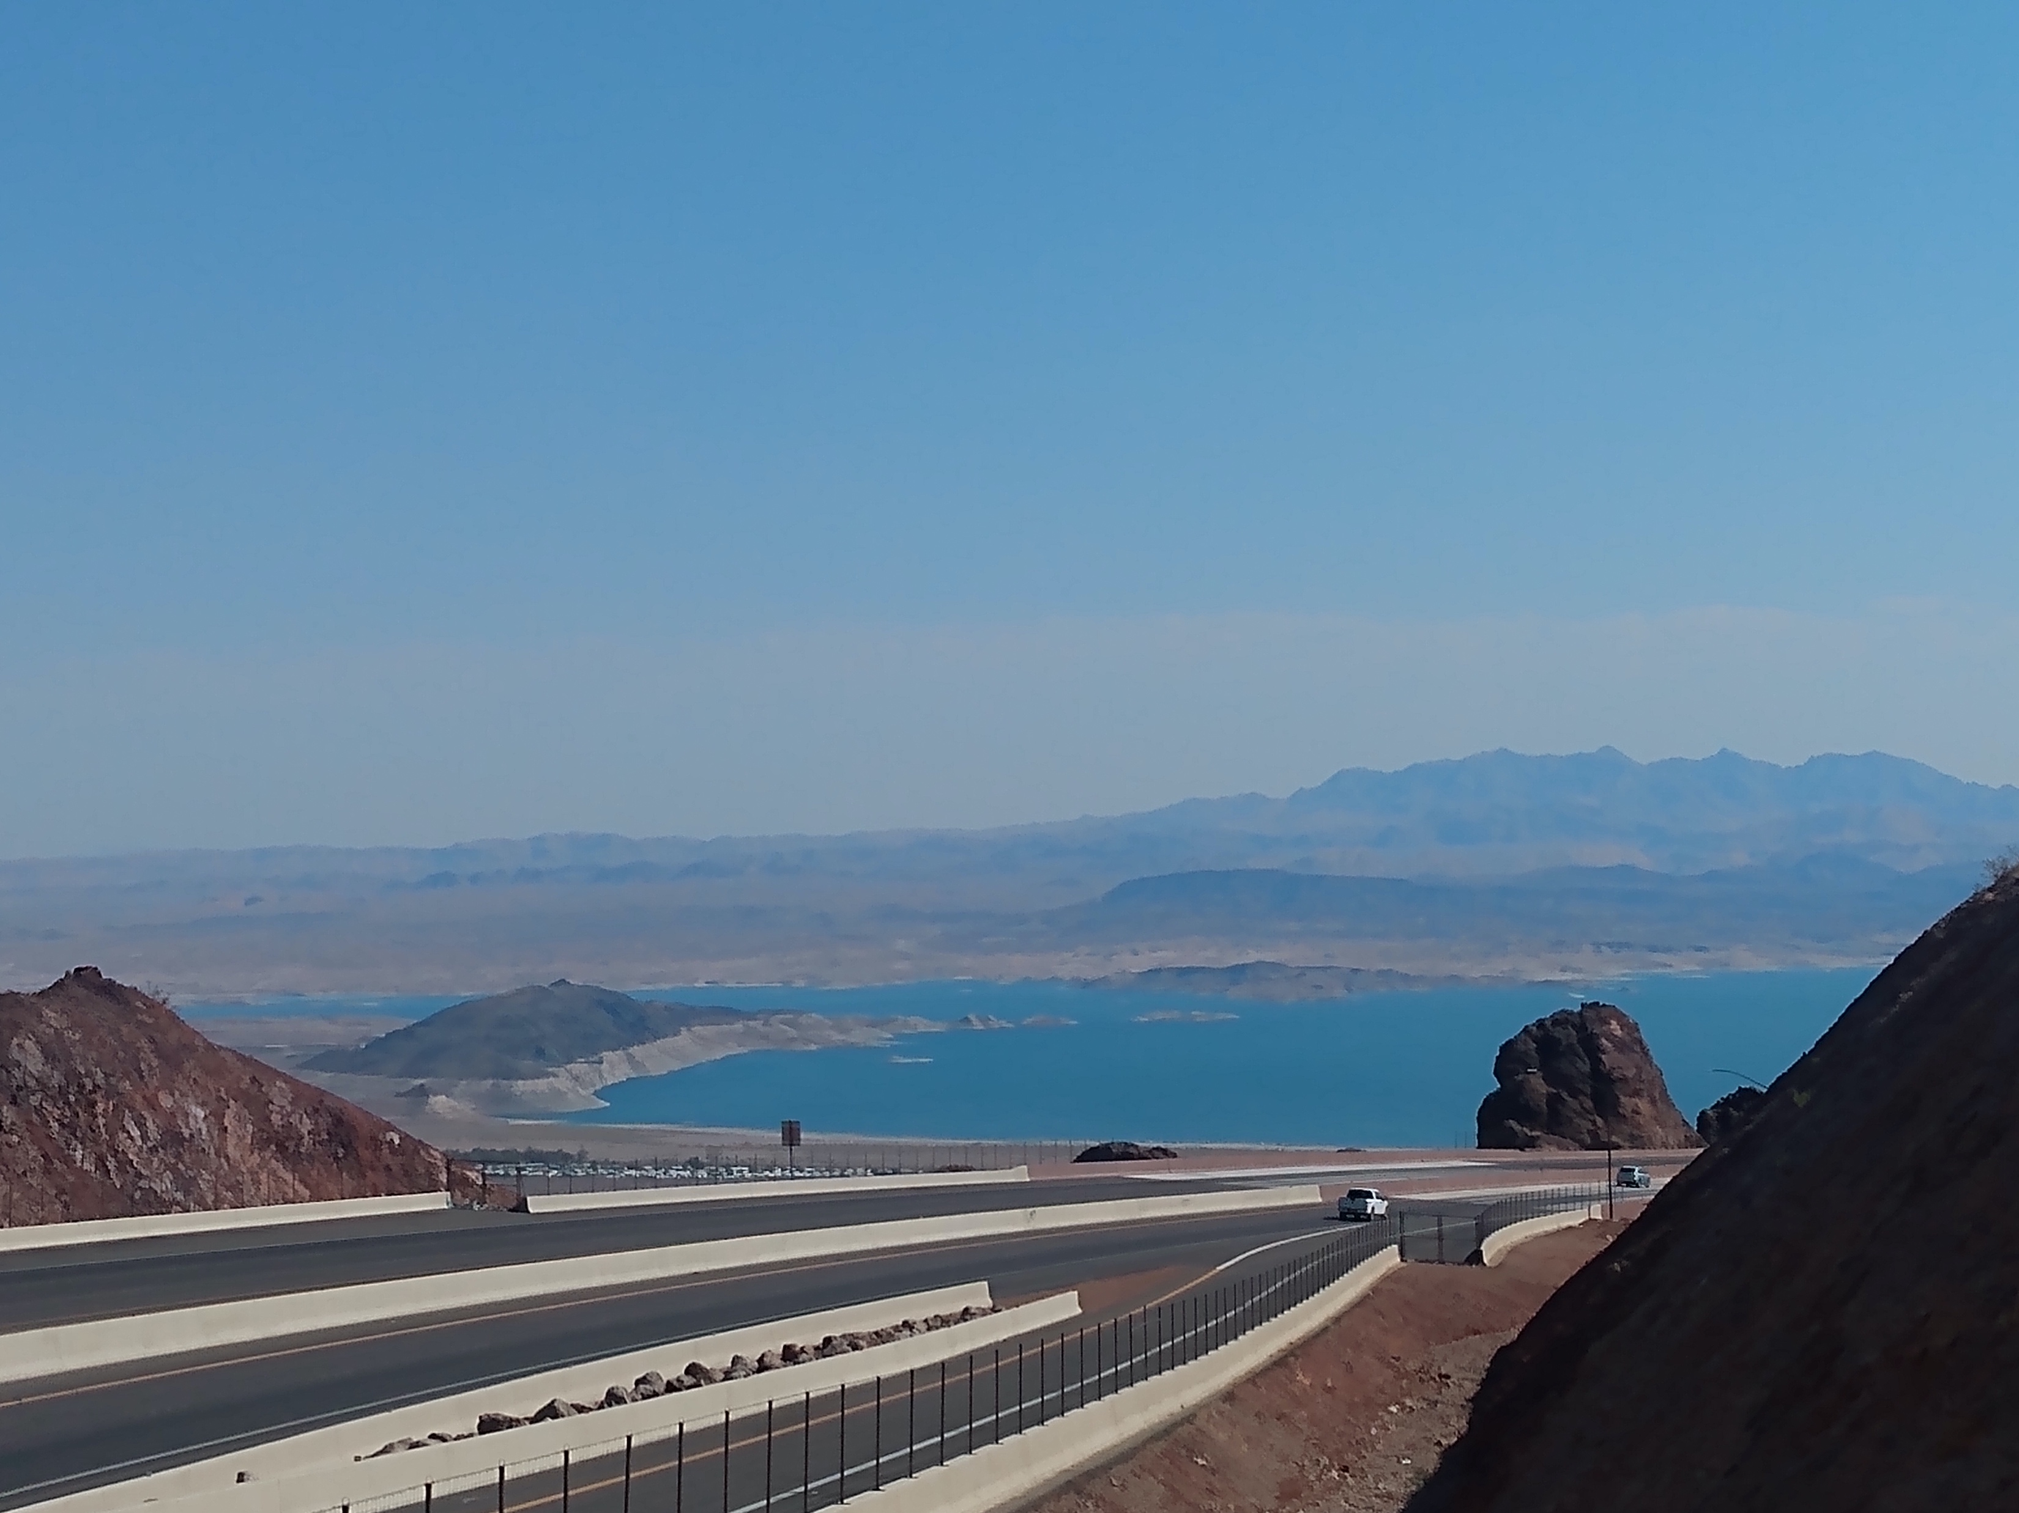
The OFMF fulfills the need to:
The clients needs to reach resources over the fabric
We need to bridge the gap between the location of the resources and clients
Get the plumbing assembled in the correct way to connect clients with resources
Provide a Security Framework

Slide 7
Why create a new Fabric Manager Framework?
Client Workload Managers, Applications, Middleware, MPI, Security, Performance Monitoring, etc.
Fabric Manager
Fabric 1
Gen-Z
Fabric 2
Resources

Slide 8
Examples of Fabric Admin Services Offered by OFMF
The Open Fabrics Management Framework
Control Services
Discovery
Inventory
Communication Services
Connection Management
Address vectors
Partition Services
Zones
Connections
Messaging Services
Queues and Contexts
Events and Errors
Atomics and other synchronizations
Security
Sub-fabrics which provide exclusionary access security
User APPs & Libraries
TBD
Slurm
PBS
Kubernetes
Orchestration Managers
Open Fabric Management Interface
Fabric Services
Fabric Services
Fabric Services
Fabric Services
Fabric Services
AWS
Gen-Z
IB
…
Ethernet
Proprietary
Fabric Manager
Gen-Z
Fabric Manager
IB
Fabric Manager
…
Fabric Manager
Ethernet
Fabric Managers
AWS
HW
Gen-Z
HW
IB
HW
…
HW
Eth
HW

Slide 9
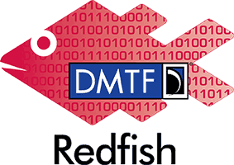
OpenFabric
Management
Framework

Slide 10
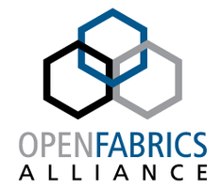
Who is involved in the OFMF Project
Companies and entities working on the project include:
Inria
Riken

Slide 11
Open Fabric Management Framework Architecture
Clients
OFMF Services
Actual Fabric
Application Domain
Administration Domain
OFMF Domain
Framework
abstract manipulations
Providers
Peer Address Lookup
libfabric
Gen-Z
attach shared memory region
Resource Inventory
openFAM
Create Zone
Slingshot
Partition Mgmt
create shared memory region
Create Partition
Authentication
Hardware
FAM Resource
Manager
Create Partition
IB
Events & Logs
Create zone
Kubernetes
Native
Model
Redfish
/
Swordfish
Model
SLURM
Notes:
This slide builds the block diagram architecture of the OFMF:
1)Left side is the user/admin/orchestration/automation domain(s)
2)Right side is the hardware that makes up the fabric and the resources that are accessed thereon
3)The middle is a representation of the functional blocks making up the OpenFabrics Management Framework
4)On the left, various workload managers, app/ libraries, and resource managers are represented. They are all clients of the Framework
5)Inside the OFMF the state of all the fabrics being represented to the clients are represented using a Redfish fabric model
6) At the right border of the OFMF there are fabric specific providers for each of the fabrics which the OFMF is supplying common services for, and each provider may have its own native model of its specific fabric
7)Any entity (SW tool, admin GUI, shell script via CLI) may need to create a virtual platform, pod, cluster, partition, vLan, job queue, subnet or other name for a set of resources that are connected together to enable some workload(s) to execute while being isolated from other jobs.
Such an entity needs a common taxonomy for describing the resources needed in the set and how the connections among them are to behave.
We are proposing to use the DMTF’s Redfish standards to model the fabric and its resources, and to provide the RESTful interfaces through which the entities on the left can learn of the modelled resources and create such a set of fabric resources.
8)Redfish currently has an object called a ‘zone’ that contains a list of the fabric endpoints which may be connected to each other. Zones can be used to enumerate the members of a vLAN, or the resources of a virtual platform.
9)The framework will update the Redfish model for the given fabric(s) and exchange the appropriate details with the fabric specific provider(s)
The Providers are responsible for updating any native models they maintain of their fabric and to issue the appropriate traffic to the fabric hardware
10) It is important to note that ‘admin tools’ are not the only clients of the OFMF services.
Applications and Resource Managers will need runtime support in the form of creating, registering, attaching, and freeing shared memory regions
OS and virtual machine managers will need an interface to request initial (boot time) resource allocations and runtime changes, as well as authentication and events and logging services.

Slide 12
Redfish/Swordfish Hierarchy: Extending Fabric Management
Service Root
Collection
Resource
Singleton
Resource
Singleton
Resource
Volumes
Volumes
Reference (link) to Volume
/redfish/v1
Collection
Storage/<id>
Volumes/<id>
./Storage
Collection
Collection
Volume (Namespace) Instance
./StoragePools
StoragePools/<id>
./AllocatedVolumes
AllocatedVolumes/<id>
StorageControllers Collection
./Controllers
Controllers/<id>
Collection
./Switches
Connections/<id>
NVMe oF:
Adds Fabric and access rights
Collection
Fabrics/<id>
./Fabrics
Collection
./Endpoints
Endpoints/<id>
Collection
./Zones
Zones/<id>
OpenFabrics Management Framework

Slide 13
Agent/Subnet Manager Use-Case Diagram
SM provides a fabric-specific ID
Add
Subnet Manager
Sweep
Changes to the fabric?
SM lets the OFMF Agent know
OFMF Redfish is updated
Delete
Reset and Wait
SM deletes the endpoint

Slide 14
The Agent is a Translator
Starts up at the same time as a Fabric Manager
Listens to the Subnet Manager for real-time updates
Communicates the updates to the OFMF

Slide 15
Tentative schedule dates and steps
✓
Requirements Analysis----July, 2021
--------------------------------------------------------------
System Design----In progress
Program Design—In progress
Program Implementation----September
Testing and Training on Software----September
Initial POC at SDC21-----September
Final Testing---2nd Week of October
Training on Demo
SC21----week before Thanksgiving

Slide 16
Questions?

