Slide 2
SC21 BoF
Modern HPC and Enterprise computing systems can benefit from a more efficient way to assemble and control network fabrics. The OpenFabrics Alliance (OFA) together with its partners the DMTF, SNIA, and the Gen-Z Consortium, are developing a new open-source fabric management ‘framework’ to provide a unified set of tools to control and monitor multiple network fabric types. This BoF seeks input from the HPC network, storage, and security communities to provide useful tools to meet their needs, as well as, open participation in the development of the OpenFabrics Management Framework.
High-speed network fabrics, in both HPC and Enterprise computing systems link resources, such as, memory, storage, and accelerators to processing nodes. Each version and vendor brand of high-speed network fabric has specific tools, features, controls, and monitoring that are unique to the fabric. There isn’t a simple and uniform way to aggregate, subdivide, and control network fabrics. Current network fabric management and control can be difficult to implement for fabrics in a dynamic environment.
In creating a common set of fabric tools, we can simplify uniform management, monitoring, and orchestration of network fabrics. A common set of tools could improve application integration with the network and allow clients to manipulate network fabrics in new ways.
The OpenFabrics Alliance (OFA), together with its partners, the DMTF, SNIA, and the Gen-Z Consortium are launching an effort to design and develop an open fabric management framework that consists of a set of common tools designed for managing and manipulating underlying fabrics in an abstract way. The resulting framework is intended to be used by clients to deliver security services, switch and end point inventories, provide route management, telemetry, diagnostics, and more.
This BoF is targeting the HPC community. We are wanting to interact with developers of fabrics, developers of fabric management solutions, and Application Developers that could benefit from developing solutions that rely on accurate, easy access to fabric information such as workload managers, task brokers, telemetry services, operations management.
This BoF is a Call to Action for those communities to discuss fabric management Use Cases and to provide input on the most urgent set of problems facing them. We are wanting to raise awareness of the OpenFabrics Management Framework and solicit new members for Open-Source participation.

Slide 3
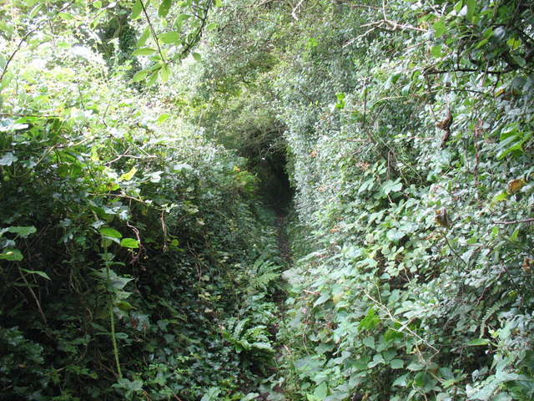
Why create a new Fabric Manager Framework?
New HPC and Cloud computing designs are becoming more heterogeneous to be able to handle more and different types of computing tasks
More granular types of HPC applications and tools
Machine Learning
Deep Learning
New alternative network fabrics, new ways to deploy memory, and custom accelerators are being dreamed up to maximize performance, for use-cases, for these tasks.
Notes:
Current intractability of handing Enterprise work versus HPC work versus Machine Learning versus Deep Learning
Modular applications that run instances on Enterprise are generally tuned to run differently than they might be on an HPC system that is running tightly-coupled applications.
An Enterprise system might require more modular deployment of web services, PAAS, data bases, etc.
HPC systems might be deploying applications running MPI
Enterprise workloads, modern HPC problems
One construct that is common to both computing environments is communication and binding of resources----how can me make things simpler?
Heterogenous deployment of memory, accelerators, such as GPUs, FPGAs, new CPUs that are designed to run specific tasks, NUMA, etc

Slide 4
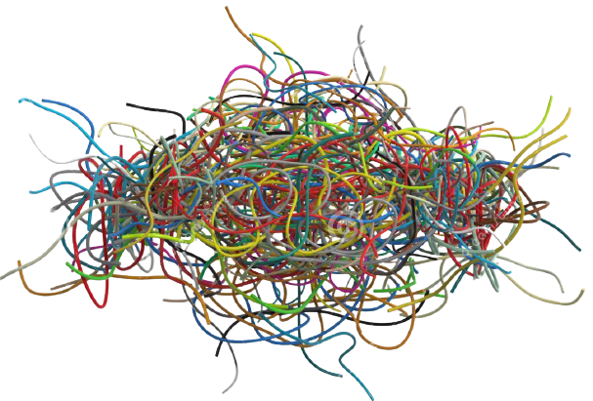
This Creates Problems in Manageability
Administrative Management Challenges
No common fabric manager interface or fabric model available to link applications with remote resources
Workload management and optimization is different for each type of fabric
Administrators are being asked to manage an increasing heterogenous fabrics infrastructure, each with its own management standard and model
User APPs & Libraries
…
…
…
Slurm
PBS
Kubernetes
Orchestration Managers
Fabric Services
Fabric Services
Fabric Services
Fabric Services
Fabric Services
Fabric Services
AWS
Gen-Z
IB
…
Ethernet
Ethernet
TBD
Fabric Managers
Proprietary
Fabric Manager
Gen-Z
Fabric Manager
IB
Fabric Manager
…
Fabric Manager
Ethernet
Fabric Managers
TBD
HW
AWS
HW
Gen-Z
HW
IB
HW
…
HW
Eth
HW
Notes:
Compute platforms largely have static control and access for fabrics because dynamic control is too difficult to manage for a Complex array of high-speed specialty fabrics
We want to create tools that will work together
Works with the vendor-provided fabrics
Shortens the learning curve with a published API for clients and vendors to be able to work with
Tools that will work together
Control simplicity
This BoF seeks Use-Cases for managing fabrics from the HPC network, storage, and security communities, as well as, open development participation in the OpenFabrics Management Framework. -----what purpose is this for? A new common management framework could provide----why is this true?-----is there a framework at all? Does every vendor provide
Tools will work together
Manager with a published API
Heterogeneous
Control simplicity
More and more diversity in fabrics
A common fabric manager framework could significantly improve performance and simplify control

Slide 5
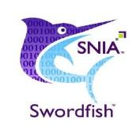
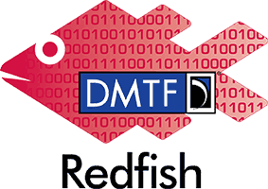
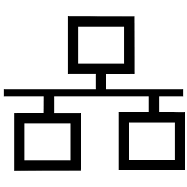
Working towards adoption with…
TARGET EXPANSION AREAS
OpenFabrics
Management
Framework
Today

Slide 6
The Fabric Admin Services offered by the OFMF
The Open Fabric Management Framework
Control Services
Discovery
Inventory
Communication Services
Connection management
App to app, manager to manager
Address Vectors
Managing fabric addresses
Partitioning Services
Zones (subnets, vLans)
Connections (permitted paths)
Permissions
Messaging Services
Queues and contexts
Events and errors
Atomics and other synchronizations
Security
User APPs & Libraries
Slurm
PBS
Kubernetes
Orchestration Managers
Open Fabric Management Framework Interface
Fabric Services
Fabric Services
Fabric Services
Fabric Services
AWS
Gen-Z
IB
…
Ethernet
Proprietary
Fabric Manager
Gen-Z
Fabric Manager
IB
Fabric Manager
…
Fabric Manager
Ethernet
Fabric Managers
AWS
HW
Gen-Z
HW
IB
HW
…
HW
Eth
HW
Notes:
Currently the OFMF working group is grinding through use cases associated with building ‘clusters’ (Slingshot and Kubernetes, IB coming) via ‘zones’, and deploying workloads from SLURM and Kubernetes via ‘connections’
During the use case walk throughs we note where OFMF services are going to be needed, and in which format the arguments are likely to be available
Basically working towards a list of the API calls needed northbound of the OFMF, and how they have to look to the fabric specific providers
Thus, the Redfish models are being defined / refined in parallel with the required services
So, the three activities strive to implement this vision as so:
The CXL/Gen-Z bridge defines the fabric features we need for MDC and how the features are mapped into a fabric manager or application node’s working space (at the bottom of the stack, the HW/FW-SW interface)
The Redfish fabric extensions allow the MDC fabric features to be modeled, and thus conveyed and controlled
The OFMF defines the generic fabric services interfaces/APIs to the upper layer tools, resource managers, and apps / libraries and the internal APIs for the fabric specific plugins

Slide 7
The Open Fabric Management Framework Architecture
Clients
Application Domain
Administration Domain
OFMF Domain
Native
Model
Redfish
Model
abstract
manipulations
libfabric
Framework
attach shared memory region
Peer Address Lookup
openFAM
Gen-Z
Agent
Gen-Z
FM
create shmem region
Create Zone
Partition Mgmt
FAM Resource
Manager
Create Zone
Slingshot
Agent
Slingshot
FM
Authentication
Hardware
Create zone
Create Zone
Events & Logs
IB
Agent
IB
SM
Kubernetes
SLURM
Notes:
Left side is the user/admin/orchestration/automation domain(s)
Right side is the hardware that makes up the fabric and the resources that are accessed thereon
The middle is a representation of the functional blocks making up the OpenFabrics Fabric Management Framework
On the left, various workload managers and app/resource manager libraries are represented. They are all clients
Any entity (SW tool, admin GUI, shell script via CLI) may need to create a virtual platform, pod, cluster, partition, vLan, job queue, subnet or other name for a set of resources that are connected together to enable some workload(s) to execute while being isolated from other jobs.
Such an entity needs a common taxonomy for describing the resources needed in the set and how the connections among them are to behave.
We are proposing to use the DMTF’s Redfish standards to model the fabric and its resources, and to provide the RESTful interfaces through which the entities on the left can learn of the modelled resources and create such a set of fabric resources.
Redfish currently has an object called a ‘zone’ that contains a list of the fabric endpoints which may be connected to each other. Zones can be used to enumerate the members of a vLAN, or the resources of a virtual platform.
Entities on the left hand side make a common call to create a Redfish ‘zone’.
The framework will update the Redfish model for the given fabric(s) and exchange the appropriate details with the fabric specific provider(s)
The Providers are responsible for updating any native models they maintain of their fabric and to issue the appropriate traffic to the fabric hardware
It is important to note that ‘admin tools’ are not the only clients of the OFMF services.
Applications will need runtime support in the form of creating, registering, attaching, and freeing shared memory regions.
OS and virtual machine managers will need an interface to request initial (boot time) resource allocations and runtime changes

Slide 8
Redfish / OFMF Fabric Model Example
Composer
ServiceRoot
Account
Service
Systems
Chassis
Fabrics
1
Gen-Z
Session
Service
1
AddressPools
Event
Service
Media
Controller
Memory
Memory
Domain
Fabric Adapter
AP1
Zones
Update
Service
1
1
1
1
1
Telemetry
Service
Memory
Chunks
Connections
Endpoints
Manager
Target
Endpoint
Chunk1
Conn1
Initiator
Endpoint
Chunk2
Chunk3
Chunk4
collection resource
singleton resource
Subordinate object
Navigation Link (odata.id)
Notes:
This is a scary slide … normally I need 45 minutes to walk through the animations that tell the story of how we use Redfish to create a common fabric model and manage fabrics with it. Today, going to cover just the green objects, in five minutes
Well, we DO Need a common model of a memory semantic fabric with disaggregated, shared resources (memory) for all the upper level tools and libraries to work with…
Let’s take a quick look at how our Redfish fabric model can be useful to a Composing tool
First, this is the Redfish ‘logical view’ of fabric resources and their logical relationships to each other (no physical details like switches ☺ )
A large memory region, say our 1 PB region, can be aggregated together out of 2x 512 TB ‘memory chunks’
Redfish has the memory chunk objects already in place because they were discovered and enumerated prior, but they are not yet composed until we create the ‘logical memory region’.
A 500 node cluster can be created by pulling in the 500 initiator endpoints (fabric bridges on the 500 hosts) into a single ‘zone’.
The memory chunks that make up the ‘logical memory region’ are also placed into the same zone.
The endpoint objects all exist because they were already discovered, but they are not collected together into a cluster or ‘zone’ so they are just disaggregated resources.
Once the 500 initiator endpoints are in the same zone as the memory chunks, the fabric specific manager can program routes through the switches. The fabric will now allow these endpoints to pass packets through the switches to each other.
However, endpoints are not yet enabled to send or receive packets until a connection is made.
Connections can be made between each host (initiators) and the multiple targets (memory chunks) that make up the logical memory region. That gives all the hosts simultaneous access to the 1 PB memory region.
However, if all host to host communication is expected to be done through shared FAM mailboxes, there should be no connections directly between hosts.
Thus, Connections enable endpoints to send or receive packets independently of whether the switches will route the packets. This is a requirement of Gen-Z’s asymmetric connection privileges.
This is how Redfish solves our common fabric model, common fabric services interface problem.

Slide 9
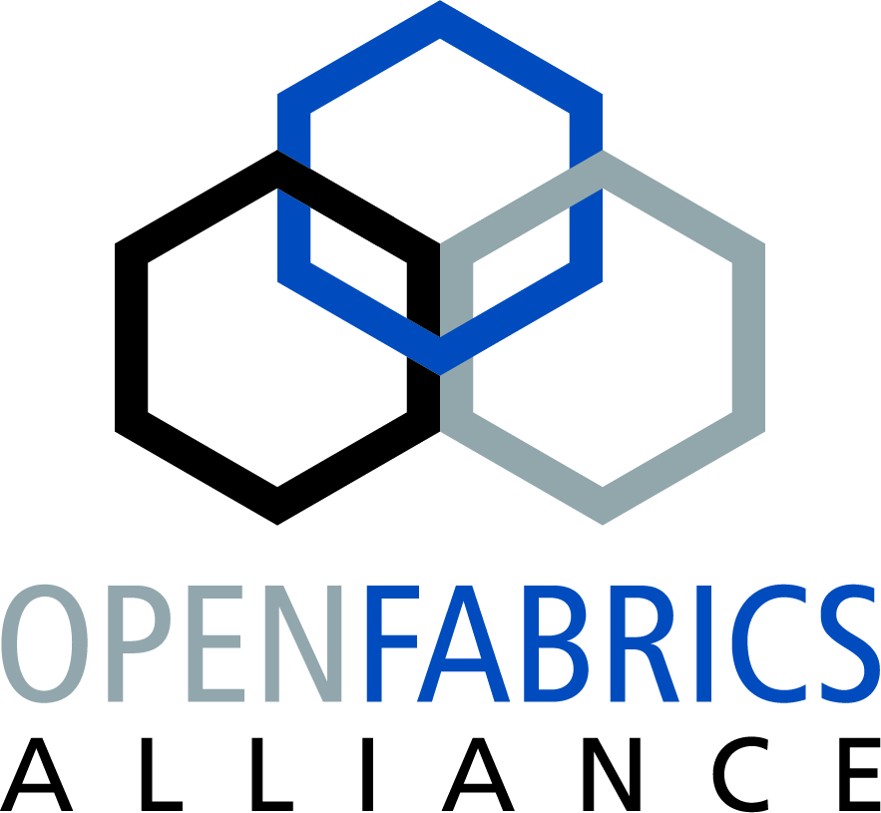
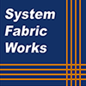
Companies & entities involved in the OFMF Project

