Slide 1
Extracting info from CXL3.0 Fabric Topology for SC22 demo

Slide 2
Mapping with current GenZ prototype
We could re-use the “node” object form the GenZ json topology representation for either a switch or a node device and “link” for representing physical fabric connections
All information can be extracted by the FM using the following commands:
Identify
Get Log (gets the command opcodes supported by the device)
Identify Switch Device
Get Physical Port State
Get Virtual CXL Switch Info (provides for each host port if it is enabled/disabled, binding status for each PPB, etc.)
FAM specific commands
Get LD Info
Get LD Allocations
[Optional] Get QoS Allocated BW (provides per LD allocated bandwidth -- useful for QoS-based binding)
[Optional] Get QoS BW Limit (provides per LD max bandwidth -- useful for QoS-based binding)
[Optional] Get Multi-Headed Info (provides #heads, #LDs, Head-to-LD mapping -- useful for QoS-based binding)
Events
Set Event Interrupt Policy (enables devices to generate and propagate events to Agent)
Get Event Records (upon interrupt being generated, retrieves event records of type requested, e.g., informational, warning, fatal)
Reference documents:
CXL 3.0 spec (Aug 1 22, Revision 3.0, Version 1.0) Section 7.6 “Fabric Manager Application Programming Interface.”, Section 7.6.6.1 “Initial System Discovery”
Example GenZ json topology file: https://github.com/OFMFWG/OFMF-Agent-POC/blob/agent_test/agent_utils/soc3-4-topo.json

Slide 3
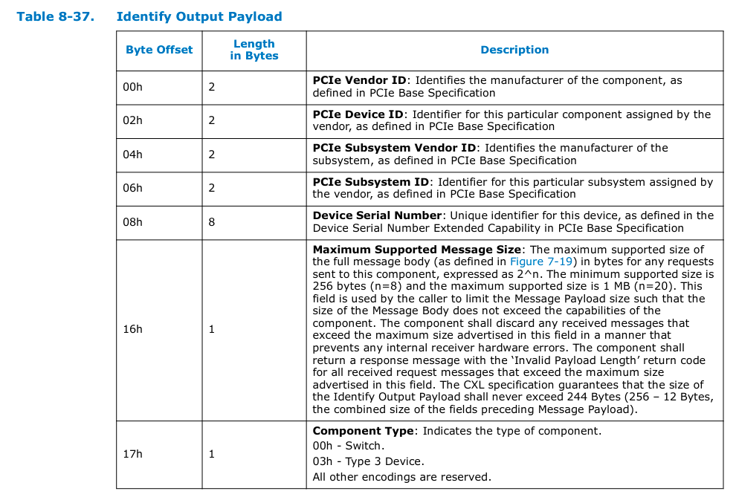
Identify command
Retrieves status information about the component, including whether it is ready to process commands. A component that is not ready to process commands shall return ‘Retry Required’.
This is the first step for identifying the type of device and its id

Slide 4
Identify Switch command

Slide 5
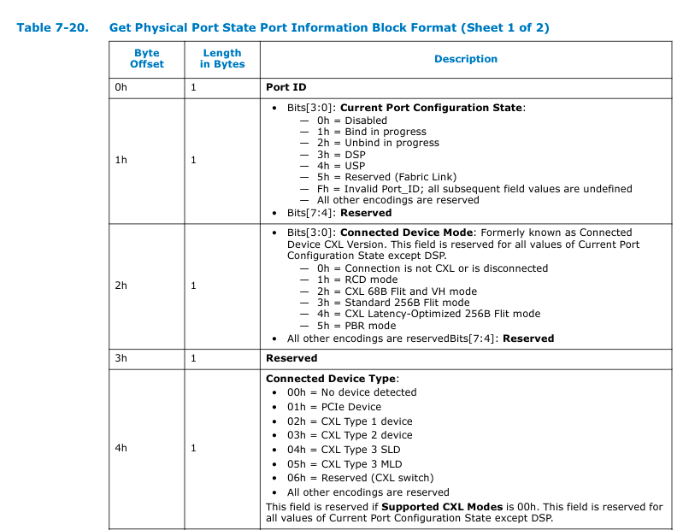
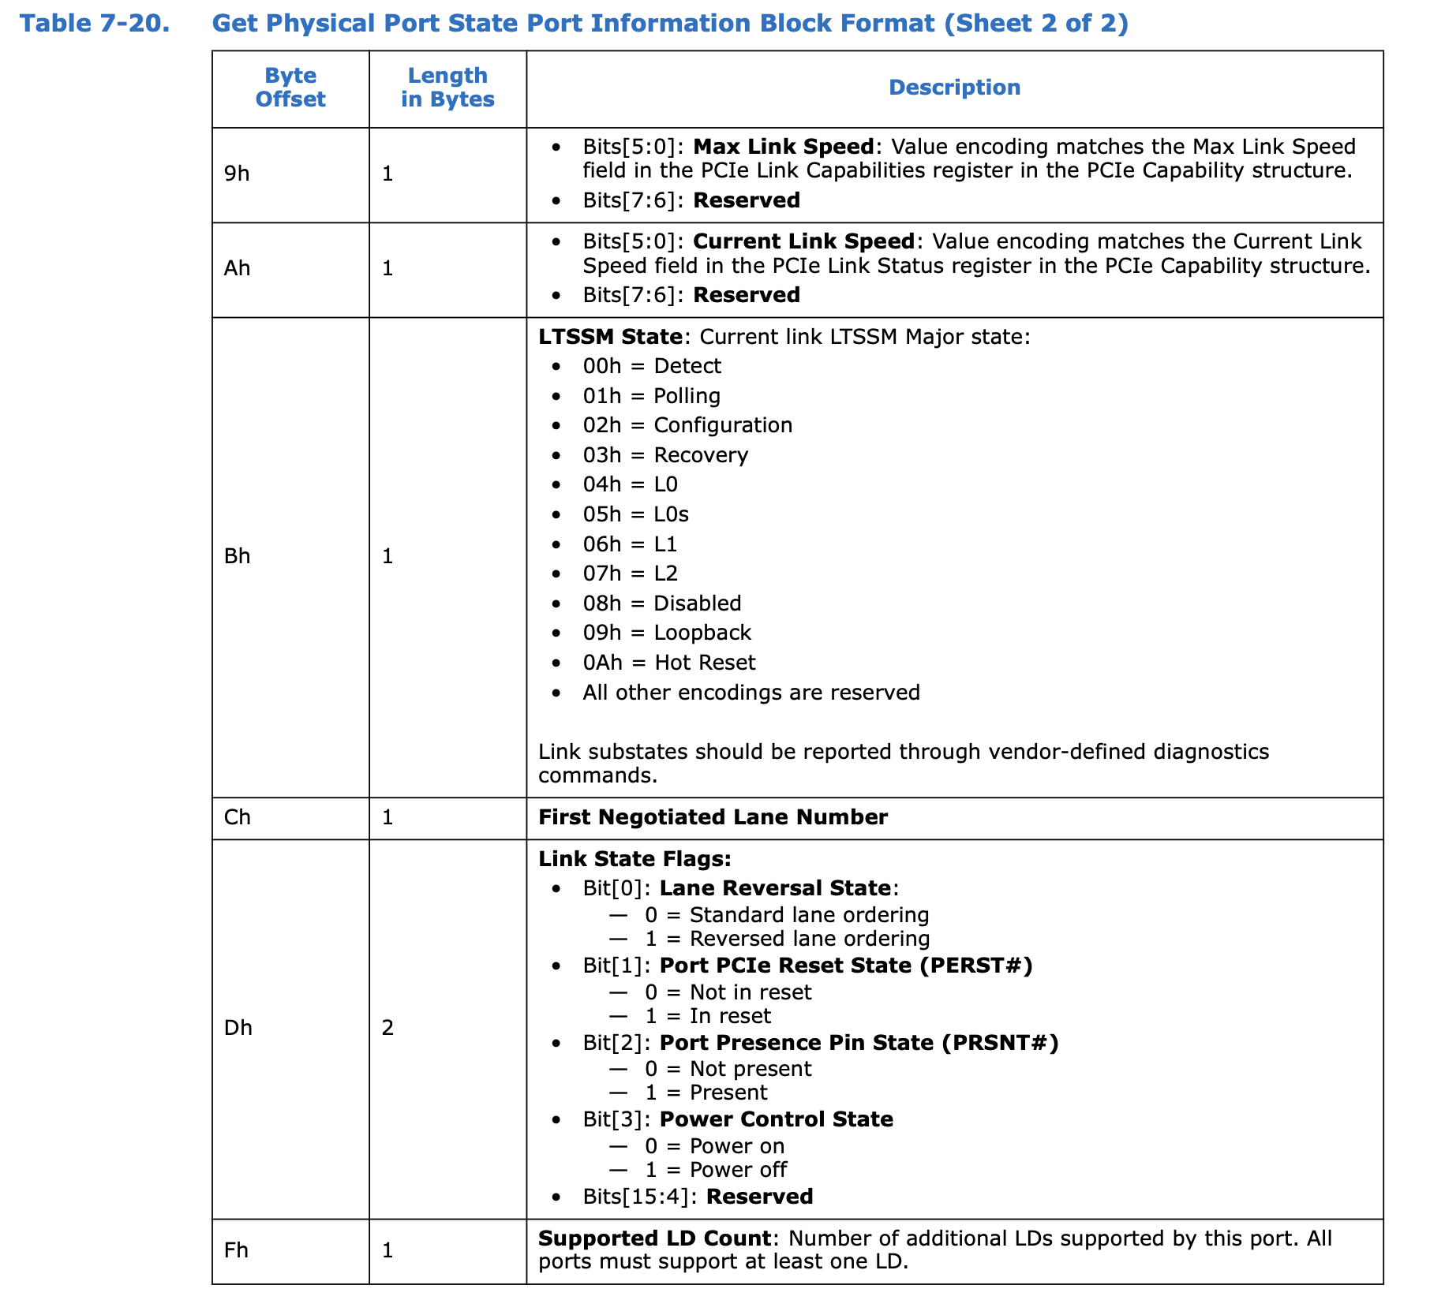
Get switch physical ports state

Slide 6
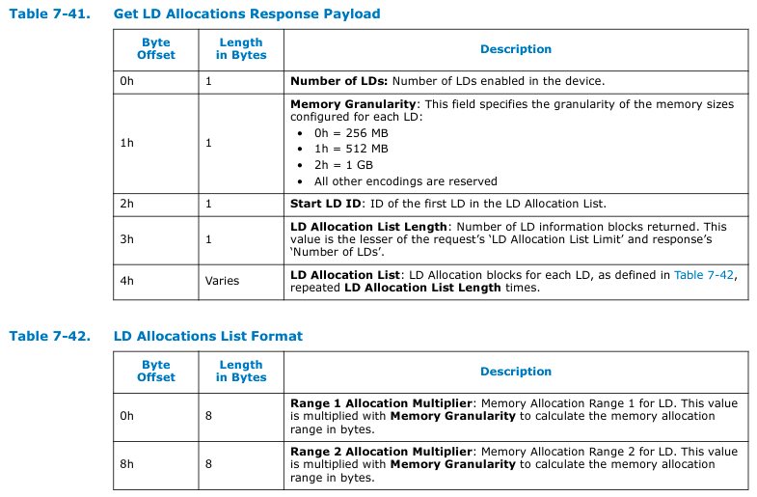
Devices discovery: MLD
Get LD info
Get LD Allocations

Slide 7
Mapping with current GenZ prototype
Common node object content for both switch on CXL T3 device
“node":{
"device_id": 64bit PCIe serial number,
"device_type": “[1 – PCIe, 2 – CXL_T1, 3 – CXL_T2, 4 – CXL_T3_SLD, 5 – CXL_T3_MLD, 6 - CXL_SWITCH]”,
“device_specs”: { ... }
}
Here we can keep device specific info that depend on the device_type field.
See next slides for details

Slide 8
Mapping with current GenZ prototype
Info taken from the “Identify Switch Device” and “Get Physical Port State” commands
Device specs for switch type
“device_specs”: {
”port_num”: number of physical ports
”active_ports”: bitmap representing the active ports
“ports”: [
“port_id”: {
“config_state”: “[0 – Disabled, 3 – DSP, 4 – USP, 5 – Fabric Link]”,
”link_state”: “UP or DOWN”
}
]
}
Repeated x port_num
we could use LTSSM State or Link State Flags

Slide 9
Mapping with current GenZ prototype
Device specs for MLD/SLD
“device_specs”: {
”ld_num”: number of logical devices,
“enabled_lds”: number of lds enabled for the device,
”mem_size”: total memory size for the device,
“mem_granularity”: granularity of memory sizes for this LD [0 – 256MB, 1 – 512MB, 2 – 1GB],
“lds”: [
”ld_id”: {
“range1_alloc”: memory allocated in bytes,
“range2_alloc”: memory allocated in bytes
},
]
}
Info taken from the “Get LD Info” and “Get LD Allocations” commands
Repeated x ld_num

Slide 10
Mapping with current GenZ prototype
Use the link object for representing the connection between a switch DSP port and a device
“link":{
“usp”: {
“device-id”: “”,
“port_id”:
}
“dsp”: {
“device-id”: “”,
“port_id”:
}
}
This needs to be finalized
Depending on whether the DSP of the link is attached to a switch or leaf device, we could used “port_id: -1” for signifying a leaf device and the actual switch port number in case of a switch.

Slide 11
Binding: create memory chunk
TODO
Need to create and pass Gen-Z resource object-like entity for the memory chunk, to Agent

Slide 12
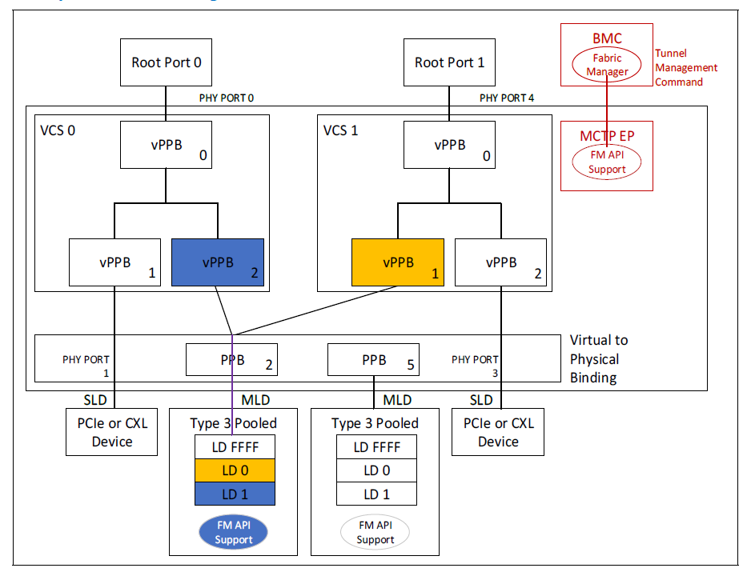
Binding: link host to FAM node
FM commands
Bind vPPB
Input: VCS ID, vPPB ID, Physical port ID
If MLD behind physical port: input also includes LD ID
After binding complete
Generates Virtual CXL Switch Event Record
FM creates and passes JSON resource object for the new connection, to Agent

