Slide 1
Swordfish API Emulator Enhancements

Slide 2
Swordfish emulator changes
Autogen Tool
Support for authentication
Session authentication
Basic authentication
No authentication
Account service implementation
POST through collection method
Response headers
Minimize Swordfish Protocol validator failed test case count
Documentation

Slide 3
Autogen Tool
Why do we need this tool?
Repetitive work to implement each resource according to the redfish path
For resource implementation for all RF/SF resources in one run
Use to implement all basic HTTP methods for any newly introduced resource
How to use the tool?
For all RF/SF resource implementation at one run:
Generate API files with the command:
python script_api.py [xml_schema_path]
Generate template files with the command:
python script_template.py [xml_schema_path] [json_schema_path]
For single resource implementation:
To generate an API file for resource collection, run: generate_api.py
To generate an API file for service/registry/single resource, run: generate_service_api.py
To generate a template file for any type of resource, run: generate_template.py

Slide 4
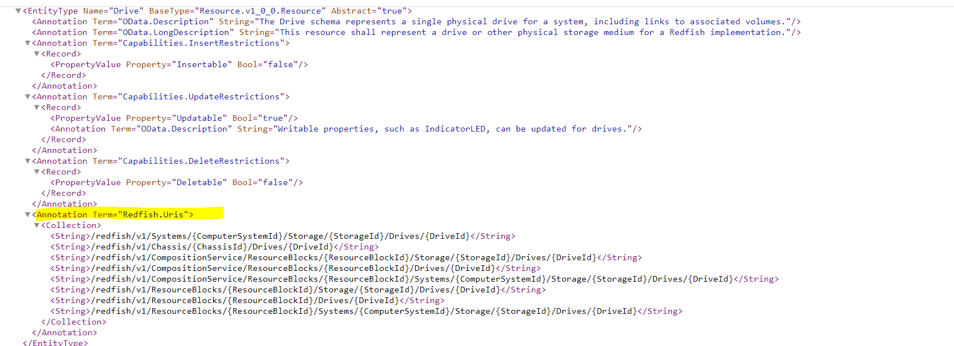
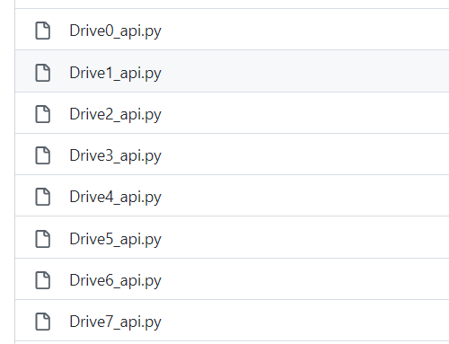
Walk through example to generate API program:
API program for resources will get generated in the ‘APIs’ folder.
API program for services and registries will get added to the Service_APIs folder.
Example, Drive resource will have 8 API codes for each URI location.

Slide 5
For identification, URI is provided in each API program file.
‘add_import’ and ‘add_resource’ files
add_import: Includes import statements for all implemented resources. This can be used to add import statements into resource_manager.py
add_resource: ‘g.api.add_resource()’ statements for all implemented resource

Slide 6
Authentication enablement
Updated emulator-config.json with new parameter
"AUTHENTICATION": "Enable"
Value could be “Enable” or “Disable”
Enable: need to provide either basic authentication or session authentication
Disable: no authentication required
If AUTHENTICATION is enabled, use HTTPS request
To use HTTPS requests, the emulator looks for HTTPS key and certificate files (self-signed or CA-signed).
Session is handled by cookies
Authentication token is used for session validation
Basic authentication just requires default username and password

Slide 7
Support for Roles and Account Service
Functionality added to create an account through ManagerAccount resource under Accountservice.
POST to ManagerAccount0 to create an account with a username, password, and role (mandatory attributes in the post body)
Privileged information not provided in case of success or failure.
POST through collection method
Old emulator does not allow to post resource instance through the collection’s POST method
Updated POST collection method.
Create non-idempotent instances.

Slide 8
Fixing headers and return codes
Resolving errors for header fixing
Response headers added:
OData-Version
Cache-Control
Etag
Link
Allow

Slide 9
Modification in response code
Previously return code for POST(create) was 200, modification is required with 201.
Redfish protocol validator error minimization
At the start around 30 failed test cases
Solved most of them, 5 are still failing
Identified and resolve issues with the NVMe drive interloop validator
REQ_POST_CREATE_VIA_COLLECTION | REQ_POST_CREATE_TO_MEMBERS_PROP
SEC_REQUIRE_LOGIN_SESSIONS | SEC_PRIV_SUPPORT_PREDEFINED_ROLES
SEC_BASIC_AUTH_STANDALONE | RESP_HEADERS_CONTENT_TYPE
SEC_SUPPORT_BASIC_AUTH | REQ_HEADERS_ODATA_VERSION
REQ_POST_CREATE_NOT_IDEMPOTENT | RESP_HEADERS_ALLOW_GET_OR_HEAD
SEC_READ_REQUIRES_AUTH | RESP_HEADERS_CACHE_CONTROL
PROTO_JSON_ALL_RESOURCES | RESP_HEADERS_LINK_REL_DESCRIBED_BY
PROTO_STD_URI_SERVICE_ROOT_REDIRECT | RESP_HEADERS_ALLOW_METHOD_NOT_ALLOWED

Slide 10
Documentation
Self Signed certificate and key generation guide
Emulator updates walkthrough document

