Slide 2
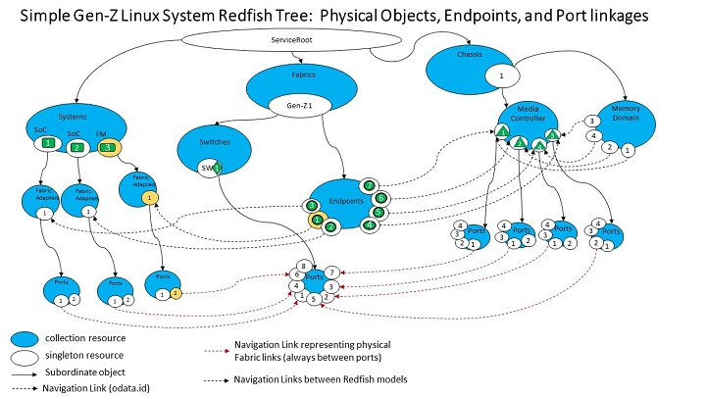
Managing Composable HPC Systems
Revised 06.18.21
Notes:
DMTF’s Redfish® is a standard data management method that allows us to control resources, chassis, fabrics, and systems. Using Redfish trees, we can keep track of information on features, current resource allocations, connections, events, environmental conditions, and security keys. Swordfish provides us with storage-related extensions like NVMe device management, file, block, and object storage information. You can access Redfish information through RESTful connections with http and https.

Slide 3
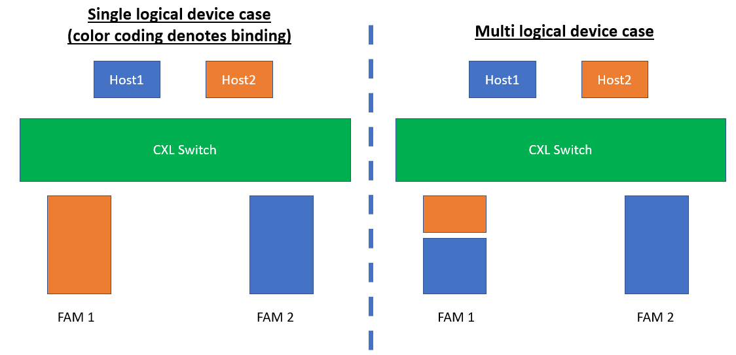
What are Composable Disaggregated HPC Systems?
CDI HPC Nodes and Fabric Attached Memory
Revised 06.18.21
Notes:
This is an example of Fabric Attached Memories being attached by CXL switches. On the right side, Fabric Attached Memory #1 is subdivided by Hosts1 and 2. With proper management, we can subdivide and aggregate the memories. Host 1 is aggregating a portion of FAM1 and FAM2. We can link and use these memories to augment or supply resources to each of the hosts.

Slide 4
Dynamically Optimize HPC Architecture
Advantages of Composability over Current HPC Architectures
Peer-to-Peer CXL-3.0 Switches and Compatible Components lead to dynamic topologies
Dynamic Aggregation and Subdivision of Resources and Network Fabrics– We can aggregate Network Fabrics
CPU
GPU
Node 1
NIC
Node 1
CXL Switch
GPU
Node 2
Node 2
CPU
NIC
GPU
Node 3
Node 3
CXL Switch
RDMA Fabric Switch
CXL Switch
Node 4
NIC
Node 4
NVME Memory Pool
CXL Switch
NVME Memory Pool
Node 5
Node 5
NIC
Notes:
CXL-3.0 is peer-to-peer. If you think about it, peer-to-peer connections can allow you to resources and all of the resources connected to the CXL switches are equally available to each node. In this example I can share GPUs connected to the swtiches, even in separate boxes CPUs, memories. Further, with management, I can reach across this RDMA fabric and switch, and more remotely pull in resources, in an emergency. Sometimes applications can run the nodes out of memory. In another example, I might have oversubscribed a physical node with too many containers. In another example, parallel IO servers might be overloaded. Lustre often uses Z-Pools and ZFS Adaptive Replacement Caches (ARC) caches can be suceptiable to overfilling and that can cause thrashing. The MDS and/or OSS services can cause Lustre failure.

Slide 5
OmniPath connecting NVMe over Fabrics
We’ll expand out a slide with disaggregated components and build out schemas to account for 1). CXL bridging across RDMA (OmniPath) fabrics, 2) OmniPath connecting NVMe over Fabrics, 3) CXL ports toggling to switches, 4) CXL connecting NVMe, 5) OmniPath switch topologies
NIC
Node 1
NIC
NIC
Node 2
NIC
NIC
NVME Memory Pool
Node 3
NIC
RDMA Fabric Switch
RDMA Fabric Switch
RDMA Fabric Switch
NIC
Node 4
NIC
NIC
Node 5
NIC
NIC

Slide 6
CXL bridging across RDMA (OmniPath) fabrics
CXL ports toggling to bridged switches
CPU
Node 1
NIC
Node 1
CXL Switch
GPU
Node 2
Node 2
CPU
NIC
GPU
Node 3
RDMA Fabric Switch
Node 3
CXL Switch
CXL Switch
Node 4
NIC
Node 4
NVME Memory Pool
CXL Switch
NVME Memory Pool
Node 5
Node 5
NIC

Slide 7
CXL connecting NVMe
Node 1
CXL Switch
CXL Switch
Node 2
NVME Memory Pool
NVME Memory Pool
Node 3
CXL Switch
CXL Switch
Node 4
CXL Switch
CXL Switch
Node 5

Slide 8
OmniPath switch topologies
Node 1
NIC
NIC
Node 1
Node 2
NIC
NIC
Node 2
Node 3
NIC
RDMA Fabric Switch
RDMA Fabric Switch
RDMA Fabric Switch
NIC
Node 3
Node 4
NIC
NIC
Node 4
Node 5
NIC
NIC
Node 5

