Slide 1
Centralized Composable HPC Management with the OpenFabrics Management Framework
Michael Aguilar
Phil Cayton (Intel), Christian Pinto (IBM), Russ Herrell (HPE)
IPDPS/COMPSYS23
St. Petersburg, Florida, USA
May 19, 2023
SAND2023-03887A

Slide 2
Contributors to the OFMF
The goal of the OFMF is to enable interoperability through common interfaces to enable client Managers to efficiently connect workloads with resources in a complex heterogenous ecosystem, without having to worry about the underlying network technology.

Slide 3
What are Composable Disaggregated HPC Systems?

Slide 4
What are Composable Disaggregated HPC Systems?
SPECIFIC OR CONSTRAINED COMPOSITION
EXPANDABLE COMPOSITION
CPU
FAM
MEMORY
BLOCK
STORAGE
Existing Chassis
FAM MEMORY
CPU
FAM
MEMORY
BLOCK
STORAGE
Existing Chassis
BLOCK STORAGE
CPU
FAM
MEMORY
BLOCK
STORAGE
Existing Chassis

Slide 5
Composable Disaggregated Infrastructure (CDI) in an HPC Architecture
SPECIFIC AND EXPANDABLE COMPOSITION
Pools can be used to augment memory with direct-addressable devices and block devices
ccNUMA for the FAM memory
NVMeoF for the Block storage
Existing Chassis
FAM MEMORY
Existing Chassis
BLOCK STORAGE
Existing Chassis

Slide 6
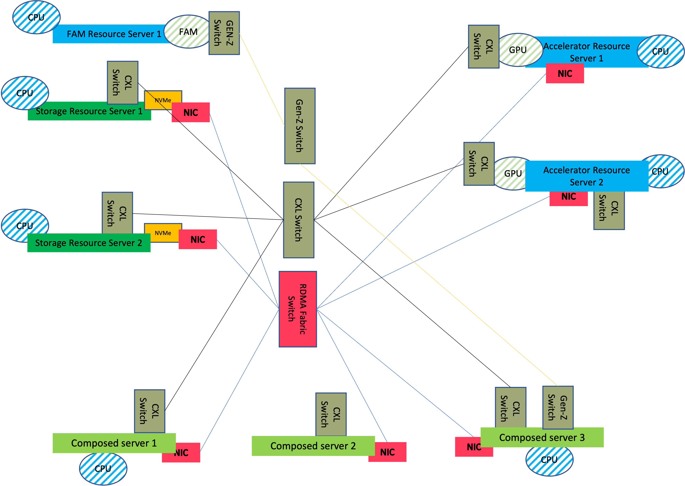
What are Composable Disaggregated HPC Systems?
Homogeneous HPC Systems become Heterogeneous HPC Systems

Slide 7
What are Composable Disaggregated HPC Systems?

Slide 8
OpenFabrics Management Framework for Composable Distributed Systems
We need a centralized control infrastructure to manage our disaggregated compositions and decompositions
We want:
To be able to control Composable Disaggregated Infrastructure (CDI) in an HPC Architecture
Redfish Representation of a Composable Disaggregated Infrastructure Components. Redfish provides us with structures that we can use to store and read component information.
Swordfish Representation of Storage Pools, Volumes, and Endpoint Groups
A centralized service that can provide current up-to-date information on CDI compositions and cluster state information
A centralized service that can abstractly manage our CDI compositions

Slide 9
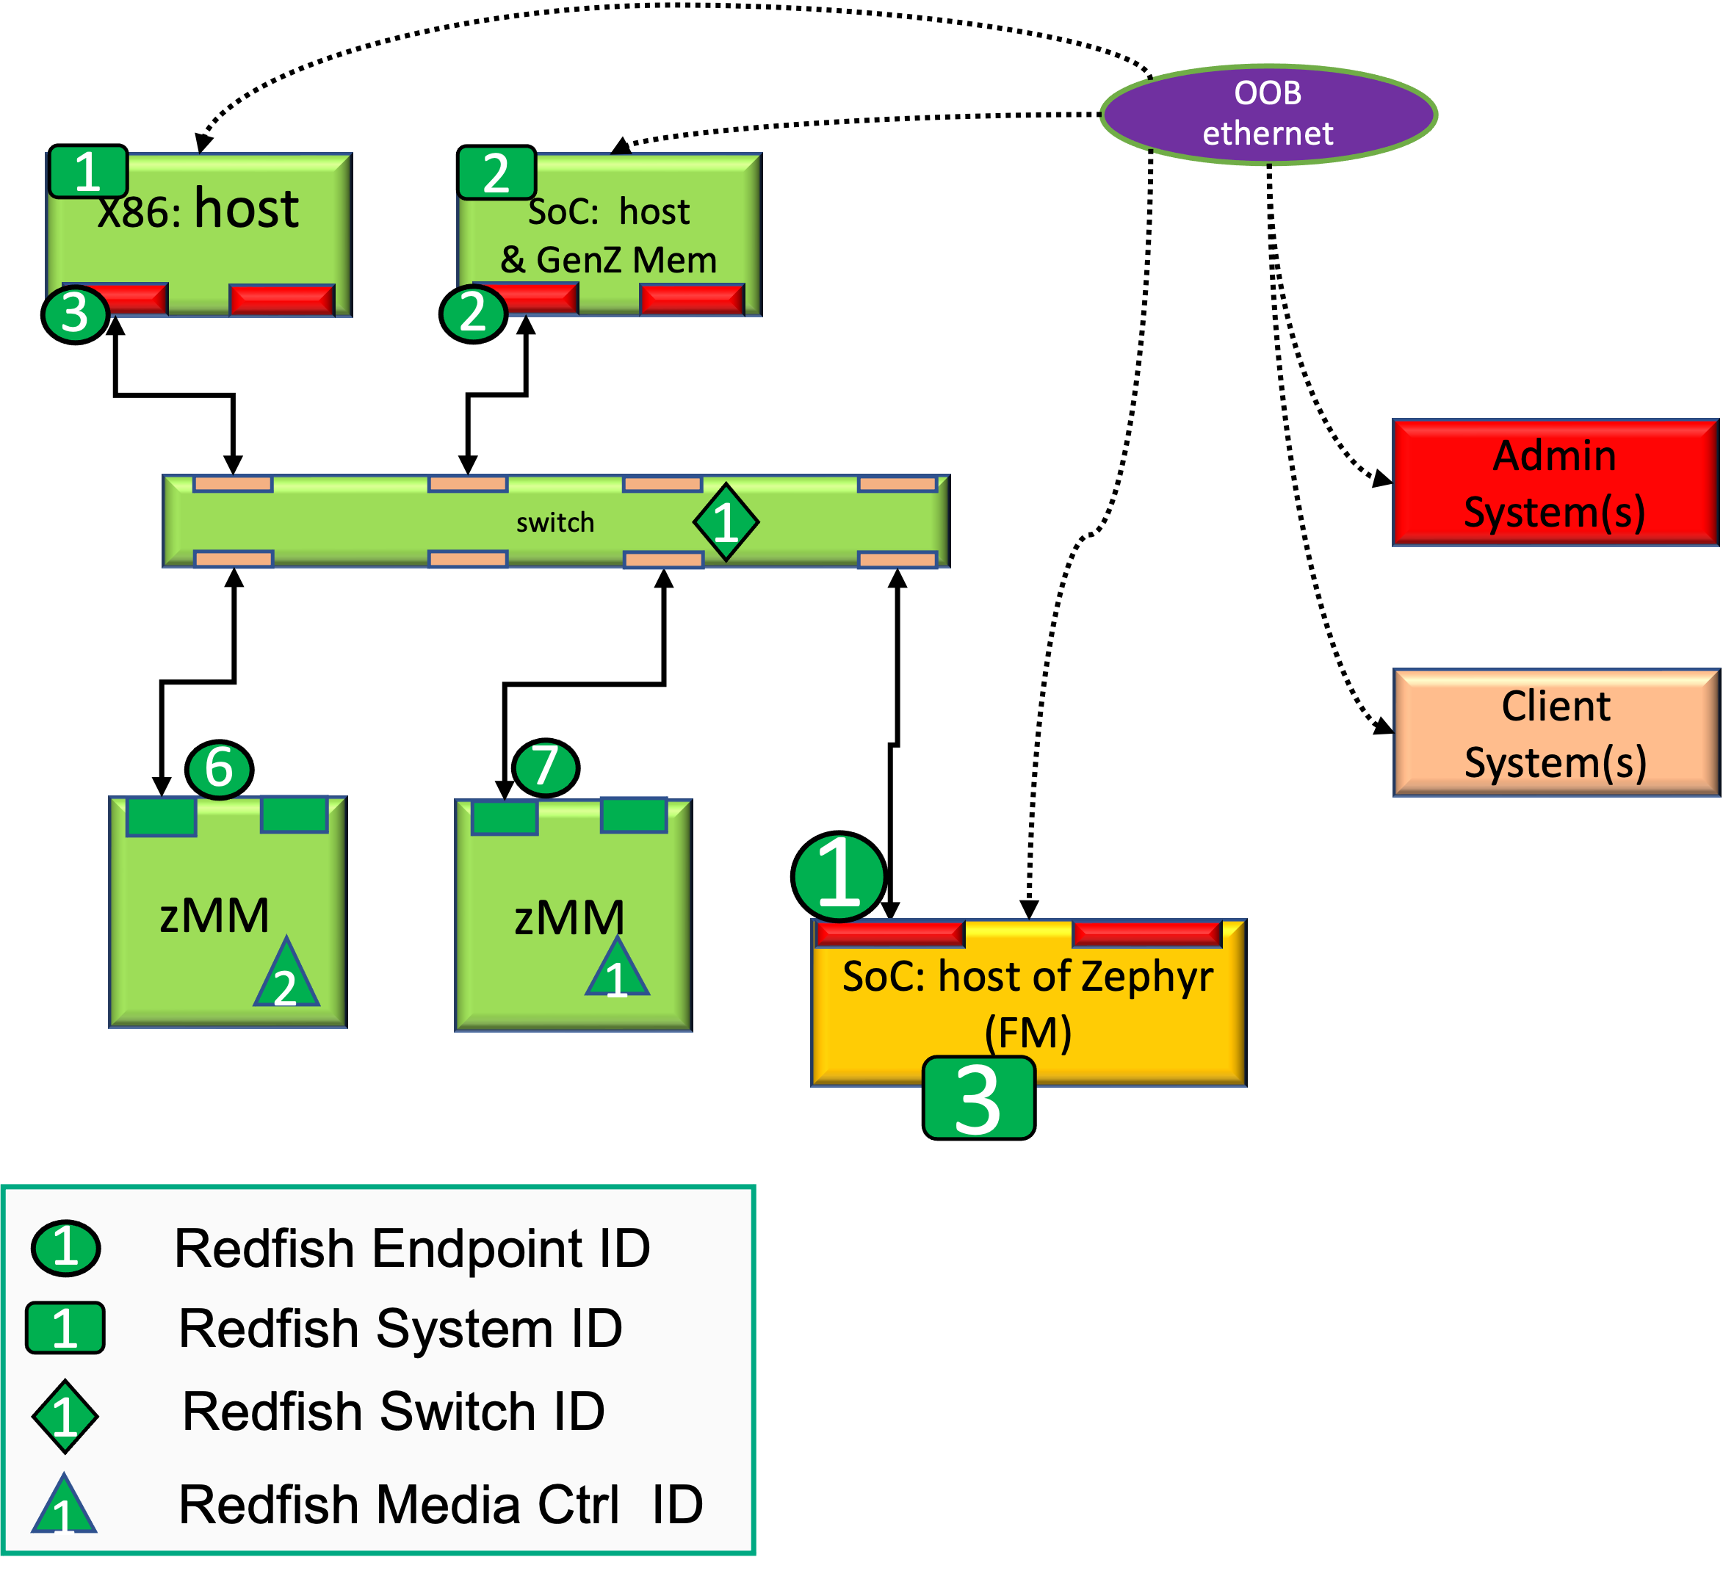
Redfish Representation of a Composable Disaggregated Infrastructure Redfish mapping of a simple HPC system

Slide 10
Redfish Representation of a Composable Disaggregated Infrastructure Redfish mapping of a simple HPC system
$> curl -X GET -H "Content-Type: application/json" htp://ofmfserv:5000/redfish/v1/Fabrics
{
"@odata.type": "#FabricCollection.FabricCollection",
"Name": "Fabric Collection",
"Members@odata.count": 2,
"Members": [
{
"@odata.id": "/redfish/v1/Fabrics/NVMeoF"
},
{
"@odata.id": "/redfish/v1/Fabrics/Ethernet"
}
],
"@odata.id": "/redfish/v1/Fabrics"
}(Swordfish)
curl -X POST -H "Content-Type: application/json" -d @fabric_connection.json http://ofmfserv:5000/redfish/v1/Fabrics/CXL
Warning: Couldn't read data from file "fabric_connection.json", this makes an
Warning: empty POST.
{
"@odata.id": "/redfish/v1/Fabrics/CXL",
"@odata.type": "#Fabric.v1_3_CXL.Fabric",
"Id": "CXL",
"Name": "Fabric"
}

Slide 11
Redfish Representation of a Composable Disaggregated Infrastructure Redfish mapping of a simple HPC system
curl -X GET -H "Content-Type: application/json" htp://ofmfserv:5000/redfish/v1/Fabrics/NVMeoF/Endpoints/Initiator1
{
"@odata.type": "#Endpoint.v1_7_0.Endpoint",
"Id": "Initiator1",
"Name": "NVMe-oF Initiator (Host)",
"EndpointProtocol": "NVMeOverFabrics",
"Identifiers": [
{
"DurableName": "host.corp.com:nvme:nvm-subsys-sn-4635",
"DurableNameFormat": "NQN"
}
],
"ConnectedEntities": [
{
"EntityType": "NetworkController",
"EntityRole": "Initiator"
}
],
"IPTransportDetails": [
{
"TransportProtocol": "Ethernet",
"IPv4Address": {
"Address": "10.3.5.205"
},
"Port": 13244
}
],
"Links": {
"Connections": [
{
"@odata.id": "/redfish/v1/Fabrics/NVMeoF/Connections/1"
}

Slide 12
Redfish Representation of a Composable Disaggregated Infrastructure Redfish mapping of a simple HPC system
curl -X GET -H "Content-Type: application/json" http://ofmfserv:5000/redfis/v1/Fabrics/NVMeoF/Connections/1
{
"@odata.type": "#Connection.v1_0_0.Connection",
"@Redfish.ReleaseStatus": "WorkInProgress",
"Id": "1",
"Name": "Host Connection 1",
"Description": "Connection info for host 1",
"ConnectionType": "Storage",
"VolumeInfo": [
{
"AccessCapabilities": [
"Read",
"Write"
],
"Volume": {
"@odata.id": "/redfish/v1/Storage/IPAttachedDrive1/Volumes/SimpleNamespace"
}
},
{
"AccessCapabilities": [
"Read",
"Write"
],
"Volume": {
"@odata.id": "/redfish/v1/Storage/IPAttachedDrive2/Volumes/SimpleNamespace"
}
}
], }
]
},
"@odata.id": "/redfish/v1/Fabrics/NVMeoF/Connections/1"

Slide 13
Redfish Representation of a Composable Disaggregated Infrastructure CXL-3.0

Slide 14
curl -X GET -H "Content-Type: application/json" http://ofmfserv:5000//redfish/v1/Storage/IPAttachedDrive2/Volumes/SimpleNamespace
{
"@odata.type": "#Volume.v1_8_0.Volume",
"Id": "1",
"Name": "Namespace 1",
"LogicalUnitNumber": 1,
"Description": "A Namespace is a quantity of non-volatile memory that may be formatted into logical blocks. When formatted, a namespace of size n is a collection of logical blocks with logical block addresses from 0 to (n-1). NVMe systems can support multiple namespaces.",
"Status": {
"State": "Enabled",
"Health": "OK"
},
"Identifiers": [
{
"DurableNameFormat": "NQN",
"DurableName": "nqn.2014-08.org.nvmexpress:uuid:6c5fe566-10e6-4fb6-aad4-8b4159029384"
}
],
"Capacity": {
"Data": {
"ConsumedBytes": 0,
"AllocatedBytes": 10737418240
}
},
"NVMeNamespaceProperties": {
"NamespaceId": "0x011",
"NamespaceFeatures": {
"SupportsThinProvisioning": false,
"SupportsAtomicTransactionSize": false,
"SupportsDeallocatedOrUnwrittenLBError": false,
"SupportsNGUIDReuse": false,
"

Slide 15
Redfish Representation of a Composable Disaggregated Infrastructure Redfish Representation of NVMe

Slide 16
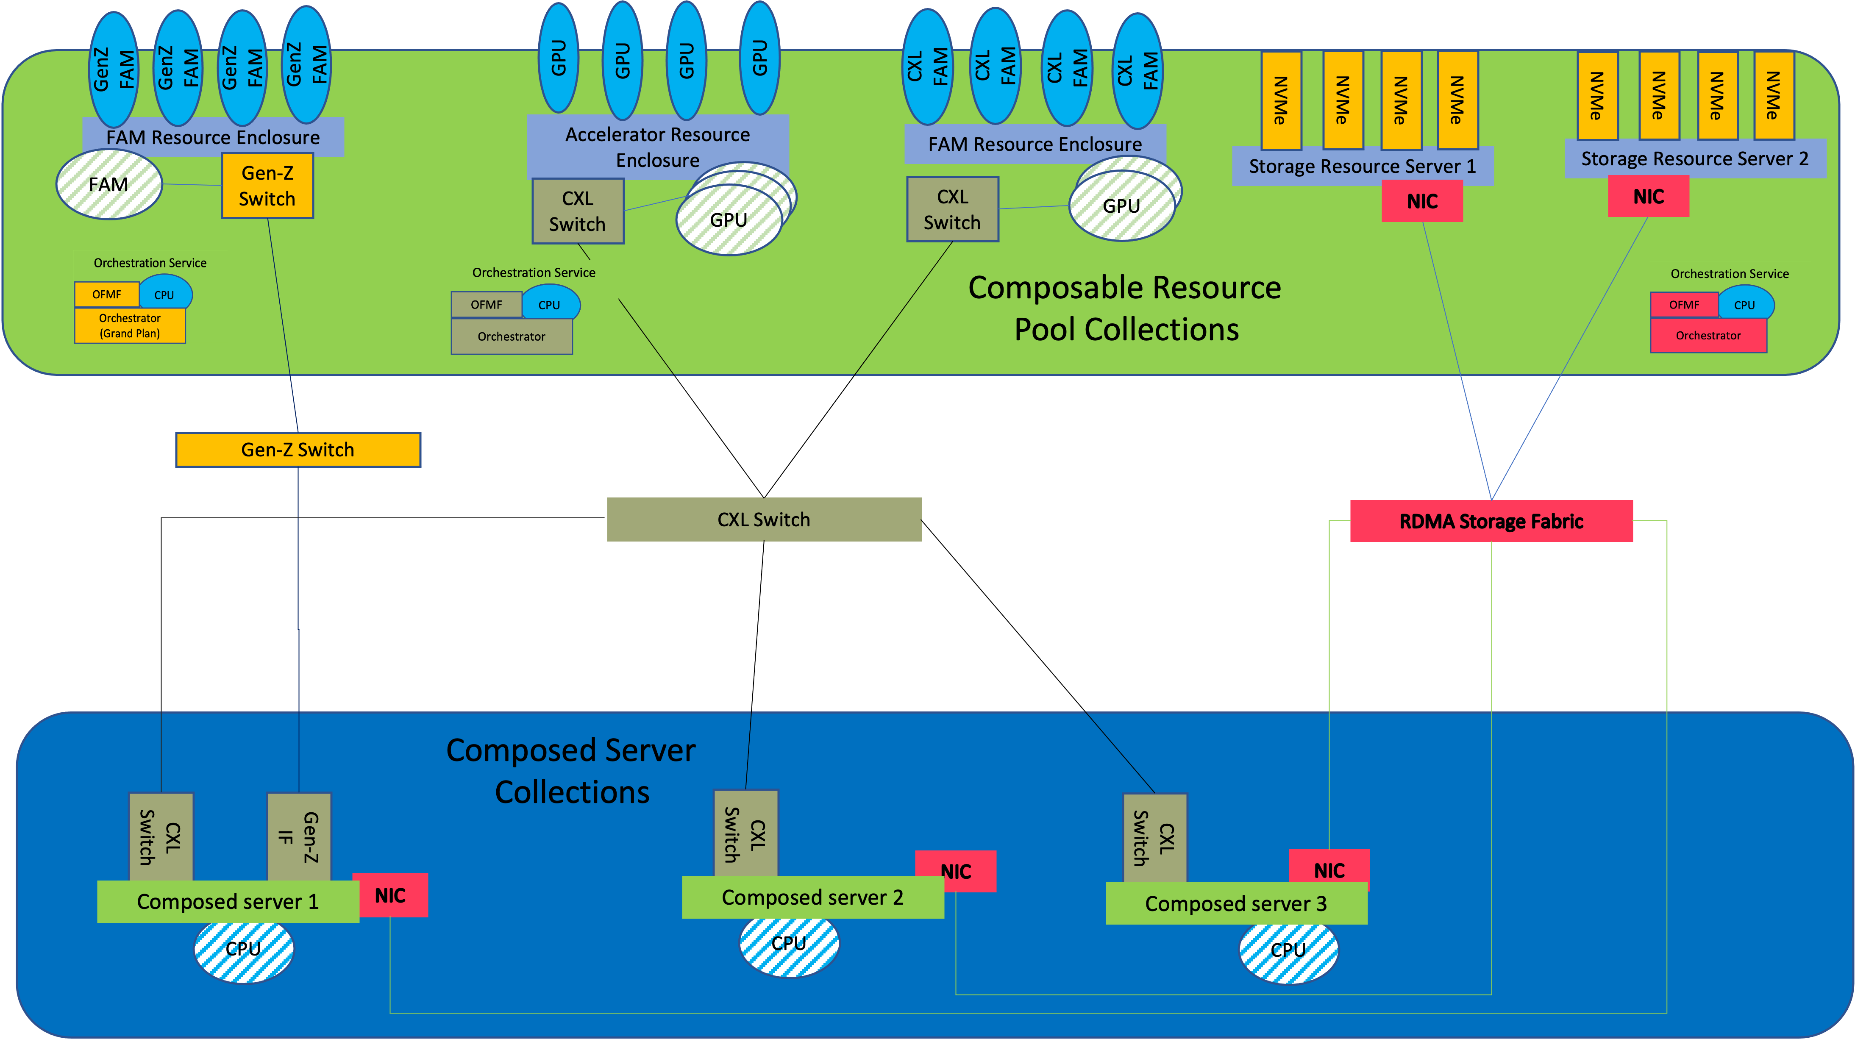
Composable Disaggregated Infrastructure (CDI) in an HPC Architecture Composable Disaggregated HPC system controlled by the OFMF

Slide 17
OFMF Architecture HardWare Fabric Agents interacting with the OFMF

Slide 18
OFMF Architecture---The OFMF components

Slide 19
OFMF Architecture Composable Infrastructure interacting with the OFMF

Slide 20
Examples of CDI HPC Use-Cases Composable Filesystem on a composable Disaggregated Infrastructure

Slide 21
Container/Workload Manager Container Composition
Application Domain
Administration Domain
Composability Layer
Fabric Resources
Monitoring
OFM Services
Container Deployment
Monitoring
Resource Inventory
Storage
Manager (OpenFam using libFabric)
Composition
Policies
Batch Job
RF tree management
Application
Resource
Control
(e.g., Compute, FAM, Storage, Fabric)
Resource Configuration
OpenFam
FAM
Manager (OpenFam using libFabric)
Fabric Configuration
Container Engine
RESTful API (RF/SF)
Message Queue
Authentication
LibFabric
Events & Logs
Access Control
Events & Logs
Interactive Job
Accelerator
Manager (OpenFam using libFabric)
Data Store
Data Store
Workload Manager

Slide 22
Examples of CDI HPC Use-Cases Container Engine interacting with the OFMF

Slide 23
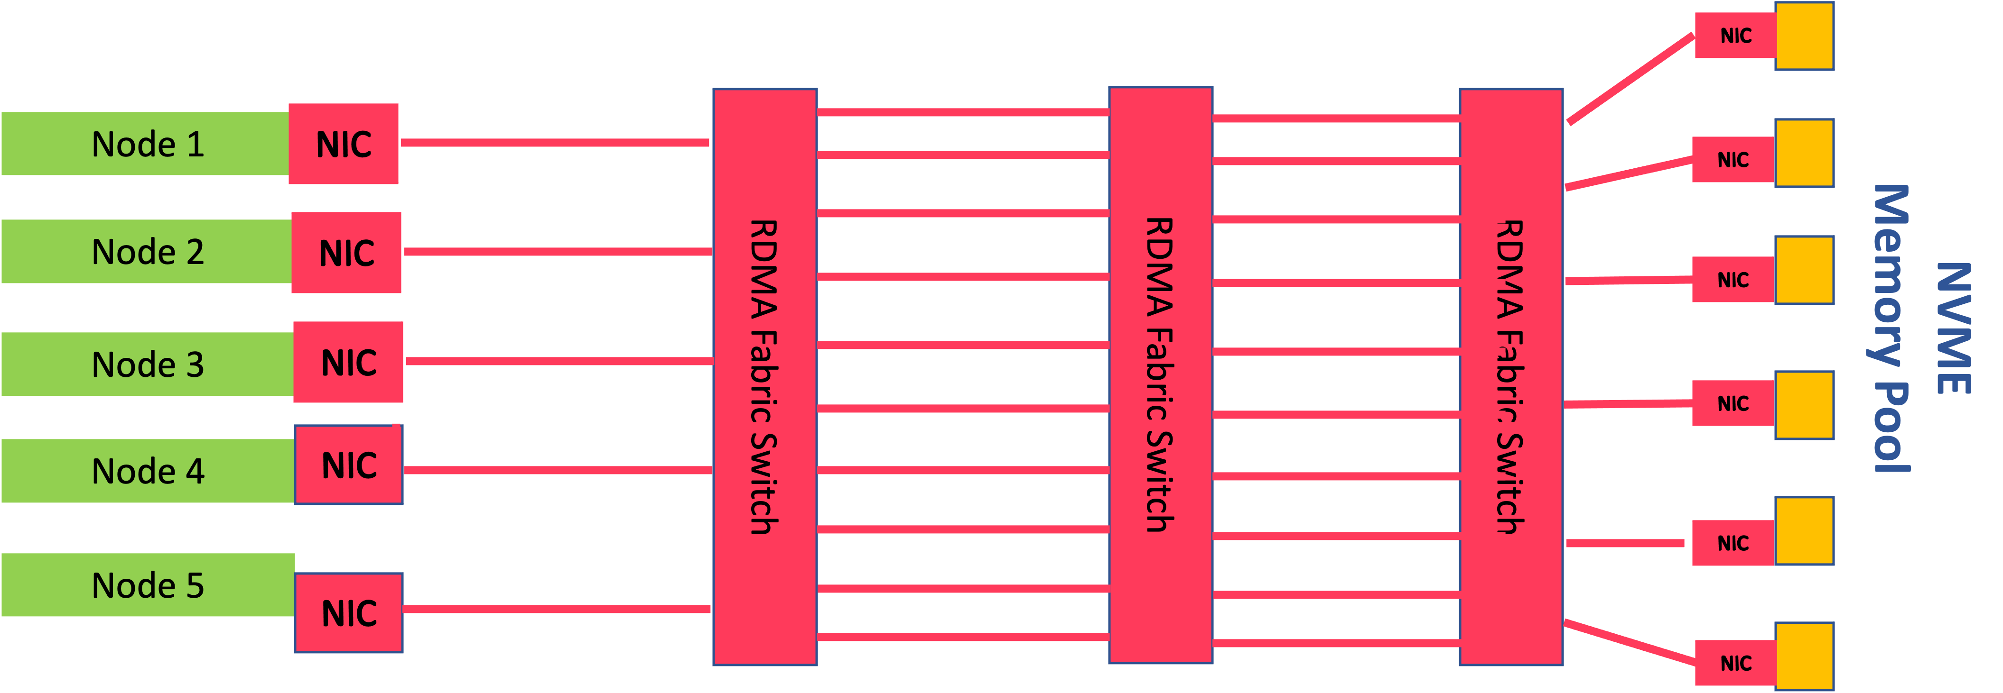
Example of NVMeoF over and RDMA fabric

Slide 24
What’s Next for OFMF Development
We are adding Events as a way to provide notifications of changes to the HPC systems
Events happen when a Hardware Agent provides details about network fabrics that are detected, hardware changes, etc. The events get propagated to the OFMF and to clients.
Redfish Mock-ups for CXL, GenZ, RDMA, Slingshot
OFMF Redfish Tree clean-up and Stranded Resource notifications
Further development of the Reference Fabric Agent framework
Reference Composabilty Manager framework
Reference Fabric Attached Memory framework
Reference Monitoring framework
OS SUPPORT FOR DYNAMIC ADDITION AND DELETION OF RESOURCES
Fish name–Sunfish?
Evangelization of the OFMF to the industry

Slide 25
Questions?

