Slide 2
Agent Framework
Resource Control Operations
(e.g., Compute, FAM, Storage Fabric)
Resource Graph Representation
(e.g., Compute, FAM, Storage Fabric)
Graph Reference Database
Resource Events
Composition Policies
Graph Reference Database
Authorization Block
Graph Reference Database Entry

Slide 3
Sunfish Services
Resource Inventory
Gather Inventory
Hardware Specific
Manager
Get Route
Redfish/Swordfish
Tree Management
Set Route
Hardware Specific
Manager
Resource Configuration
Transactions
Add Resource
Fabric Configuration
Message Queue
RESTful API (RF/SF)
Set Route
Authentication
Data
Get Configuration
Access Control
Subscribe to Events
Events & Logs
Events
Redfish/Swordfish
Authenticate to Devices

Slide 4
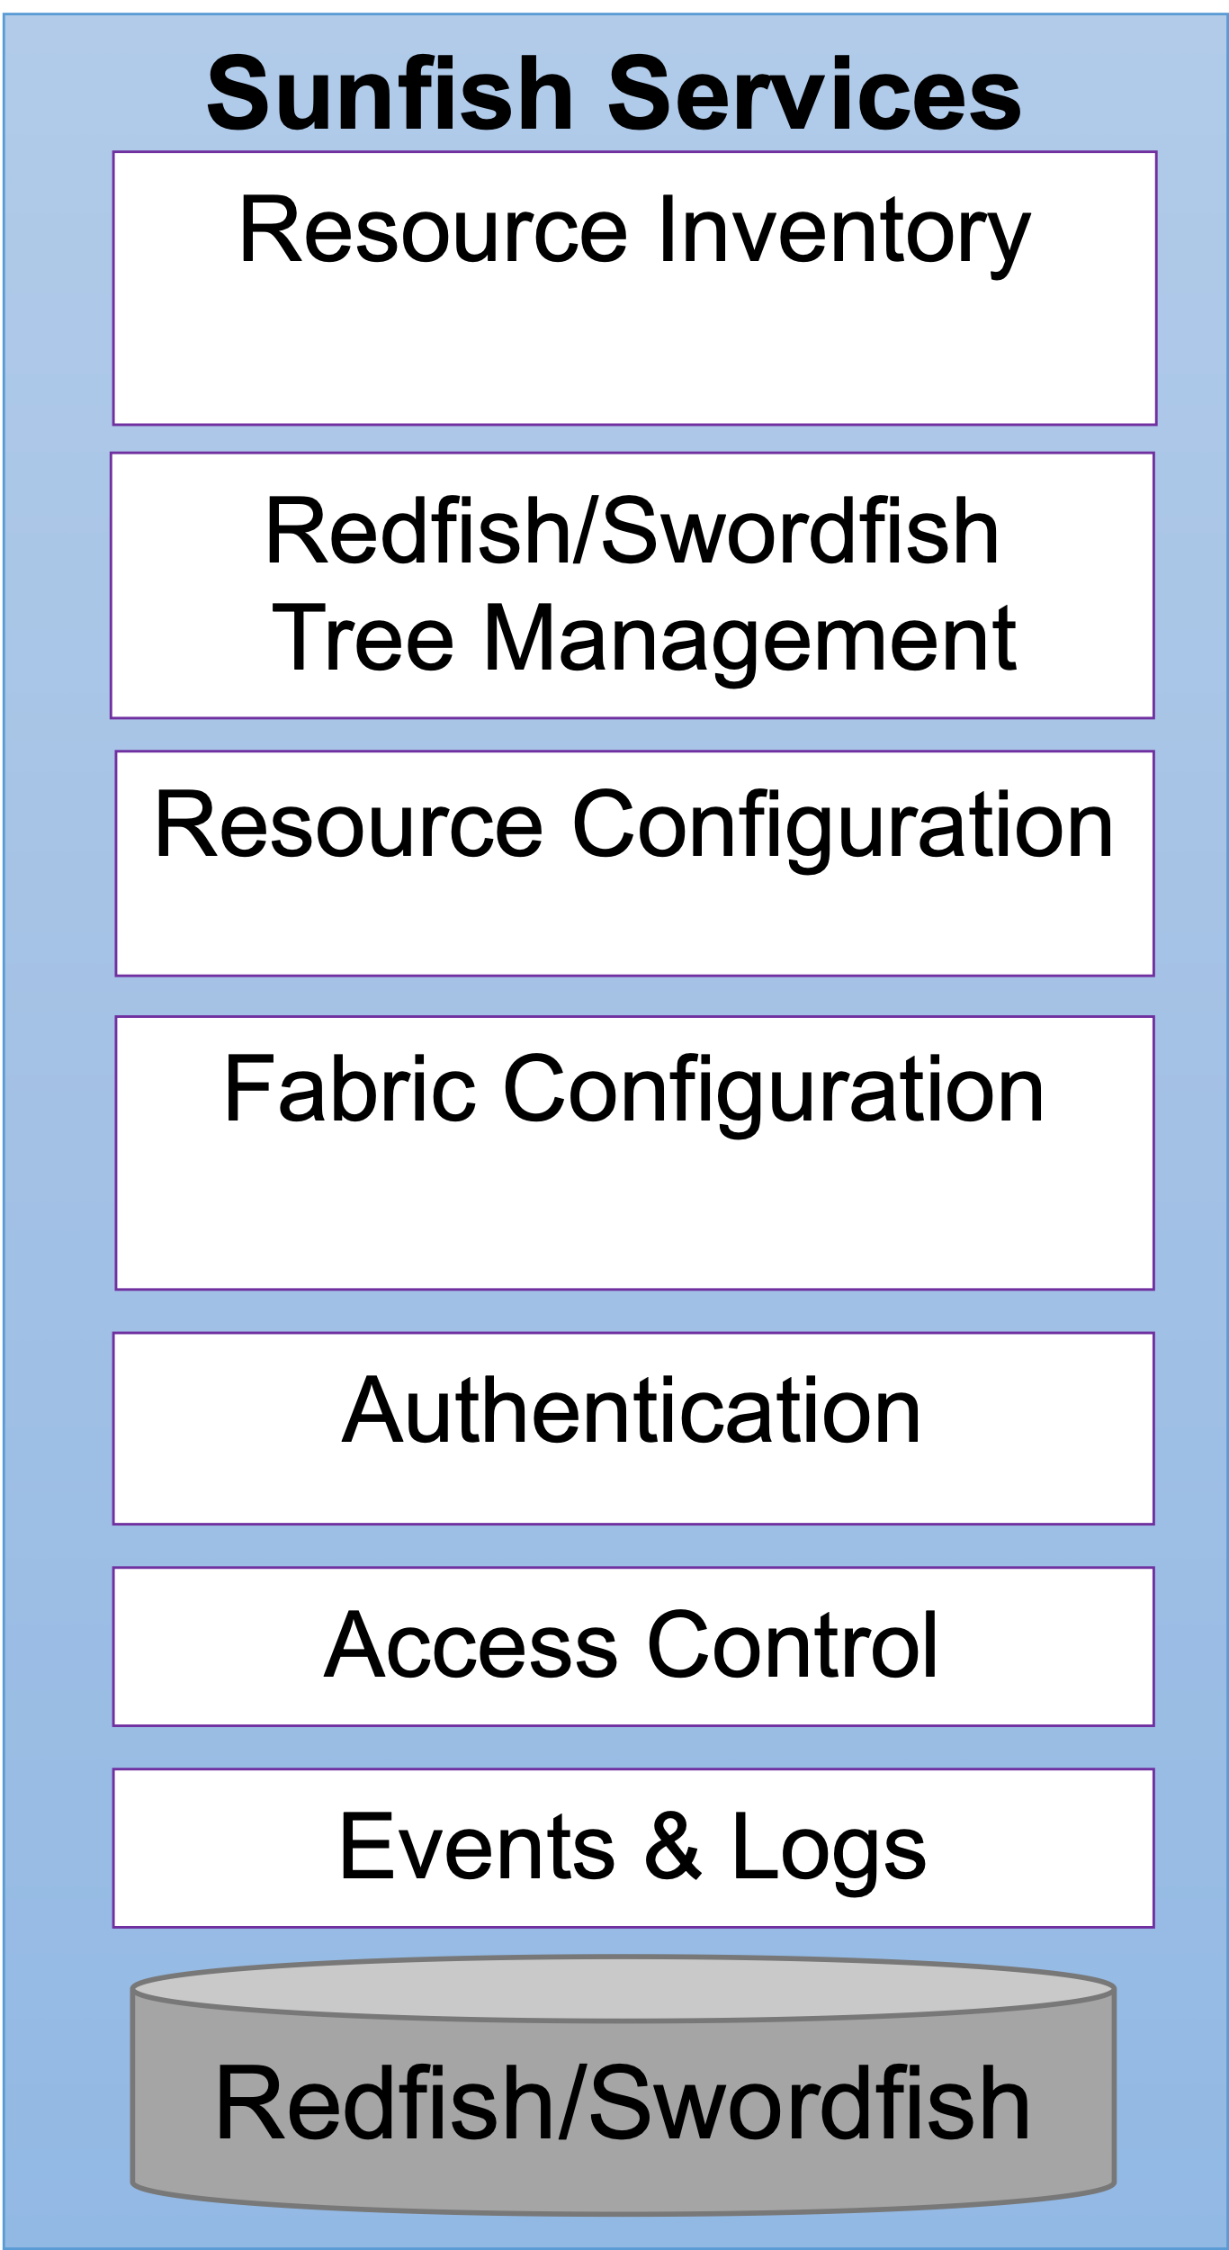
Agent Operations
Query Inventory
Get Configuration
List Available Events
Get Current Time
Get Route
Record current Device State
Register for Events
Check for Device State Change
Restful API (RF/SF)
Message Queue
Set Route
Authenticate to Device Manager
Report Resource Issue
Gather Device –Specific Features
Add Resource
Get Change from Device Manager
Report New Resource
Gather Resource Connection Attachments
Set Route
Authenticate to Sunfish
Report Deleted Resource
Gather Error Logs
Associate Name with Device
Get Route
Send Event
Gather Hardware Acceleration Tree
Display the Links

