Slide 1
Agent – Sunfish Registration
Russ Herrell
OFA Sunfish WorkGroup
04/11/25

Slide 2
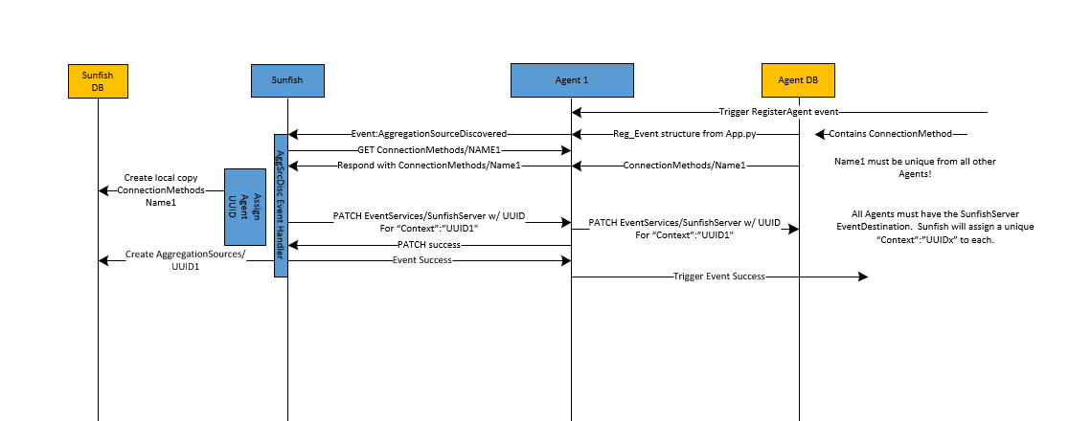
The Agent – Sunfish Registration Flow
© OpenFabrics Alliance 2025
²
Notes:
“Here is a pictorial view of the Redfish model which Sunfish has uploaded from the CXL agent.
This Redfish bubble diagram contains all the major Redfish objects of the demo topology, but only about 1/2 of all the links.
This diagram shows the physical port connections that detail the physical topology (think cables between Ports), which we can generally ignore when working with the logical resources like hosts and FAM
Sunfish utilities and Composition services will provide examples of how to hide this complexity and present users a higher level abstracted view of basic fabric resources”

Slide 3
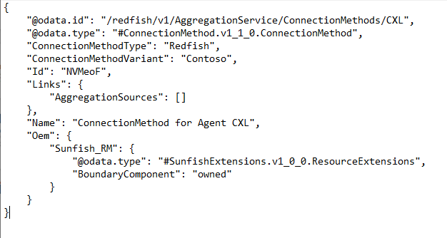
The Agent – Sunfish Registration Files: ConnectionMethod
Connection Method Object
Required on Agent.
Will be uploaded to Sunfish.
ConnectionMethods/NAME
NAME and ID of ConnectionMethod must be unique, so Sunfish can upload one from each Agent.
This NAME has nothing to do with the fabric name, so CXL is a poor example.
Sunfish needs to append the Aggregation Source Navigation Link object to the Sunfish copy
“@odata.id”: “../UUID1
Sunfish OEM.Sunfish_RM property may or may not exist depending upon Agent implementation
© OpenFabrics Alliance 2025
³
Notes:
“Here is a pictorial view of the Redfish model which Sunfish has uploaded from the CXL agent.
This Redfish bubble diagram contains all the major Redfish objects of the demo topology, but only about 1/2 of all the links.
This diagram shows the physical port connections that detail the physical topology (think cables between Ports), which we can generally ignore when working with the logical resources like hosts and FAM
Sunfish utilities and Composition services will provide examples of how to hide this complexity and present users a higher level abstracted view of basic fabric resources”

Slide 4
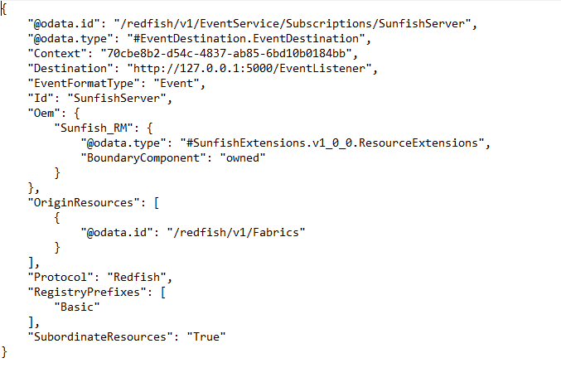
The Agent – Sunfish Registration Files: EventDestination (Subscriber description)
EventDestination Object
Required Pre-loaded on Agent.
(Pretend Sunfish has already subscribed to Agent).
MUST be Named “SunfishServer”
“Context” value should start as “”.
Sunfish will PATCH this object with a valid, unique UUID formatted UUIDx when it creates the Sunfish ../AggregationService/
AggregationSources/UUIDx object
© OpenFabrics Alliance 2025
⁴
Notes:
“Here is a pictorial view of the Redfish model which Sunfish has uploaded from the CXL agent.
This Redfish bubble diagram contains all the major Redfish objects of the demo topology, but only about 1/2 of all the links.
This diagram shows the physical port connections that detail the physical topology (think cables between Ports), which we can generally ignore when working with the logical resources like hosts and FAM
Sunfish utilities and Composition services will provide examples of how to hide this complexity and present users a higher level abstracted view of basic fabric resources”

Slide 5
The Agent – Sunfish Registration Files: AggregationSource object
AggregationSource object created by Sunfish for Sunfish database.
Sunfish assigns each Agent a unique UUID when it registers
HostName is URL of Agent’s Redfish API to be used by Sunfish
ID of this AggregationSource (IE, Agent) is used as the “Context” in the EventDestination on the Agent. Sunfish will PATCH the ../EventService/Subscriptions/
SunfishServer object’s
“Context” property
Sunfish needs to append the navigation links of all resources uploaded from this AggregationSource (IE, Agent)
© OpenFabrics Alliance 2025
⁵
Notes:
“Here is a pictorial view of the Redfish model which Sunfish has uploaded from the CXL agent.
This Redfish bubble diagram contains all the major Redfish objects of the demo topology, but only about 1/2 of all the links.
This diagram shows the physical port connections that detail the physical topology (think cables between Ports), which we can generally ignore when working with the logical resources like hosts and FAM
Sunfish utilities and Composition services will provide examples of how to hide this complexity and present users a higher level abstracted view of basic fabric resources”

Slide 6
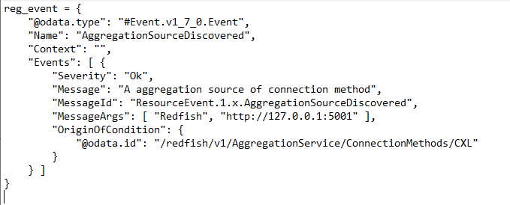
The Agent – Sunfish Registration Files: Registration Event
Event object to be sent to Sunfish from Agent is currently hardcoded in the Agent’s App.py program!
One Event description in Events list.
Sunfish supposedly handles more than one Event in the list
AggregationSourceDiscovered
MessageId is decoded by Sunfish Even Handler
2nd ARG is URL of Agent’s API which Sunfish is to use to converse with Agent. This gets plugged into the Sunfish AggregationSource object
Sunfish needs to query the Agent for this ConnectionMethod to associate with the Agent.
Sunfish will create a local copy of each ConnectionMethod, so these NAMEs need to unique on each Agent.
© OpenFabrics Alliance 2025
⁶
Notes:
“Here is a pictorial view of the Redfish model which Sunfish has uploaded from the CXL agent.
This Redfish bubble diagram contains all the major Redfish objects of the demo topology, but only about 1/2 of all the links.
This diagram shows the physical port connections that detail the physical topology (think cables between Ports), which we can generally ignore when working with the logical resources like hosts and FAM
Sunfish utilities and Composition services will provide examples of how to hide this complexity and present users a higher level abstracted view of basic fabric resources”

Slide 7
Simplified Redfish Model of a Single CXL 3.1 MLD
Root
Chassis
PooledCXL
Memory
PCIe
Devices
1
CXL_
System1
Systems
Fabric
Adapters
1
CXL_
System2
Fabrics
1
Memory
Domains
CXL
1
Zones
Connections
Processors
Switches
1
Processors
CXL2
CXL
LDs
1
1
2
1
Memory
Chunks
2
3
4
I2
T1
endpoints
vT1_1
Ports
I1
Ports
vT1_2
1
1
Ports
1 MLD with 2 LogicalDevices
Each of these LogicalDevices may be mapped to a single host
Done with Zones and Connections not yet shown
Each LogicalDevice is allocated a mix of private and shared MemoryChunks (Red links show the shared MemoryChunk
Redfish Clients can’t tell if the MLD is real or emulated.
D1
1
U1
Ports
D2
U2
D3
D5
D4
⁷
© OpenFabrics Alliance 2023
Notes:
“Here is a pictorial view of the Redfish model which Sunfish has uploaded from the CXL agent.
This Redfish bubble diagram contains all the major Redfish objects of the demo topology, but only about 1/2 of all the links.
This diagram shows the physical port connections that detail the physical topology (think cables between Ports), which we can generally ignore when working with the logical resources like hosts and FAM
Sunfish utilities and Composition services will provide examples of how to hide this complexity and present users a higher level abstracted view of basic fabric resources”

Slide 8
Simplified Redfish Model of a Single CXL 3.1 MLD
Root
Chassis
PooledCXL
Memory
PCIe
Devices
1
CXL_
System1
Systems
Fabric
Adapters
1
CXL_
System2
Fabrics
1
Memory
Domains
CXL
1
Zones
Connections
Z1
Not shown: The MemoryRegions and the Extents collections under each LD
Processors
Switches
C1
1
Processors
CXL2
CXL
LDs
1
1
2
1
Memory
Chunks
2
3
4
I2
T1
endpoints
vT1_1
Ports
I1
Ports
vT1_2
1
MemoryChunks 1,2,3 and 4 are created and allocated to LDs 1 and 2 per the diagram (the navigation links from MemoryChunks to the LDs, and other Redfish objects not shown are required)
Hardware manager would use these details to issue any Initiate Dynamic Capacity Add Requests to the MLD
Zone Z1 specifies Initiator endpoint I2 has vT1_1 (LD1) in its virtual hierarchy
Hardware manager would use these details to issue the vPPB bind command to switch CXL2
Connection C1 specifies I2 has a connection to LD1 and MemoryChunks 1, 3, and 4
1
Ports
D1
1
U1
Ports
D2
U2
D3
D5
D4
⁸
© OpenFabrics Alliance 2023
Notes:
“Here is a pictorial view of the Redfish model which Sunfish has uploaded from the CXL agent.
This Redfish bubble diagram contains all the major Redfish objects of the demo topology, but only about 1/2 of all the links.
This diagram shows the physical port connections that detail the physical topology (think cables between Ports), which we can generally ignore when working with the logical resources like hosts and FAM
Sunfish utilities and Composition services will provide examples of how to hide this complexity and present users a higher level abstracted view of basic fabric resources”

