Slide 1
Sunfish
SC24 Sunfish Birds of a Feather
SAND2024-15345C

Slide 2
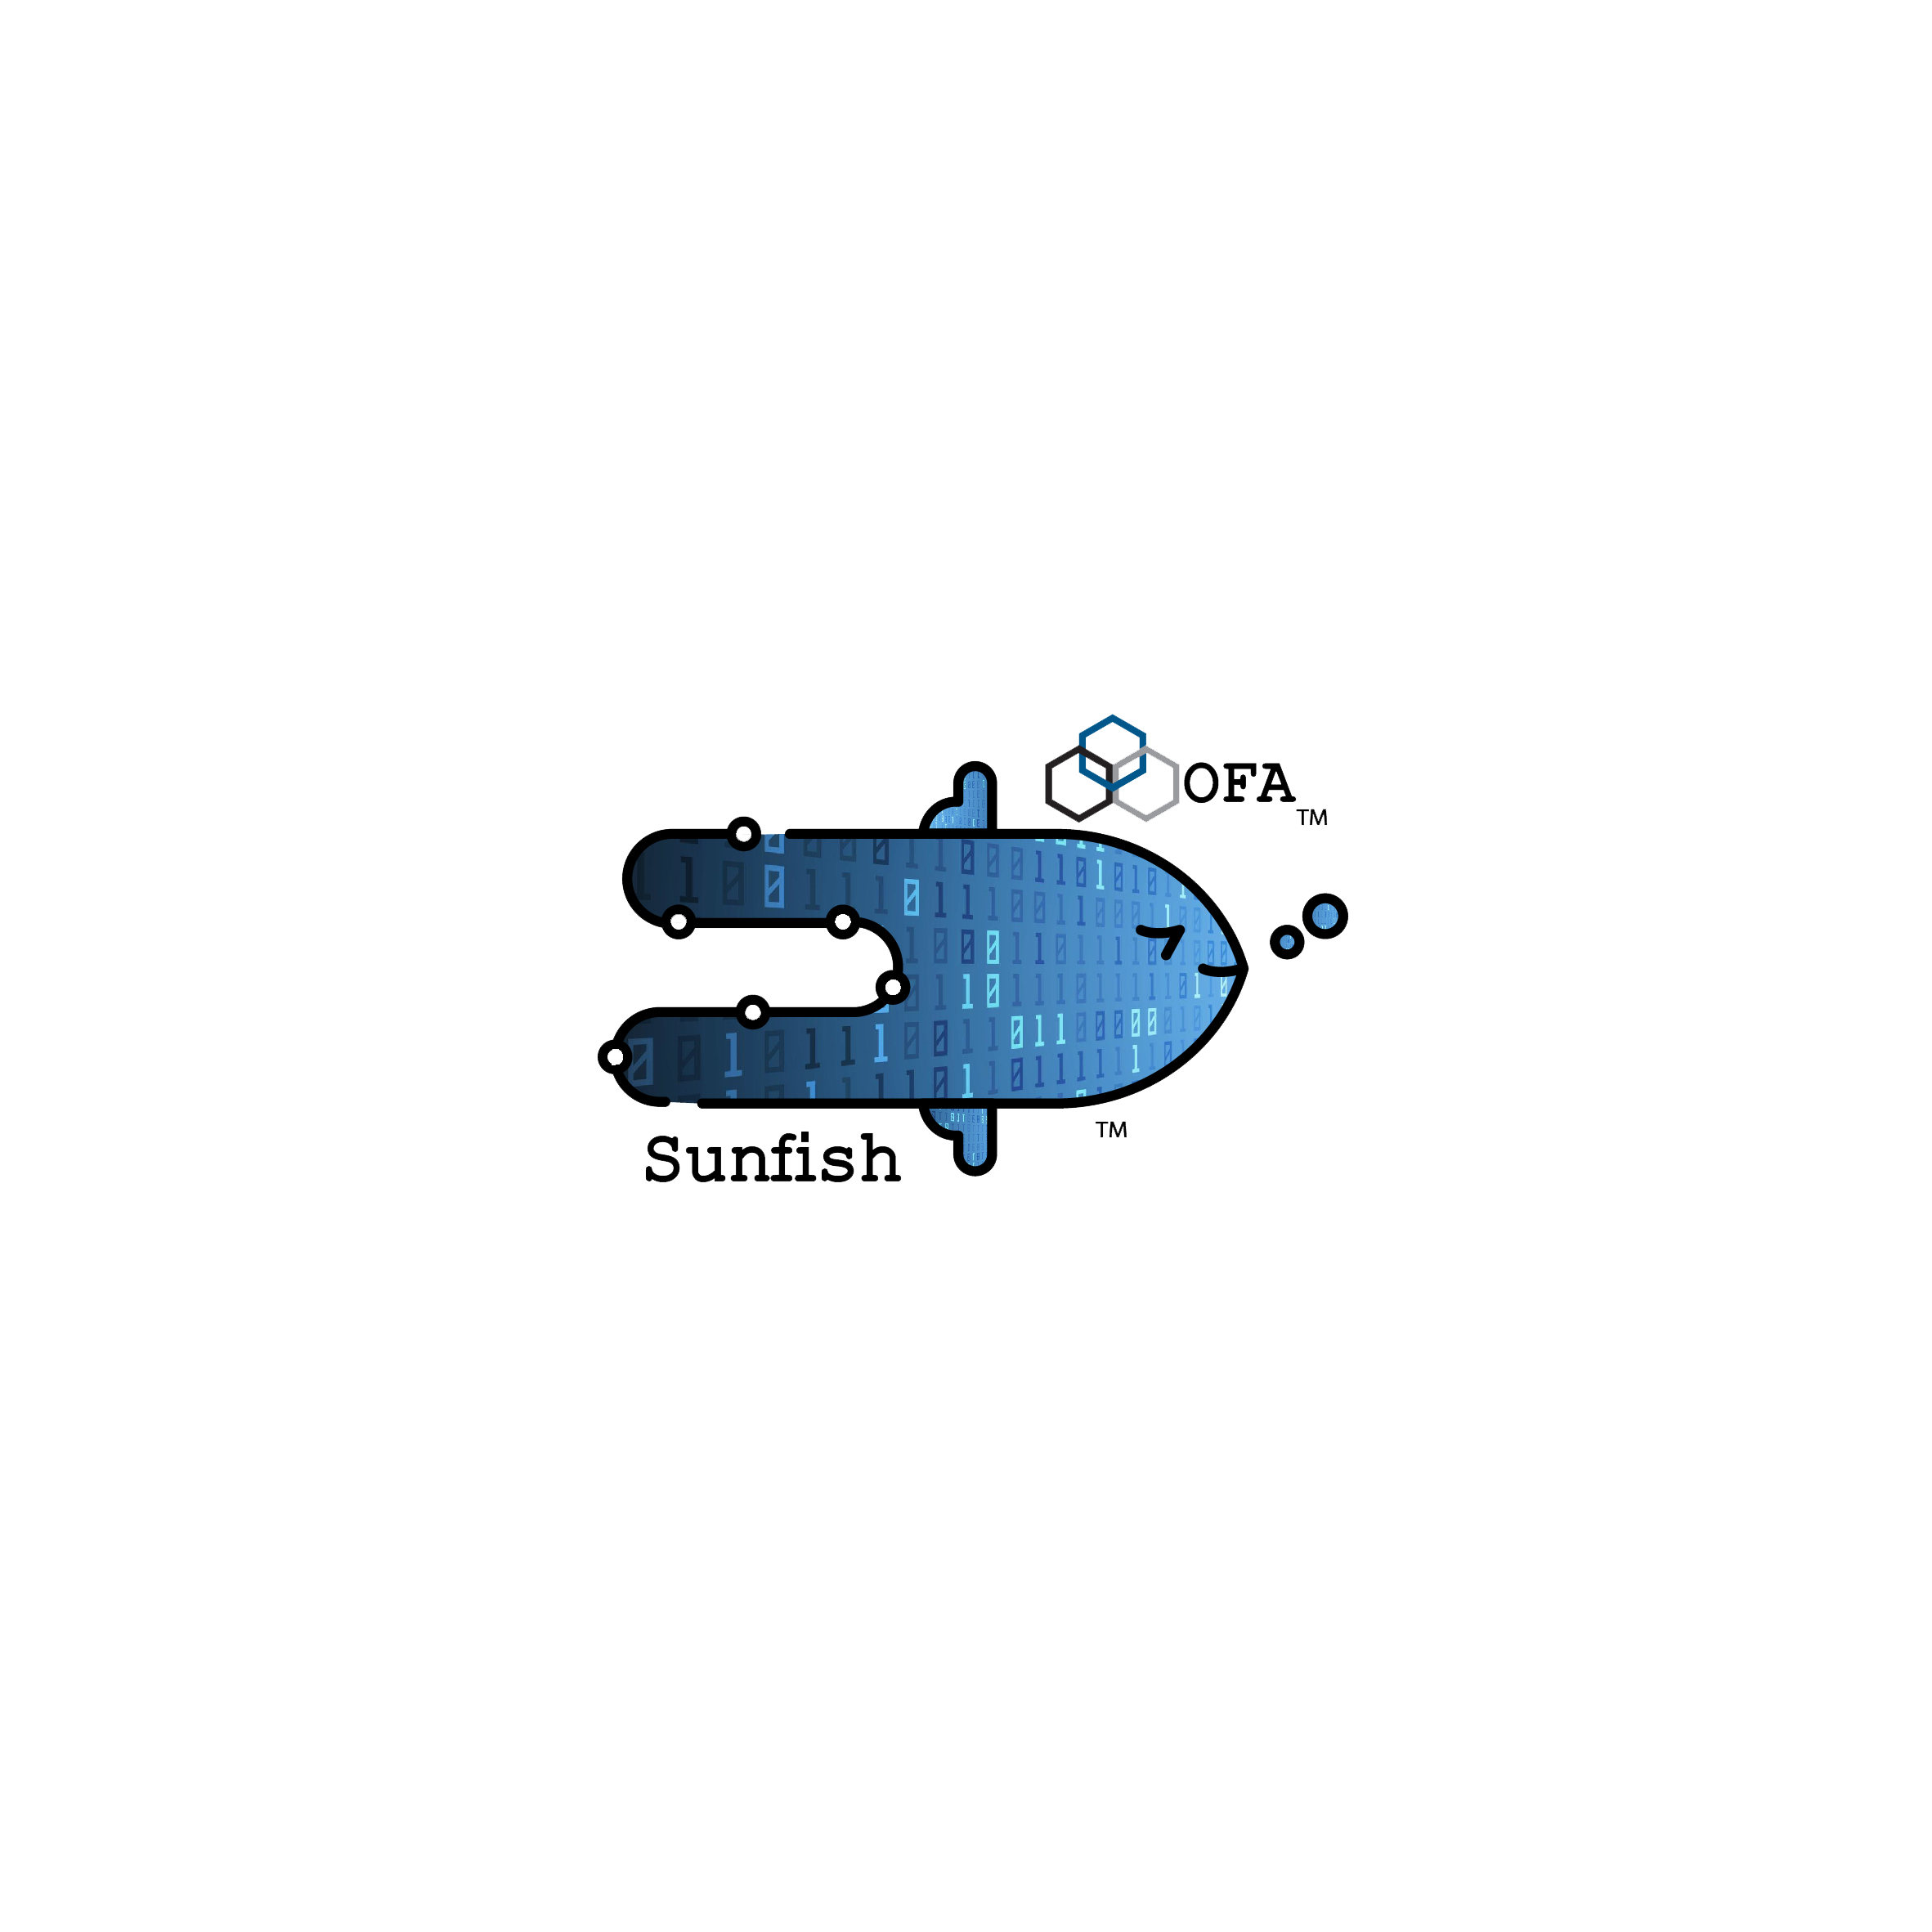
Sunfish
Overview and Introduction of Sunfish (Michael Aguilar, Sandia)
H3 Presentation of CXL Sunfish Agents (Brian Pan, H3)
Flux/Sunfish (Nathan Hanford, LLNL)
Discussion
Notes:
Welcome to the Sunfish BoF session. My name is Michael Aguilar and I am a Co-Chair for the OpenFabrics Management Framework Working Group. I will be providing you with a quick overview of Sunfish and then I will be introducing Brian Pan of H3 Platform who will be demonstrating their implementationof NVMe over CXL using Sunfish to manage compute node aggregation. Nathan Hanford will be discussing the integration of Sunfish with Flux to provide direct HPC resource allocation.

Slide 3
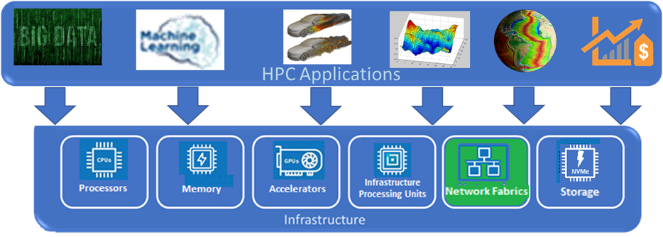
Composable disaggregated resources
Composable Disaggregated Resources:
Can potentially reduce capital expenditures and operating expenses
Feed the beast’ in terms of workload (e.g., AI, HPC) data requirements
Composable Disaggregated Infrastructure (CDI)
Computational resources are physically separated over high-speed/low-latency fabrics
Computational resources are dynamically composable, as needed, into a computer system
Composable HPC and Enterprise Computing Systems:
Enable efficient usage of available hardware resources by provisioning it where it is needed
Mitigate the need for hardware overprovisioning
Reduce electricity consumption and cooling costs
4% of the World’s Energy Consumption is input into Datacenters
(https://www.energy.gov/eere/buildings/data-centers-and-servers)
Notes:
Current HPCs are designed to provide node allocation, not resource allocation. For fully populated compute nodes, this can lead to ‘resource stranding’, or unused resources within the HPC system. In the current approach, you are still paying for energy and cooling. In fact, a vendor that I met with was proposing measuring the amount of unused resources in each batch run, as part of their new tooling. A better approach would be to be able to allocate resources from resource pools to each batch job running on the cluster.

Slide 4
Management of disaggregated resources
Sunfish Services
Resource Inventory
GPU
RF tree management
Resource Configuration
HCA
NVMe
Fabric Configuration
GPU
FPGA
NVMe
Authentication
Access Control
Events & Logs
DRAM
DRAM
CPU
DRAM
Redfish Tree
Notes:
In an HPC, at scale, there are a very large quantity of resources and it’s necessary to be able to ‘wrangle’ them. That’s why we are creating Sunfish. Sunfish is a framework that provides both Redfish, as a central database, and tools.

Slide 5
Sunfish
Comprehend dynamic hardware resources – event driven updating of available resources
Dynamically reserve resources and release allocated resources
Management Layer
Hardware Layer
Sunfish Services
Resource Inventory
CXL Manager
RF tree management
CXL
Agent
Resource Configuration
Fabric Configuration
Fabric Manager
Authentication
Access Control
SAN
Agent
Events & Logs
Appliance Manager
Redfish Tree
RedFish
Vendor Native API

Slide 6
Sunfish
Sunfish enables optimized resource/workload placement
The Sunfish Composability Manager provides Application Domain Clients with Deep-Learning Resource Aggregation Optimization, a Graph Database for informational queries, and can reduce the amount of traffic to the Sunfish Core services.
Resource Control Operations
(e.g., Compute, FAM, Storage Fabric)
Redfish/Swordfish
Sunfish Services
Resource Graph Representation
(e.g., Compute, FAM, Storage Fabric
Resource Inventory
Graph Reference Database
Transactions
RF tree management
Resource Configuration
Resource Events
RESTful API (RF/SF)
Message Queue
Fabric Configuration
Evaluate Client Requirements
Data
Authentication
Access Control
Composition Policies
Events & Logs
Graph Reference Database
Redfish Tree
Events
Authorization Block
Graph Reference Database Entry

Slide 7
H3 Platforms/Sunfish Presentation
Brian Pan from H3 Platform

Slide 8
Flux/Sunfish Presentation
Clients
Management Layer
Virtual Cluster Managers
Flux
API
Integration
Module
CDI Composition Interface
Redfish/Swordfish
Resource Control Operations
Sunfish Services
Resource Inventory
Resource Graph Representation
Message Queue
RF Tree Management
Resource Events
Resource Configuration
RESTful API (RF/SF)
Events
Data
Transactions
Fabric Configuration
Evaluate Client Requirements
Authentication
Composition Policies
Access Control
Authorization Block
Events and Logs
Nathan Hanford from Lawrence-Livermore National Lab
DB Entry
Redfish Tree
Graph Reference Database
8

Slide 9
Sunfish status, next steps, and discussion
Soliciting new use cases and hardware
Started working on the Flux client side integration
New endpoint models
New workflows
Exploring reference architecture for client-side resource managers
Developing a reference CXL Agent and associated utilities
Integrating SNIA Swordfish as an NVMe technology Agent
Architecting customization plugin and Redis storage backend
Finalizing documentation for Sunfish version 0.6

