Slide 1
Flux Architecture and Resource Pools
UUR
Broker 3
NVMe
NVMe
Broker 1
Broker 4
NVMe
NVMe
Broker 0
Broker 5
NVMe
NVMe
Broker 2
Broker 6
NVMe
NVMe
Type
UUID (Unique ID for this resource)
Basename
Name
ID (OPTIONAL numeric ID to be appended to basename to get name)
Properties (static properties associated with this instance)
Size (Total number of resources in this pool)
Units (OPTIONAL units associated with the size value)
The concept to describe each identifiable resource is called resource pool. A resource pool is a group of one or more indistinguishable resources of a same kind.
When a resource needs to described at coarse granularity, it can be pooled together with other resources of the same type. Conversely, when finer granularity is required, it can be promoted to its own individual pool.
https://flux-framework.readthedocs.io/projects/flux-rfc/en/latest/spec_4.html
UUR

Slide 2
Flux Resource Data Model

Slide 3
NVMeoF/Sunfish Architecture
NVMe1(n1)
NVMe2(n2,n3)
NVMe0
n1,n2,n3
NVMeoF
Agent
Flux Broker 0
Sunfish Services
NVMe0
n1,n2,n3,n4
Resource Inventory
NVMe1(n2,n3)
NVMe2(n1,n4)
RF tree management
Resource Configuration
NVMe1(n1,n3)
NVMe2(n2,n3)
NVMe0
n1,n2,n3,n4
Fabric Configuration
Data Store
Flux Broker 0
Authentication
NVMe1(n1)
NVMe2(n1)
NVMe1
n1
Access Control
Events & Logs
NVMe1(n1,n2)
NVMe2(n3,n4)
NVMe0
n1,n2,n3,n4

Slide 4
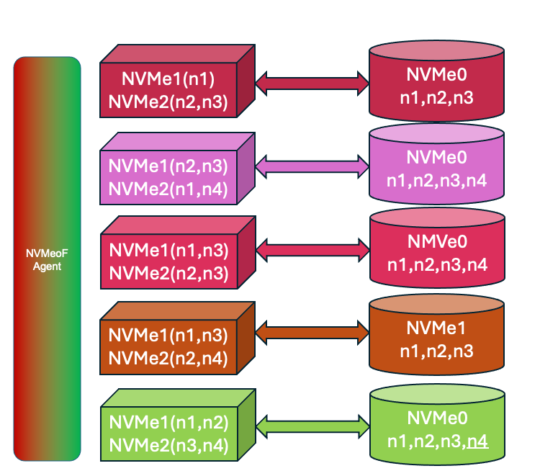
Flux Architecture and Resource Pools
UUR
Sunfish Services
Resource Inventory
Redfish Layer
Hardware Layer
RF tree management
Resource Configuration
Slingshot
Agent
Slingshot FM
Fabric Configuration
Authentication
Data Store
Access Control
Events & Logs
Broker 1
(Compute)
Events, Data, Transactions between Flux and Sunfish
Broker 2
Broker 5
(Compute)
Flux
Broker 0
Broker 3
(Compute)
Broker 4
(Compute)
NVMeoF Agent does a periodic discovery of NVMeoF namespaces and updates Sunfish
Flux Brokers use Prolog/Epilog for Resource aggregation, Resource Release, data ingress/egress.
UUR

Slide 5
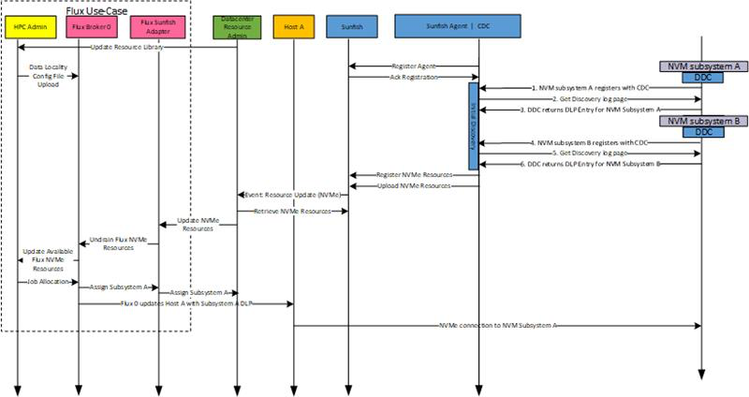
Flux/Sunfish/NVMe-oF Timing Diagram

Slide 6
Flux Architecture and Resource Pools NVMeoF
Broker 1
(Compute)
On Board Resources from lstopo
Cabinet
Is a part of
Contains
Flux
Broker 0
(Admin)
On Board Resources from lstopo
Broker

Slide 7
Flux Architecture and Resource Pools NVMeoF
Broker 1
(Compute)
On Board Resources from lstopo
Cabinet
Is a part of
Contains
Flux
Broker 0
(Admin)
On Board Resources from lstopo
NVMeoF EndpointX

Slide 8
Flux Architecture and Resource Pools NVMeoF
Redfish
Sunfish Services
Resource Inventory
v1
RF tree management
Resource Configuration
Fabric Configuration
Chassis
Managers
Session
Service
Authentication
Data Store
Systems
Account
Service
Storage
Fabrics
Access Control
Events & Logs
NVMeoF
ContainerX
ChassisX
Sessions
NIC card interface
NVMeoFX
NVMeoF
K8s Deployment
In Chassis X
Flux
Broker 0
(Admin)
NVMe0
n1
NVMe0
nX
On Board Resources from lstopo
Endpoints
EndpointGroups
Connections
https://redfish.dmtf.org/schemas/DSP2046_2022.2.html#aggregationservice-101

Slide 9
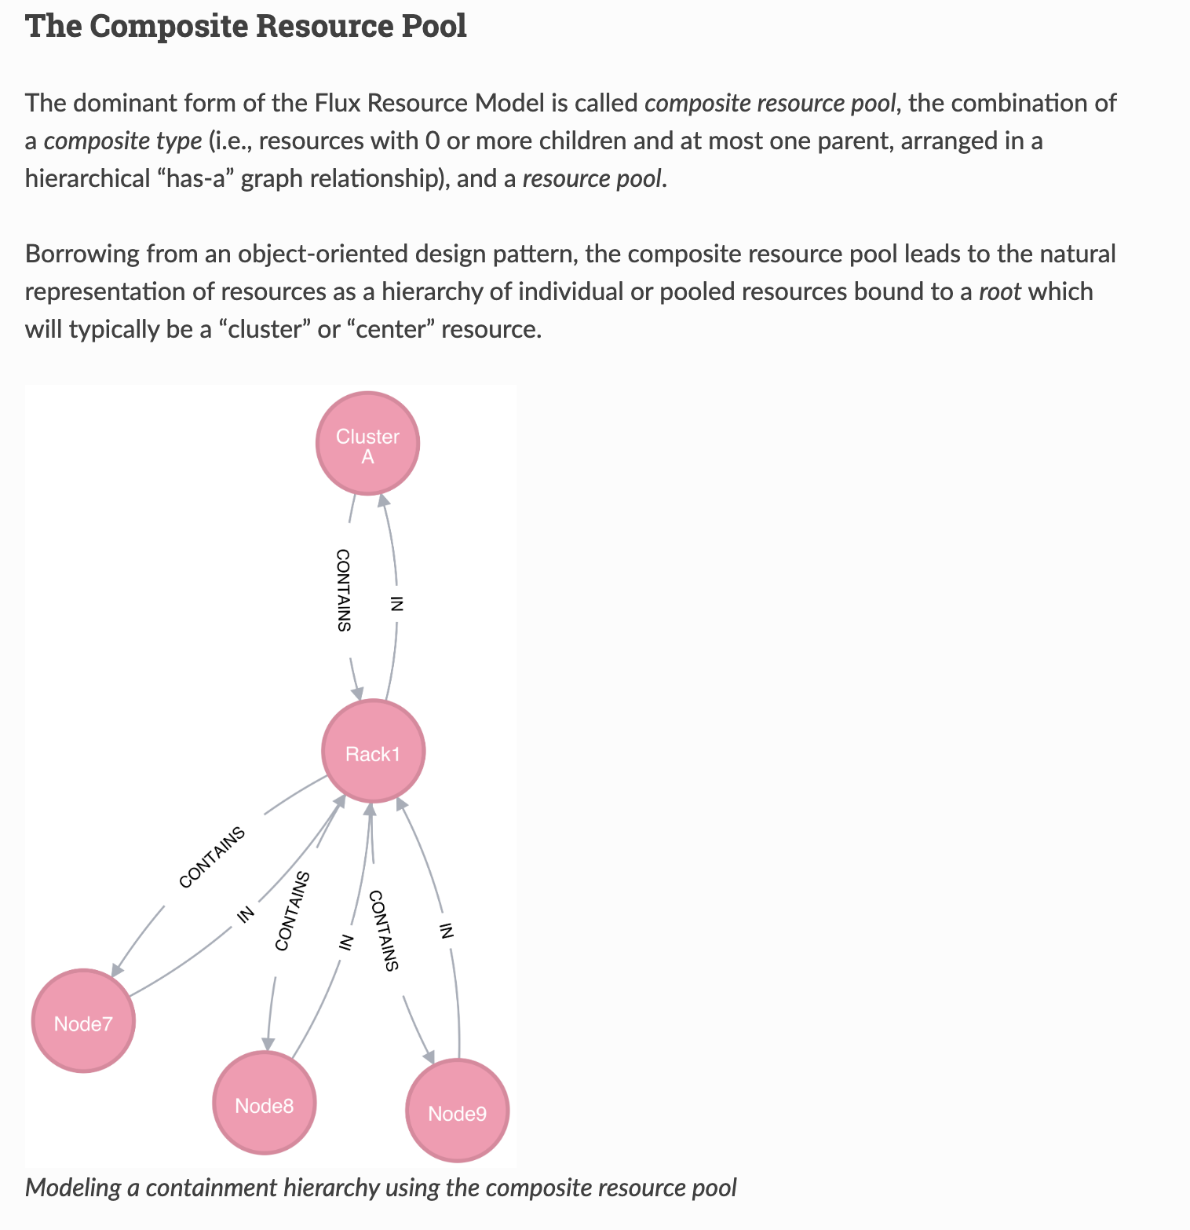
Flux Composite Resource Model

Slide 10
Agent
NVMeoF Central Discovery Agent
Sunfish that is geared only to NVMeoF endpoints
Any and all available endpoints of NVMeoF
Aggregated components of each NVMe drive and container endpoints
Namespaces
IP addresses
How to access the drive namespaces-NqN (blake14)
Address of the port that you need to connect to
nvme connect -t rdma -n <endpoint dns name> -a <IPoIB address> -s 4420
Multi-tenant restrictions

Slide 11
Sunfish Agent Discovery and Handoff Walk-Through
Assumption is that all of the NVMeoF are up and running—Container start-up
Sunfish Agent acts as a Centralized Discovery Controller
It is querying the NVMeoF endpoints
It learns and fills logs:
How to access the drive namespaces-NqN (blake14)
Address of the port that you need to connect to
nvme connect -t rdma -n <DNS name> -a xxx.xxx.xxx.xxx -s 4420
Multi-tenant restrictions
Send events

Slide 12
Sunfish NVMeoF Agent
sudo nvme discover -t TRANSPORT -a DISCOVERY_CONTROLLER_ADDRESS -s SERVICE_ID
sudo nvme discover -t tcp -a <ip address> -s 4420
nvme discover --transport=tcp --host-traddr=<ip address> --trsvcid=8009
Replace TRANSPORT with the underlying transport medium: loop, rdma, tcp, or fc. Replace DISCOVERY_CONTROLLER_ADDRESS with the address of the discovery controller. For RDMA and TCP, this should be an IPv4 address. Replace SERVICE_ID with the transport service ID. If the service is IP based, like RDMA or TCP, service ID specifies the port number. For Fibre Channel, the service ID is not required. https://manpages.debian.org/testing/nvme-cli/nvme-discover.1.en.html#:~:text=The%20NVMe-over-Fabrics%20specification%20defines%20the%20concept%20of%20a,which%20it%20can%20connect%20to%20on%20the%20network.
The NVMe hosts only see the subsystems they are allowed to connect to.
nvme list-subsysPrints the layout of the multipath devices. multipath -ll

Slide 13
Client
dnf install nvme-cli
modprobe nvmet-rdma
modprobe nvmet
modprobe nvme-rdma
lsmod | grep nvme
dnf -y install xfsprogs
nvme discover -t rdma -a <IPoIB address> -s 4420
nvme connect -t rdma -n <DNS name> -a <IPoIB address> -s 4420
lsblk
dmesg
nvme list
nvme disconnect -n <DNS name>

Slide 14
Target
dnf install nvme-cli
modprobe nvmet
modprobe nvmet-rdma
modprobe nvme-rdma
lsmod | grep nvme
mkdir /sys/kernel/config/nvmet/subsystems/<DNS name>
cd /sys/kernel/config/nvmet/subsystems/<DNS name>
echo 1 > attr_allow_any_host
mkdir namespaces/10
cd namespaces/10/
nvme list
echo -n /dev/nvme1n1 > device_path
echo 1 > enable
mkdir /sys/kernel/config/nvmet/ports/1
pushd /sys/kernel/config/nvmet/ports/1
ip addr show
echo <IPoIB address> > addr_traddr. ; # IPADDR address for ib0
echo rdma > addr_trtype
echo 4420 > addr_trsvcid
echo ipv4 > addr_adrfam
ln -s /sys/kernel/config/nvmet/subsystems/<DNS name> /sys/kernel/config/nvmet/ports/1/subsystems/<DNS name>
dmesg | grep "enabling port"
exit

Slide 15
Assumptions
Starting at time 0
Static endpoints
Static NVMeoF resources
All endpoints are already online
Fabric endpoints have an IP address
Flux Brokers have static endpoints
included in the /etc/flux/resource
folder---they stay drained, initially
Sunfish NVMeoF Agent
Sunfish Library
Sunfish Agent Server
Read the Configuration file for endpoints
For each available endpoint, then
retrieve Discover Log Page and register for keep alive timeout
Populate the Redfish Registry
Register Agent with Sunfish Server
For all endpoints {
Crawl through endpoint registry
Send event to Sunfish Server
Push discovery log page }

Slide 16
Sunfish NVMeoF Agent
Keep alive from each endpoint
If keep alive is missing for endpoint {
Update registry,
Send Event to Sunfish server,
Update Sunfish server}
Assumptions
Agents periodically poll endpoints

Slide 17
Assumptions
Resources in Flux Broker 0 are
listed as name-jbod,
name-host-jbod, name-endpoint
Resources remain drained in Flux
until Sunfish signals that the
resources are active
HPC headnode can turn on
resources via Redfish commands
Communication between Sunfish Server and Flux Broker 0 is done via Events and JSON.
Sunfish Server
Sunfish Server registers with Flux Broker 0
Sunfish Server populates Flux Broker 0 dynamic resource list
Flux NVMeoF resources are listed as Active is Sunfish has the resource available
Flux NVMeoF resources are drained, initially
Flux Broker 0 handles the CDI aggregation

Slide 18
https://www.ibm.com/docs/en/storage-ceph/7?topic=target-defining-nvme-subsystem
https://www.ibm.com/docs/en/storage-ceph/7?topic=target-defining-nvme-subsystem

