Slide 1
Flux and Sunfish for Deploying CDI Resources for Ephemeral Burst Buffers
Michael Aguilar, Catherine Appleby
Sandia National Laboratories
Storage Technology Showcase
June 9, 2025
UUR
SAND2025-06753C

Slide 2
Combining Flux, Sunfish and Deep Learning to create an optimized platform for io burst buffers
Agenda
Problem Statement and CDI
Flux
Sunfish
Resource Scheduling with Sunfish
BeeOND Ephemeral Parallel Filesystem
Ephemeral Starfish File Data Asset Management---Data Ingress and Data Egress
Implementation of the BeeOND burst buffer
Questions?
UUR

Slide 3
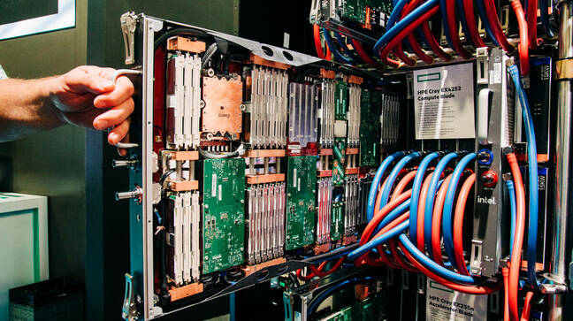
Problem Statement and Cdi
We are wanting to improve granular HPC and Cloud resource utilization, improving batch job throughput, and allow us to create new software-defined HPC and Cloud architectures and applications.
Whenever we leave stranded resources in each node, we are wasting HPC and Cloud system performance . Implementation of Composable Disaggregated Infrastructure (CDI) allows us to share some HPC resources across multiple interactive and batch jobs improving resource utilization and allowing us to create new additional machine features, that we can make use of.
We want to maximize our capital investment in new Cloud and HPC/AI machines, which are being asked to run more diversified workloads. CDI also allows Admins to make software-defined compute platforms for specific batch and interactive jobs.
Workload Manager Integration with CDI Management enables us to:
Allocate dynamic, fast, parallel, and Near-Node filesystems for compute nodes
Manage configuration of high-speed fabrics (e.g. optimize link configuration)
Manage Fabric-Attached Memory (FAM) over CXL and PCIe
Allocate AI/ML accelerators between HPC batch jobs regardless of the high-speed network architecture
UUR

Slide 4
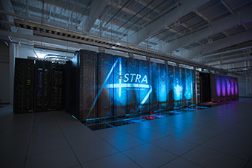
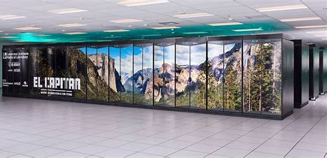
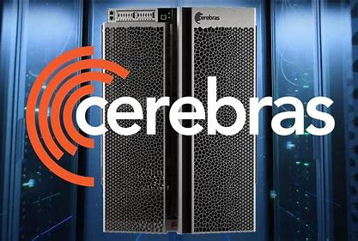
Problem Statement and Cdi
Sandia and LLNL’s new Tri-lab Coral-2 HPC systems feature highly dense designs, with multiple sockets combined to contain many CPU and GPU cores and HBM memory on each socket. To ensure optimal performance, we need to supply I/O data to each of these cores with minimal restrictions.
Using CDI, we can solve the problem of presenting data to socket cores that are starved of data. The proposal is that we are implementing local parallel storage capacity to provide each Workload Manager allocated core with its own NVMeoF burst buffers.
Contention for IO operations from many HPC systems and compute nodes on remote shared parallel filesystems
MGT
OST
Networks
MDT
OST
UUR

Slide 5
Problem Statement and Cdi
By bringing the filesystem closer to the compute node cores, we can achieve lower I/O latency, higher I/O bandwidth, and improved run-time consistency.
We are configuring our compute nodes to function as both parallel I/O servers and clients. These nodes will run batch jobs while simultaneously handling I/O tasks.
UUR

Slide 6
Management of CDI Storage Resources Burst Buffer Use-Case
CDI burst buffers are utilized to provide high-speed storage for next-generation supercomputers.
We leverage CDI to implement software-defined ephemeral parallel filesystems composed of near-node storage.
Very dense packaging means fewer physical nodes and better transit times for on-node CPU->CPU, CPU->GPU, GPU->GPU, CPU->FPGA, and HBM memory transactions
Most HPC/AI system nodes are diskless to reduce energy, cooling, and overall cost
Currently, our HPC systems implement on-node burst buffer I/O storage using RAM disks stealing available memory from potential compute applications.
RAM disk capacity is insufficient for some HPC/AI workload requirements
Burst-buffers are used to provide near-node, high-speed, storage
Bringing run-time IO data closer to the dense packages allows us to ‘feed the beast’.
Burst-buffers of different orientations and stripe-sizes are optimized for different workloads or phases of workloads
Modeling and Simulation codes versus AI/ML training and inference codes
UUR
Notes:
Data preprocessing - raw data ingest and organization e.g., deduplication, privacy/ethical processing to for example remove PII and remove bias, etc, and then written to storage
Data Preparation - loading raw data and identify patterns/outliers/relationships, extract features, convert data types, …
Model Training - load data from storage into memory from storage for training as well as periodic checkpoint saving
Model evaluation, and tuning - tuning, adjusting parameters, etc.
Inferencing information from data - loading model data, business specific data, etc. to solve problems and generate responses and thus business value
long-term archiving of training data

Slide 7
Flux
Current Strengths and Capabilities:
Workload Management for multiple HPC users
Supports Composable Disaggregated Infrastructure (CDI) integration
Graph-based Resource Management for Batch Processing of both HPC and AI Applications
Modular design enables new API features
Support for passing extensive CLI parameters to batch processing
Granular resource monitoring and accounting for each Batch run
Software defined compute nodes for both Batch and CI/CD
RESTful interface using JSON
Event driven
Able to bring in/out resources, from a running HPC system
Current Weaknesses:
Available Resources are furnished from a static file within /etc/flux upon Flux start-up. Flux does not currently comprehend dynamic resources.
Flux can impart Near Node Flash from inside the rack but Flux has no knowledge of optimal remote CDI resource matches
Flux cannot release resources to other concurrent Flux instances or Workload Managers
UUR

Slide 8
Sunfish CDI Management Framework
Sunfish enables CDI management:
Key Benefits:
Releasing stranded resources for increased scalability, immutability, and composability
Energy/cooling efficiency – including power smoothing
Strengths and Capabilities:
Management of hardware resources through hardware-specific Agents
Event driven
Redfish/Swordfish APIs for resource management for reduced administration, and ease-of-use
Redfish-supported multi-tenancy
Aggregates resources from multiple hardware Agents and resolves resource-naming collisions
May be simultaneously integrated with multiple Workload Managers, e.g., Flux and Kubernetes
UUR

Slide 9
Sunfish CDI Management Framework
Sunfish Services
Resource Inventory
GPU
RF tree management
HCA
NVMe
Resource Configuration
Fabric Configuration
GPU
FPGA
NVMe
Authentication
Access Control
Events & Logs
DRAM
DRAM
CPU
DRAM
Redfish Tree
UUR

Slide 10
Integration of Flux with Sunfish
Projected Capabilities
Single open-source framework to be used as an interface for HPC architectural implementations
Batch support for resource sharing from under-utilized compute node resources
Verification of successful CDI aggregation for batch-job runs
Integration of virtual graphical spatial representations of remote physical resources
Dynamic optimized resource scheduling using Deep-Learning algorithms
Built-in support for multitenancy and security for CDI resources within software-derived nodes
Granular accounting of CDI resources for individual batch runs
UUR

Slide 11
Resource scheduling with Sunfish
Problem:
Need to schedule resources and jobs to maximize use, reduce latency and job starvation
Current Approach:
Addressed currently via heuristic or optimization algorithms
Heuristics can be fair
Optimization algorithms have to be highly tailored to specific machines
Temporary Resource Pools
Resources
Intelligent Resource Scheduler (IRS)
J
Job Queue
J
J
J
J
J
© OpenFabrics Alliance
UUR

Slide 12
Scheduling with deep learning
We can represent the problem as a combinatorial optimization problem
How to solve?
Solvers take time, especially with scheduling dynamically as more jobs arrive
Evaluating the objective is usually fast
Deep Learning
Rapidly generate solutions, converge on a good solution
Use the objective function as a loss function
“Learn” from previous solutions, iterate over time
Resource pools = knapsacks
Objective/loss function can take into account:
Run time network congestion
Start-up latency
Any other recorded resource or job characteristic
12
UUR
Notes:
This is a knapsack problem, right now as a temporal multidimensional, multiple knapsack, where each pool is the knapsack, with constraints on jobs and resources.
Converges on a good solution, but not necessarily optimal.

Slide 13
BeeOND Ephemeral Parallel Filesystem
BeeOND can be used for Burst Buffering and Temporary Storage
BeeGFS
BeeOND Parallel Storage
Lustre
GPFS
Copy In/
Copy Out
NFS
13
UUR

Slide 14
BeeOND Ephemeral Parallel Filesystem BeeGFS Provided BeeOND Start-Up
Clunky for Customers to Operate
Start and Stop take more time to run---Latency
Start
Slurm Allocates Nodes
Customer
Creates Node List
Customer
Manually Starts Filesystem
Customer Inputs Data
Customer Runs Application
Customer Copies off Data
Customer Manually Stops Filesystem
Slurm Deallocates Nodes
Stop
UUR

Slide 15
BeeOND Ephemeral Parallel Filesystem Sandia--How we have developed the BeeOND Start-Up and Stop
Workload Manager Node Allocation
Workload Manager Node Deallocation
Prolog
Epilog
Unmount and Restore Back to ‘Unprovisioned State’
All Nodes are Treated the Same
Who Am I----What Node am I and What’s My Role?
Sandia Custom Start Script
Sandia Custom Stop Script
MGMT
MDS Nodes
OSS Nodes
OSS Nodes
MGMT
MDS Nodes
OSS Nodes
OSS Nodes
UUR

Slide 16
BeeOND Ephemeral Parallel Filesystem
Seamless for Customers
Start
Slurm Allocates Nodes and BeeOND Filesystem is built Out
Customer Inputs Data
Customer Runs Application
Customer Copies off Data
Slurm takes back nodes and BeeOND Filesystem is deconstructed
Stop
UUR

Slide 17
BeeOND Ephemeral Parallel Filesystem
Seamless for Customers
Slurm Allocates Nodes and BeeOND Filesystem is built Out Data copied in as part of Flux-Prolog
Customer Runs Application
Start
As part of Flux/Epilog, ID data with Starfish, Data Copied out. Afterwards, Slurm takes back nodes and BeeOND Filesystem is deconstructed
Stop
UUR

Slide 18
Ephemeral starfish data asset management data ingress and data Egress
Ingress metrics | --setattr=starfish_ingress=<Path>
Egress metrics | --setattr=starfish_egress_rule=<extension, etc.>
Egress path | --setattr=starfish_egress_dir=<Path>
UUR

Slide 19
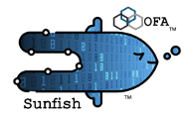
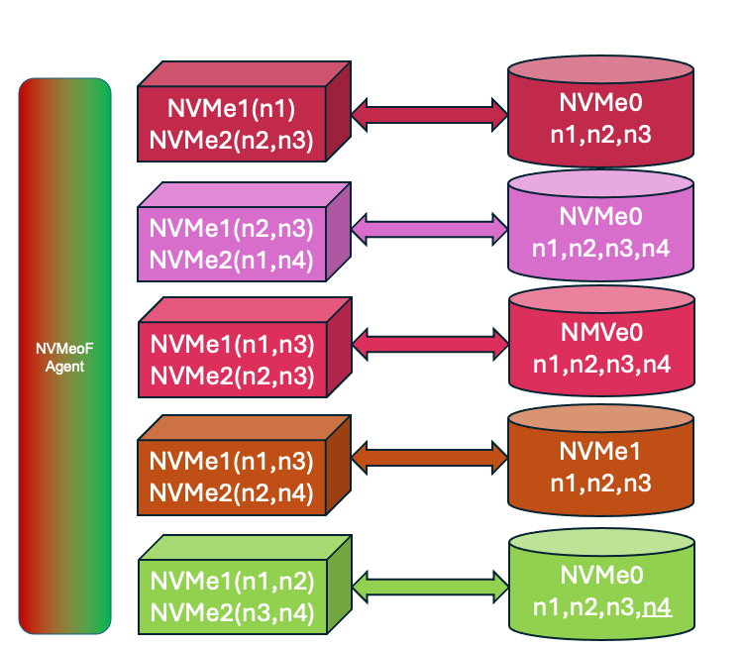
Implementation of the BeeOND burst buffer
UUR
Sunfish Services
Resource Inventory
Redfish Layer
Hardware Layer
RF tree management
Resource Configuration
Slingshot
Agent
Slingshot FM
Fabric Configuration
Authentication
Data Store
Access Control
Events & Logs
Broker 1
(Compute)
Events, Data, Transactions between Flux and Sunfish
Broker 2
Broker 5
(Compute)
Flux
Broker 0
Broker 3
(Compute)
Broker 4
(Compute)
NVMeoF Agent does a periodic discovery of NVMeoF namespaces and updates Sunfish. Sunfish updates Flux with on-line Resources.
Flux Brokers use Prolog/Epilog for Resource aggregation, burst buffer deployment, Resource Release, data ingress/egress.
UUR
UUR

Slide 20
Implementation of the BeeOND burst buffer
Redfish
Redfish
Sunfish Services
v1
Resource Inventory
v1
RF tree management
Resource Configuration
Fabric Configuration
Chassis
Chassis
Managers
Managers
Session
Service
Systems
Session
Service
Authentication
Data Store
Systems
Account
Service
Storage
Fabrics
Access Control
NVMeoF
ContainerX
NVMeoF
ContainerX
ChassisX
Events & Logs
ChassisX
Sessions
Sessions
NIC card interface
NVMeoFX
NVMeoF
NIC card interface
In Chassis X
K8s Deployment
In Chassis X
K8s Deployment
Flux
Broker 0
(Admin)
NVMe0
n1
NVMe0
nX
On Board Resources from lstopo
Endpoints
EndpointGroups
Connections
https://redfish.dmtf.org/schemas/DSP2046_2022.2.html#aggregationservice-101
UUR

Slide 21
Implementation of the BeeOND burst buffer
Assumptions
Starting at time 0
Static NVMeoF endpoints and all endpoints are already online
NVMeoF Fabric endpoints have an IP address
Flux Brokers have static NVMeoF resource endpoints included in the /etc/flux/resource folder--they stay drained, initially
Resources in Flux Broker 0 are listed as name-nvmeof, name-host-jbod, name-endpoint
Resources remain drained in Flux until Sunfish signals that the resources are active
HPC head node can turn on resources via Redfish commands
Communication between Sunfish Server and Flux Broker 0 is done via Events and JSON.
UUR

Slide 22
Implementation of the BeeOND burst buffer
Flux/Sunfish Interface
Flux reads /etc/flux/resources.conf
Flux registers with Sunfish Events to get up-to-date HPC/Datacenter
telemetry
Order Flux to drain all of the NVMeoF Endpoint nodes
(drain)
Flux
Initialize Sunfish Tree devoid of NVMeoF endpoints
Register Sunfish Agent with Sunfish
Sunfish
Sunfish
NVMeoF
Agent
Sunfish Server registers with Flux Broker 0
Flux NVMeoF resources are listed as Active==Sunfish has the resource available
Flux NVMeoF resources are drained, initially
Flux Broker 0 handles the CDI aggregation
Initialize Sunfish Agent Tree devoid of NVMeoF endpoints
exclude ✔ 3 clustername-admin1,clustername-login[1-2]
drained ✔ 950 compute[1-949]
drained ✗ 50 clustername-nvmeof[1-49]
UUR

Slide 23
Implementation of the BeeOND burst buffer
Flux/Sunfish Interface
Notify Datacenter administration and update Flux resource library
Flux
Asynchronously
upload NVMeoF into Sunfish
Sunfish
Sunfish
NVMeoF
Agent
Sunfish Agent retrieves the NVMe discovery log page from each Direct Discovery Controller
Each Direct Discovery Controller returns it’s Discovery Log Page containing the NVMeoF information
NVMe Subsystems register with the Sunfish Agent acting as the Centralized Discovery Controller
exclude ✔ 3 clustername-admin1,clustername-login[1-2]
drained ✔ 950 compute[1-949]
drained ✗ 50 clustername-nvmeof[1-49]
UUR

Slide 24
Implementation of the BeeOND burst buffer
Flux/Sunfish Interface
Undrain NVMeoF resources
Flux Allocate/Deallocates
NVMeoF to each batch job node
Flux drains/undrains/torpid each endpoint, as notified by Sunfish
Flux
Sunfish NVMeoF Agent
Keep alive from each endpoint
If keep alive is missing for endpoint {
Update registry,
Send Event to Sunfish server,
Update Sunfish server}
Sunfish is monitoring the Sunfish Agent
Endpoint comes online, fails, etc. means that Sunfish notifies Flux and registers changes
Sunfish
Sunfish
NVMeoF
Agent
Agent monitors integrity of NVMeoF endpoint network connections and availability
available ✔ 967 clustername-nvmeof[1-4],[26-32],compute[1-899,945-949]
available ✗ 4 clustername-nvmeof[7,10],compute[943-944]
allocated ✔ 52 clustername-nvmeof[16-25],compute[900-944]
exclude ✔ 3 clustername-admin1,clustername-login[1-2]
drained ✔ 950 compute[1-949]
drained ✗ 21 clustername-nvmeof[5-25]
UUR

Slide 25
Implementation of the BeeOND burst buffer
Flux/Sunfish Interface
Undrain NVMeoF resources
Flux Allocate/Deallocates
NVMeoF to each batch job node
Flux drains/undrains/torpid each endpoint, as notified by Sunfish
Flux
Endpoint comes online, fails, etc. means that Sunfish notifies Flux and registers changes
Sunfish is monitoring the Sunfish Agent
Sunfish
Sunfish
NVMeoF
Agent
Agent monitors integrity of NVMeoF endpoint network connections and availability
available ✔ 982 clustername-nvmeof[1-19],[16-32],compute[1-942,945-949]
available ✗ 4 clustername-nvmeof[7,10],compute[943-944]
allocated ✔ 52 clustername-nvmeof[16-25],compute[900-944]
exclude ✔ 3 clustername-admin1,clustername-login[1-2]
drained ✔ 950 compute[1-949]
drained ✗ 5 clustername-nvmeof[20-24]
UUR

Slide 26
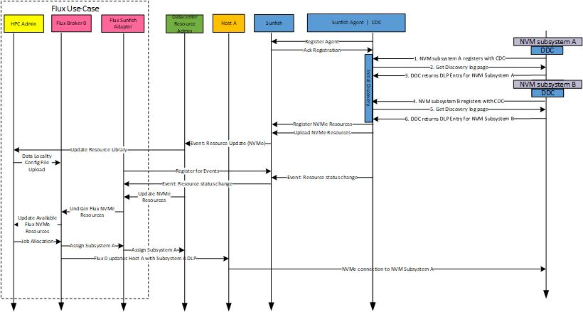
Implementation of the BeeOND burst buffer
UUR

Slide 27
Flux Deployment of Sunfish Burst Buffer
flux run -N <nodes requested> <<<--bank=bank #>>>> <<<-x>>>> --time-limit=<hours>
--setattr=beeondtype=<burst buffer type (RAM disk, Local Storage, Remote Storage)>
--setattr=beeond_filestorage=NVMe
--setattr=sunfishbb=nvmenamespace:<subsystem namespace quantity on each node>
--setattr=starfish_ingress=<Path>
--setattr=starfish_egress_rule=<extension, etc.>
--setattr=starfish_egress_dir=<Path>
<batch code (eg. hostname)>
UUR

Slide 28
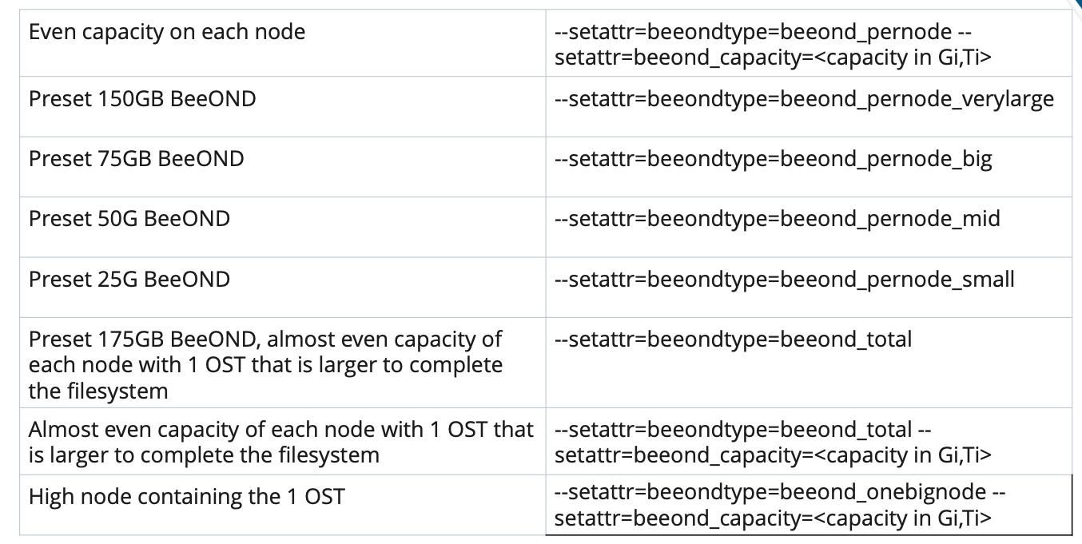
Flux Deployment of Sunfish Burst Buffer
--setattr=beeondtype=<burst buffer type>
UUR

Slide 29
Flux Deployment of Sunfish Burst Buffer
--setattr=beeond_filestorage=NVMe ←--- Disk format and device drivers loaded
modprobe nvmet
modprobe nvmet-rdma
modprobe nvme-rdma
lsmod | grep nvme
mkdir /sys/kernel/config/nvmet/subsystems/ < Subsystem NqN (I used DNS name)>
cd /sys/kernel/config/nvmet/subsystems/ < Subsystem NqN (I used DNS name)>
echo 1 > attr_allow_any_host
mkdir namespaces/10
cd namespaces/10/
nvme list
echo -n /dev/nvme1n1 > device_path
echo 1 > enable
mkdir /sys/kernel/config/nvmet/ports/1
pushd /sys/kernel/config/nvmet/ports/1
UUR

Slide 30
Flux Deployment of Sunfish Burst Buffer
--setattr=sunfishbb=nvmesubsystem:<subsystem quantity on each node>
Broker 1
(Compute)
Broker 2
Broker 5
(Compute)
Broker 3
(Compute)
Broker 4
(Compute)
UUR

Slide 31
Questions?
Sandia National Labs
Joe Mervini, Jeff Ogden, Jen Green, Matt Curry, Shyamali Mukherjee, Joel Stevenson, Ben Allan, Scot Swan
Lawrence-Livermore National Lab
Nathan Hanford, William Hobbs, Brian Behlendorf, Olaf Faaland, Cameron Harr, Trent D’Hooge
OpenFabrics Management Framework Working Group
Russ Herrell, Phil Cayton, Peter Lee, Christian Pinto, Richelle Ahlvers, Michele Gazzetti, Jeff Hilland, John Mayfield, Jim Hull
Thinkparq
Joe McCormick, Troy Patterson, Philipp Falk
Starfish
Milo Golub, Matt Hutchison, Anne Blanchard
UUR

