Slide 1
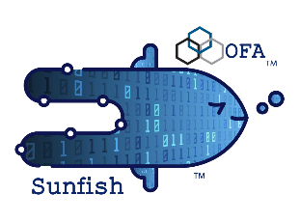
Sunfish: An Opensource Management Framework
How to Manage Composable Disaggregated Infrastructure
11/17/25

Slide 2
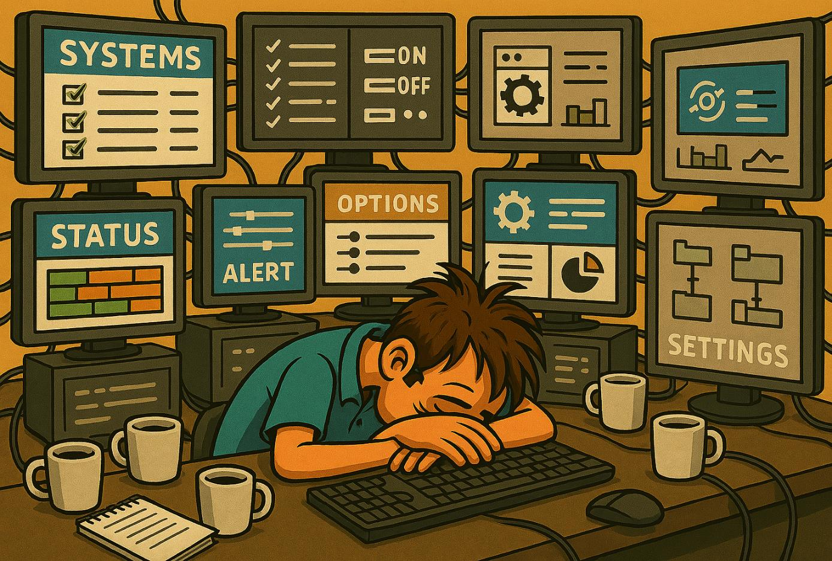

When everything is working, but not on the right things
Your data center has become
Multi-Vendor
Multi-Tenant
Multi-Fabric
Sophisticated schedulers, monitors, and resource managers recommend an optimized Grand Plan of resource assignments and workload deployments
To optimize any such plan, these tools need a complete and consistent view (model) of all relevant resources
Who is aggregating and describing the complete set of resources available across all the fabrics of your data center?
© OpenFabrics Alliance 2025
Notes:
When everything is working, but not on the right things

Slide 3
When everything is working, but not on the right things
Once there is a global view (model) of the fabric resources, the optimization tools define the state of specific fabric resources by manipulating the global view
What exists now on the hardware side is a collection of diverse management tools that only watch over a class of individual resources
These different hardware managers each have their own class and vendor-specific management APIs
Who is translating the Grand Plan into configuration settings across all these different hardware managers?
© OpenFabrics Alliance 2025
Notes:
When everything is working, but not on the right things

Slide 4

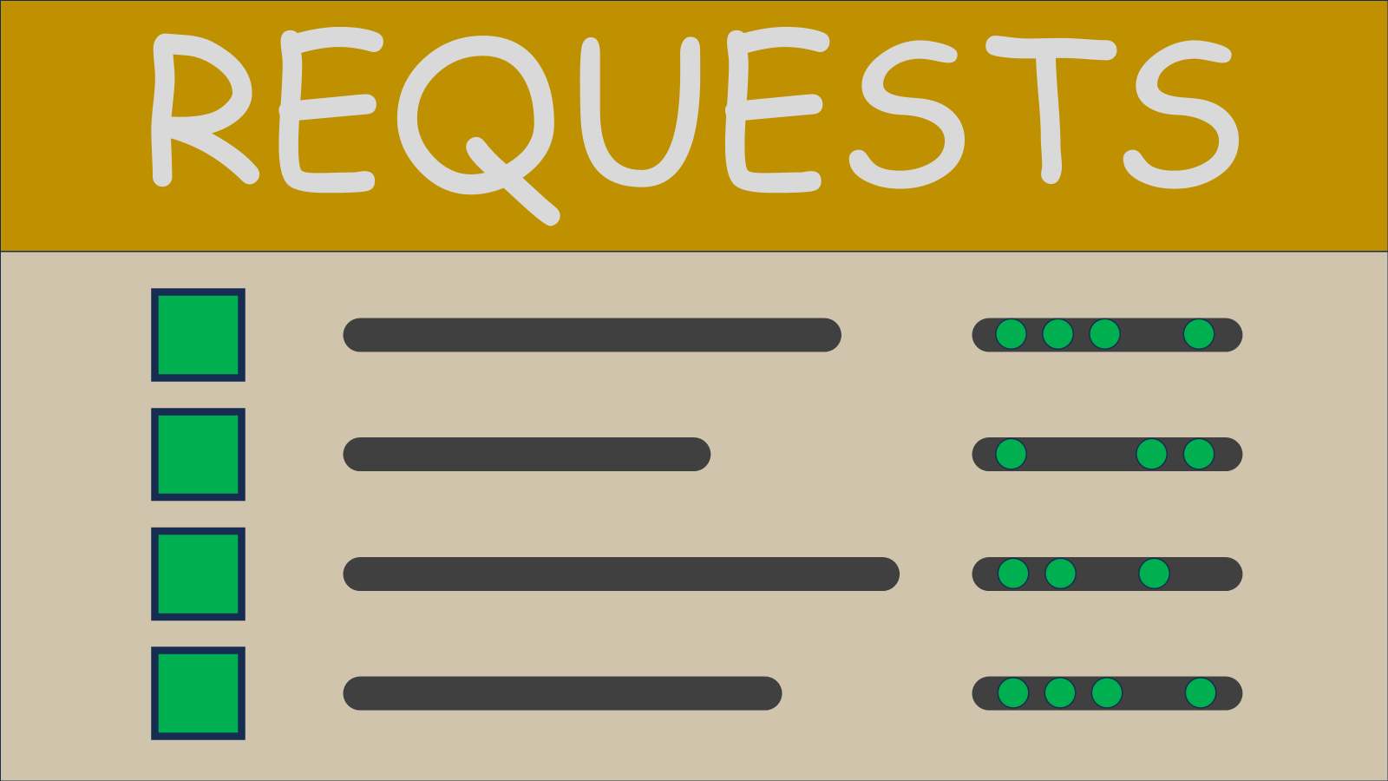
The Sunfish Framework for a Composable Disaggregated Infrastructure Manager
The OpenFabrics Alliance’s Sunfish Project is defining a framework that
enables resource vendors to aggregate their products into a global view of the data center using an industry standard schema
enables a single view of all the aggregated resources
enables multiple tenants (clients) to request configuration changes of appropriate resources
Sunfish Project defines one interface to model, aggregate, and control Composable Disaggregated Infrastructure resources
© OpenFabrics Alliance 2025
Notes:
Sunfish, when you absolutely, positively need to sleep at night.

Slide 5
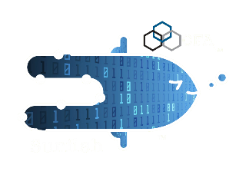
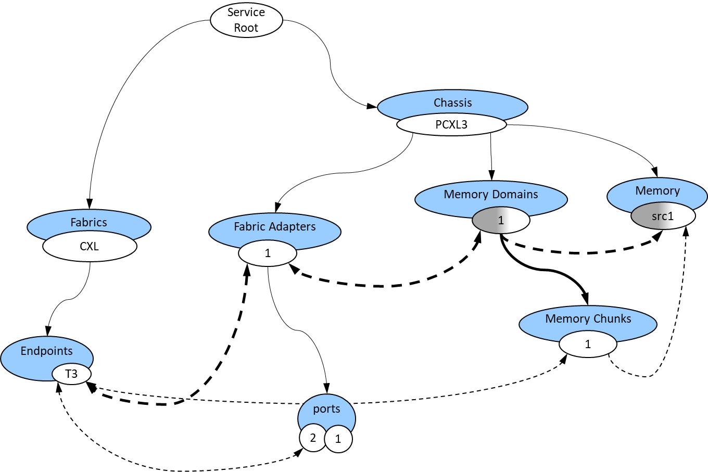
Sunfish in Visual Form
Sunfish Clients see abstracted Fabric Attached Resource objects
Sunfish Services manages the Redfish models of all resources from multiple hardware Agents
Sunfish Agents hide the hardware specifics by creating appropriate Redfish models of resources
Sunfish Services
Users, Apps, utilities, monitors, Resource Managers or Admins
Hardware Specific Agent
Hardware
Managers
Specific
HW
RESTful API (RF/SF)
Sunfish defines the policies that Agents follow when creating resource models so that Clients know how to interpret and manipulate them
5
© OpenFabrics Alliance 2025
Notes:
On the right we have our disaggregated resources with potentially many different management entities in direct control using vendor and device specific means
We need an Agent layer (some might prefer the term ‘provider’ but in Sunfish world we call it an Agent) to aggregated the inventory from one or more hardware managers and convert the hardware specific device and resource descriptions into a publicly accepted and commonly interpreted Redfish model.
The Agent hands this whole model over to the Sunfish Services. This effectively ‘hides’ much of the hardware specific details from the clients.
Clients of Sunfish Services see the Redfish models of resources and manipulate these models to establish or alter the state of individual resources or their assignments (bindings) to consumers (e.g. hosts)
It is critical that Agents and Clients have the same interpretation of a Redfish object found in the Sunfish database, so the Sunfish framework also has policies and requirements to be followed when creating or interpreting the Redfish models.

Slide 6
Sunfish Reference Code Repositories

Slide 7
Sunfish Service Core Library
sunfish_library_reference
The Sunfish_library_reference contains several core functions designed to sort and execute requests (GET, POST, PATCH, DELETE) against various Redfish objects (Switches, Ports, Chassis, MemoryDomains, etc.), read and write the Sunfish resource storage, and check for the need to forward such requests to the owning Agent
Reading and Writing the resource database requires a minimum set of Resource objects, so there is a required Resources directory as part of the actual library repo
These same core functions are needed by most Agents to manage the Agent’s local Redfish data base. Therefor, these core routines are built into a Class library and distributed via Wheel
The sunfish_library_reference repo can be downloaded from github, built, and tested as a standalone repo
Sunfish_lib_core
Sunfish_plugins: Redfish Event Handlers, backend_FS storage
Resources (DB)
server_start_Resources

Slide 8
Sunfish Server and Agent
sunfish_server_reference
This repository is used to build either a Sunfish Server or Agent
The Sunfish_server_reference contains these key pieces:
Several versions of an app.py file to be run via Flask. The Sunfish core library is imported into the app.py runtime instance
A Resources directory which would be the default minimum Redfish Resources to allow the core-lib library to initialize
A mockups directory which contains a few useful mockups of fabric topology Resources that will replace the default minimum Resources
A Scripts directory which contains several useful scripts for cloning the correct repos, setting up useful mockup Resources, and launching multiple instances of the different server flavors
Copy the appropriate app_x_server.py file to the app.py file and select which mockups to use within the server to set the flavor of the server
Example mockups available:
A basic Sunfish Server
A single NVMeoF Agent
Two CXL Agents (Fabric Manager and Appliance Manager)
Sunfish
Server or Agent
Scripts
Flask API
(app.py)
app_XXXXX_server.py
Sunfish_lib_core
Sunfish_plugins: Redfish Event Handlers, backend_FS storage
Resources (DB)
server_start_Resources
mockups

Slide 9
Sunfish Scaling
Sunfish hierarchical aggregation
Since the sunfish_server_reference can act as both an Agent frontend as well as an aggregation function which uploads Redfish Resource trees, it supports multiple levels of Agents aggregating resources from very large-scale installations
Large scale applications would be more appropriately implemented in some language other than Python
HW Mgr
CXL Agent
Sunfish
Server
CXL Agent
Aggregator
HW Mgr
CXL Agent
HW Mgr
HW Mgr
CXL Agent
HW Mgr
CXL Agent
Aggregator
HW Mgr
CXL Agent
HW Mgr
HW Mgr
CXL Agent
Aggregator
CXL Agent
HW Mgr
HW Mgr
CXL Agent
HW Mgr
HW Mgr

Slide 10
Sunfish and Multiple Agents
An Example of Sunfish Framework Capabilities

Slide 11
The Multiple Agent Problem
CXL
Fabric Switch
The CXL fabric is managed by multiple managers
a shareable pool of FAM Capacity as an appliance
A fabric switch connecting 3 Hosts to the FAM resources
2 CXL Agents coordinate the hardware
Sunfish reference implementation aggregates all resources, manages 1 namespace
Host 1
U1
Host 2
U2
F1
C1
Host 3
U3
F1
D1
C2
CXL
Switch
MLD
F2
F2
F3
D2
SLD
U4
F3
D3
F4
C4
F4
SLD
D4
SLD
Appliance Mgr
Clients
Sunfish
CXL Agent
Fabric Mgr
CXL Agent
11
© OpenFabrics Alliance 2025
Notes:
The Agent represents a mocked-up fabric using pre-loaded Redfish ‘mockup’ objects.
There is no emulation of the Fabric Manager or the Appliance Manager.
Subsequent changes will impact the Redfish models in the Sunfish and Agent appropriately.
Many fabrics will be made up of multiple ‘assemblies’ or ‘enclosures’, each of which may be controlled by its own manager
All these assemblies ‘plug’ into a set of fabric switches, which have their own manager. We also model the hosts as being part of the fabric switch manager’s domain.
Each of these managers manifest their Redfish APIs through a Sunfish CXL Agent
Sunfish thus merges the different Agent namespaces into one for the clients

Slide 12
Simplified Model of Fabric Manager Redfish Tree
Root
Chassis
CXL-Chassis
Host 1
CXL
Fabric Switch
Host 2
CXL_
System1
Systems
CXL_
System2
CXL_
System3
Fabrics
Host 3
CXL
CPUs
1
CPUs
CPUs
1
1
I3
I2
Endpoints
CXL Agent
Fabric Mgr
Ports
I1
1
Ports
1
Ports
Switches
1
CXL1
U1
Ports
F1
U2
F2
F1
Ports
Boundary Links
U3
F3
F2
U4
F4
F4
© OpenFabrics Alliance 2025
Notes:
“Here is a pictorial view of the Redfish model which Sunfish will upload from the CXL FM agent.
The block diagram shows the 3 hosts and the fabric switch that are controlled by the ‘fabric manager’
The Redfish bubble diagram shows a simplified Redfish model of the resources
The fabric switch ports that connect to the appliance switch are boundary links between the two management domains

Slide 13
Simplified Model of Appliance Manager Redfish Tree
Root
Boundary Links
Chassis
PooledCXL
C1
Fabrics
Memory
Domains
Memory
1
2
9
10
1
4
10
CXL
Fabric
Adapters
2
3
1
2
3
4
C2
CXL
Switch
MLD 1
PCIe
Devices
SLD 2
1
4
2
3
1
3
4
2
C4
SLD 3
SLD 4
Memory
Chunks
VT1.2
1
1
VT1.1
1
8
Appliance Mgr
CXL
LDs
2
Memory
Chunks
Endpoints
2
7
Switches
T1
3
Ports
3
9
6
Memory
Chunks
CXL2
T2
4
5
T4
T3
1
1
CXL Agent
CXL
LDs
Ports
1
1
Memory
Chunks
CXL
LDs
Ports
1
Ports
F1
F1
D1
1
1
F2
Ports
D2
F2
D3
CXL
LDs
F4
F3
F4
D4
1
Ports
13
© OpenFabrics Alliance 2025
1
Notes:
The appliance block diagram shows the 4 CXL memory devices and the enclosure switch.
The associated Redfish model for the appliance can be quite complex. Note that the appliance manager also named its ‘fabric’ “CXL”.
All the upstream ports on the appliance switch are ‘Boundary Links’

Slide 14
The Redfish Resource Tree Aggregation Problem
Only ONE Root allowed
Root
Root
Chassis
Chassis
PooledCXL
CXL-Chassis
No Conflicting URIs
Fabrics
Fabrics
Memory
Domains
Memory
1
4
1
4
CXL_
System1
Systems
CXL_
System3
CXL
CXL
Fabric
Adapters
2
3
2
3
CXL_
System2
1
4
PCIe
Devices
2
3
1
2
3
4
Switches
CPUs
CXL1
Memory
Chunks
CPUs
Switches
VT1.2
1
8
1
1
CPUs
VT1.1
1
2
Memory
Chunks
1
1
Endpoints
2
CXL
LDs
7
I3
T1
3
Ports
3
9
6
Memory
Chunks
I2
Endpoints
CXL2
T2
4
5
Ports
I1
T4
T3
1
1
1
Ports
Ports
1
1
CXL
LDs
Ports
1
1
Memory
Chunks
CXL
LDs
Ports
1
U1
Ports
F1
F1
Ports
Ports
F1
D1
1
1
U2
F2
F2
F2
F1
Ports
D2
U3
F3
F2
CXL
LDs
U4
F4
F4
F4
F3
D3
1
Ports
F4
D4
1
14
© OpenFabrics Alliance 2025
Boundary Links must be resolved
Notes:
“Here are the two managers’ inventories (as presented by two CXL Agents) in one view. There are two Redfish URI namespaces – Two Roots.
Sunfish has to fix the conflicts between these two namespaces. The big ones we are discussing today:
Redfish API rules requires Sunfish present clients with only ONE Root
Sunfish cannot simply drop both namespaces onto a single Root, as name (URIs) collisions may result
When multiple managers are used within the same fabric, boundary links that tie their domains together must be resolved, otherwise the physical topology cannot be determined by just examining the Sunfish model (the individual managers do not know the Redfish ID (URI) that the other managers are assigning to the component on the other end)
Imagine a dozen appliance managers, and 4 fabric (switch) managers…. Sunfish Library is developing the tools to make this aggregation a ‘plug, aggregate, and play’ proposition

Slide 15
Sunfish Multiple Agent Aggregation Options
Sunfish supports two methods for resolving Redfish URI conflicts among multiple Agents:
Sunfish aliases duplicate Redfish names (URIs); clients see and manage the individual Agent domains and infer when fabrics of different names are really one fabric.
All Agents managing resources on the same Fabric upload the same Fabrics object model (with the same Redfish Fabric UUID property); Sunfish merges duplicate Fabrics objects into one object, but aliases name conflicts below the shared Fabrics object.
For those fabrics (for example, CXL) that support hardware-link-partner-identity exchanges over Boundary Links, Sunfish also supports connecting Boundary Links between the Redfish models of the associated boundary Ports being uploaded by different Agents.
15
© OpenFabrics Alliance 2025
Notes:
There are two functionalities coded into the Sunfish Core Library for handling Redfish URI conflicts among multiple Agents. The first is to simply ‘disambiguate’ the two Agents’ names. If the Redfish URI assigned by the Agent to an object being uploaded into Sunfish conflicts with an existing object’s Redfish URI, Sunfish will alias (i.e., rename) the one being currently uploaded. Sunfish tracks all aliased names and uses the correct version when communicating with Agents vs communicating with clients.
If Sunfish detects that a Fabric object (and only a Fabric object) is being uploaded with both the same Redfish URI and the same Redfish Fabric object UUID property, Sunfish will not rename the conflicting Fabric object; Sunfish will ‘merge’ the new object with the existing one, basically by updating the existing Fabric object to show it is ‘shared’ with multiple Agents.
Some fabric specifications, such as CXL, have hardware links that exchange the hardware IDs of the components on each end of a link. In the case of a Sunfish Agent for a CXL fabric, it forwards the hardware IDs for the component expected on the other end of a Boundary Link (when it knows them), and Sunfish will use these hardware IDs to match up the Redfish URI of the expected component.

Slide 16
A Simple Solution is to Rename all Conflicts (Sunfish Exposes All Agent Domains)
Pro: Works with arbitrary, Sunfish compliant Agents
Only ONE Root
Root
Con: No simple indicator all the Endpoints are on the same fabric
CXL-Chassis
Chassis
PooledCXL
Fabrics
No Conflicting URIs
Memory
Domains
Memory
CXL
1
4
1
4
CXL_
System1
Systems
CXL_
System3
Sunfish_3d74_CXL
Fabric
Adapters
2
3
2
3
CXL_
System2
1
4
PCIe
Devices
2
3
1
2
3
4
CPUs
Memory
Chunks
Switches
VT1.2
1
8
1
1
CPUs
CPUs
VT1.1
1
2
Memory
Chunks
1
1
Endpoints
T1
2
CXL
LDs
7
I3
CXL2
T2
3
Ports
3
9
4
5
6
Memory
Chunks
I2
Endpoints
T3
1
Ports
Ports
I1
T4
1
1
1
Ports
Switches
1
CXL
LDs
Ports
CXL1
1
1
Memory
Chunks
CXL
LDs
Ports
1
U1
Ports
F1
D1
1
1
U2
F2
F1
Ports
D2
U3
F3
F2
CXL
LDs
U4
F4
F3
D3
1
Ports
Boundary Links resolved
F4
D4
1
16
© OpenFabrics Alliance 2025
Notes:
Sunfish present clients only ONE Root,
if Systems, Fabrics, or Chassis instances have conflicts, Sunfish renames these instances and all the subordinate paths and all navigation links
Sunfish compliant Agents include fabric specific boundary port details that enable Sunfish to ‘fill in the blanks’ of the physical topology as inventories are uploaded, so boundary links can still be resolved
Any Sunfish compliant agent can register and upload its inventory; Sunfish will end up giving each Agent its own ‘namespace’ within the Sunfish tree
The downside is that Clients will have to trace the physical topology via Ports to determine that Endpoints I1, I2, and I3 can connect with Endpoints T4, T3, etc.

Slide 17
Second Aggregation Solution Sunfish Merges the Fabrics
Works with cooperating Sunfish compliant Agents
Only ONE Root
Root
CXL-Chassis
Chassis
PooledCXL
Fabrics
No Conflicting URIs
Memory
Domains
Memory
1
4
1
4
CXL_
System1
Systems
CXL_
System3
CXL
Fabric
Adapters
2
3
2
3
CXL_
System2
1
4
PCIe
Devices
2
3
1
2
3
4
VT1.2
VT1.1
Memory
Chunks
I3
T1
CPUs
I2
Endpoints
T2
1
CPUs
CPUs
1
8
1
1
1
1
I1
T3
CXL
LDs
2
Memory
Chunks
T4
2
Ports
3
6
7
Memory
Chunks
3
9
4
5
Ports
Switches
1
1
1
Ports
Ports
1
1
CXL1
CXL2
CXL
LDs
Ports
1
1
Memory
Chunks
CXL
LDs
Ports
1
U1
Ports
F1
D1
1
1
U2
F2
F1
Ports
D2
U3
F3
F2
CXL
LDs
U4
F4
F3
D3
1
Ports
Boundary Links resolved
F4
D4
1
17
© OpenFabrics Alliance 2025
Notes:
Sunfish present clients only ONE Root,
if Fabrics instances have conflicts, Sunfish will check the UUID of the fabric for a match to the existing fabric, and does NOT rename the new Agent’s Fabric. Rather, it simply assumes that the Grand Plan calls for this Agent to upload its resources to the existing fabric. The original Fabric object is assumed to be the one to keep, but BOTH Agents are ‘owners’ and can update subordinate collections (like Endpoints and Switches). Conflicts in any subtree of the common fabric WILL be renamed.
Sunfish compliant Agents include fabric specific boundary port details that enable Sunfish to ‘fill in the blanks’ of the physical topology as inventories are uploaded
All Agents on the same fabric MUST declare the same URI, @odataId, and fabric UUID property in their fabric object that they upload before Sunfish will Merge all Agents’ inventories under the same fabric object.

Slide 18
Thank You
Sunfish Github Repositories
Sunfish Documentation
https://github.com/OpenFabrics/sunfish_docs
Sunfish Core Library
https://github.com/OpenFabrics/sunfish_library_reference
Sunfish Server (and Agent Server)
https://github.com/OpenFabrics/sunfish_server_reference
Sunfish Working Group Members
Michael Aguilar (Sandia) Co-chair
Phil Cayton (Intel)
Richelle Ahlvers (Intel)
Russ Herrell (Individual Contributor)
Brian Pan (H3 Platform)
Doug Ledford (Redhat)
Elham Hojati (Intel)
Jeff Hilland (HPE)
John Mayfield (HPE)
Sunfish Working Group Contact Info
Doug Ledford dledford@redhat.com
Michael Aguilar mjaguil@sandia.gov
18
© OpenFabrics Alliance 2025

