Slide 2

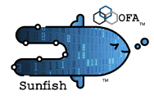

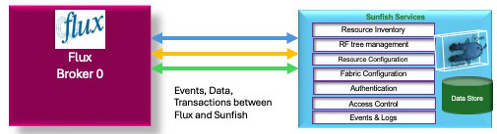
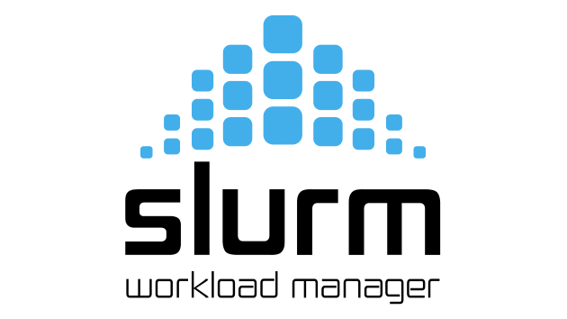
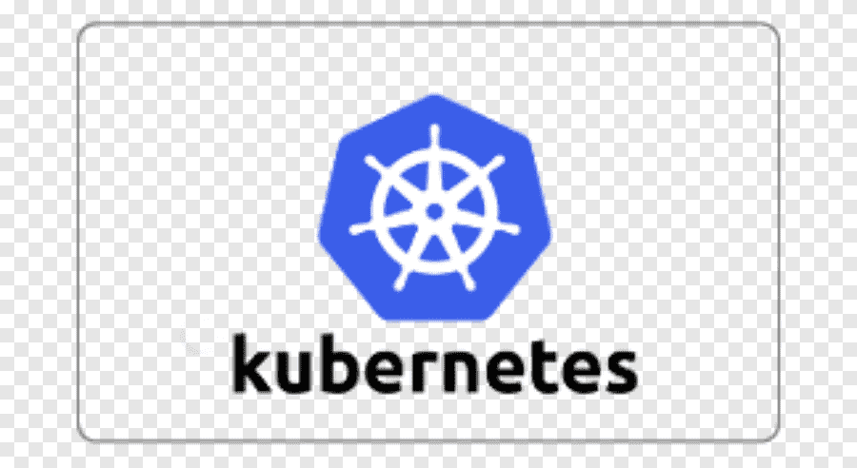
Flux Sunfish Deploying a Data Center
Datacenter-Wide Resource Governance
Flux
Broker 0
(Admin)
Sunfish Services
Resource Inventory
RF tree management
Resource Configuration
Fabric Configuration
Authentication
Data Store
Access Control
Events & Logs
Flux HPC Cluster 1
Slurm HPC Cluster 1
Flux AI/ML Cluster 1
Data Center
Ingress/Egress Cluster 1
Flux AI/ML Cluster 2
Kubernetes HPC Cluster 1

Slide 3

Sunfish Deploying a Data Center
Sunfish Resource Management
Overall Datacenter Workload Scheduler
Knapsack Service

Slide 4
New Flux scheduler plug-in that incorporates multi-agent reinforcement learning
Nash Equilibrium
Bellman Equation
Neural network

Slide 5
Compute Node
Compute Node
Compute Node
Compute Node
Knapsack Scheduler
Flux Broker 0
Flux/Sunfish Adapter
Swordfish
Storage Manager
Sunfish Server
Sunfish Agent Heartbeat
Sunfish Agent/CDC
DDC Flux Agent Heartbeat
DDC
NVMe Storage Subsystem
Sunfish Agent Registers with Flux Broker 0
Log info goes to the DDC
DDC Registers with Flux Broker 0
Pending Flux Request for Batch and Resources
DDC detected, CDC gets Discovery Log Page
Register Sunifish Agent
DDC returns DLP f NqN
Upload NVMe Resource
Sunfish Event
Upload from Sunfsih
to Swordfish
Trigger Reguest for Resource Configuration
Here is what I want the Resource to look like
The resource allocation is complete
Asynchronous Resource Changed Event
Batch job allocated
CDC gets update
Sunfish Resource
updated Event
Sunfish gets update
Distributes workload and storage details (hardware Resources
Connection made and storage accessed
Connection made and storage accessed

