Slide 2

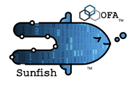

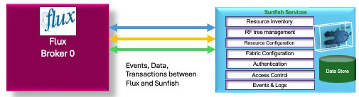
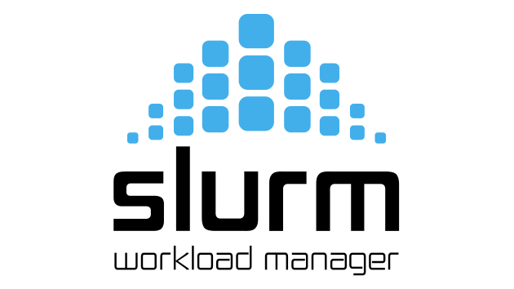
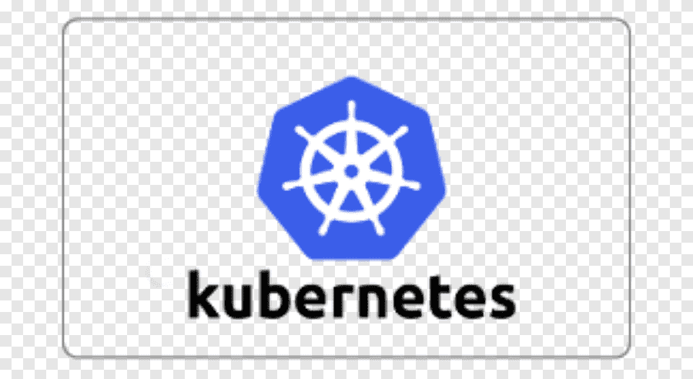
Flux Sunfish Deploying a Data Center
Datacenter-Wide Resource Governance
Flux
Broker 0
(Admin)
Sunfish Services
Resource Inventory
RF tree management
Resource Configuration
Fabric Configuration
Authentication
Data Store
Access Control
Events & Logs
Flux HPC Cluster 1
Slurm HPC Cluster 1
Flux AI/ML Cluster 1
Data Center
Ingress/Egress Cluster 1
Flux AI/ML Cluster 2
Kubernetes HPC Cluster 1

Slide 3

Sunfish Deploying a Data Center
Sunfish Resource Management
Overall Datacenter Workload Scheduler
Knapsack Service

Slide 4
New Flux scheduler plug-in that incorporates multi-agent reinforcement learning
Nash Equilibrium
Bellman Equation
Neural network

Slide 5
A
B
C
D
E
F
G
H
J
K
L
M
N
P
Compute Node
Compute Node
Compute Node
Compute Node
Knapsack Scheduler
Flux Broker 0
Flux/Sunfish Adapter
Swordfish
Storage Manager
Sunfish Server
Sunfish Agent Heartbeat
Sunfish Agent/CDC
DDC Flux Agent Heartbeat
DDC
NVMe Storage Subsystem
1
2
Sunfish Agent (Flux Heartbeat) Registers with Flux Broker 0
Log info goes to the DDC
3
DDC Registers with Flux Broker 0
4
5
Pending Flux Request for Batch and Resources
DDC detected, CDC gets Discovery Log Page
6
DDC returns DLP f NqN
7
Register Sunifish Agent
8
Upload NVMe Resource
9
Sunfish Event
10
Upload from Sunfsih
to Swordfish
11
Trigger Request for Resource Configuration
12
Here is what I want the Resource to look like
13
The resource allocation is complete
14
Asynchronous Resource Changed Event
16
Batch job allocated
15
CDC gets update
17
Sunfish Resource
updated Event
18
Sunfish gets update
19
Distributes workload and storage details, hardware Resources
20
Distributes workload and storage details, hardware Resources
21
Connection made and storage accessed
22
Connection made and storage accessed

Slide 6
Actor Descriptions
Compute Node: Cluster server acting as worker bee
Compute Node : Cluster server acting as worker bee
Compute Node : Cluster server acting as worker bee
Compute Node : Cluster server acting as worker bee
Knapsack Scheduler: AI based scheduler that matches workloads/jobs to compute, memory and storage resources
Flux Broker 0: top level Flux Broker (workload manager) of a cluster
Flux Sunfish Adapter: a Flux-Sunfish API instance running on a Flux Broker 0 (N/A?)
Swordfish Storage Manager: a storage manager using the Swordfish API
Sunfish Server: a Sunfish API service providing the Sunfish Core Services
Sunfish Agent Heartbeat: Flux instance running on the Sunfish Agent server providing presence detection and heartbeat exchange with a Flux Broker 0 instance
Sunfish Agent/CDC: A Sunfish NVMe Storage Agent combined with an NVMe Centralized Discovery Controller (CDC)
DDC Flux Agent Heartbeat: Flux instance running on the entity supplying the Direct Discovery Controller (DDC)
DDC (Direct Discovery Controller): Entity running on the NVMe storage subsystem that supplies the Discovery Log Page (DLP) in response to queries
NVMe Storage SubSystem: the entity that controls the NVMe hardware (drive) and provides the NVMe command API

Slide 7
High Level Flow Descriptions
Flux agent (K) registers its presence with Flux Broker 0 (F), indicating the presence of the Sunfish Agent/CDC server (L)
NVMe Subsystem (P) supplies Discovery Log Pages (DLP) to the Direct Discovery Controller (DDC) (N) asynchronously to any client conversations of (P) or (N)
DDC (N) registers its presence with Flux Broker 0 (F), indicating the presence of NVMe subsystems
Flux Broker 0 (F) asynchronously passes along customer requests for workloads to be run with abstracted quality of service and resource descriptions to the Knapsack Scheduler ( E ). The scheduler enters these requests into its optimization processes and eventually selects a set of compute, memory, and storage resources that will form a virtual cluster well suited to running these workloads.
Asynchronously and independently, the Sunfish Agent/CDC (L) locates the DDC (N) and requests the Discovery Log Pages
The DDC (N) responds with the DLPs to the Sunfish Agent (L) which converts the DLP descriptions of Namespaces to appropriate Redfish objects such as fabric Endpoints.
The Sunfish Agent (L) sends a registration event to the Sunfish Server (J) (possibly asynchronously to ‘5’ and ‘6’
Eventually the Sunfish Agent (L) sends an upload event to the Sunfish Server (J), and the Sunfish Server will respond with a series of recursive queries (GETs) to upload all the Redfish objects being used by (L) to represent the NVMe Subsystem(s) discovered by the DDC (L).

