Slide 2

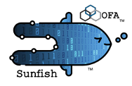
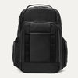
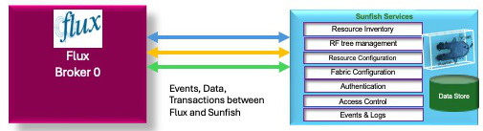
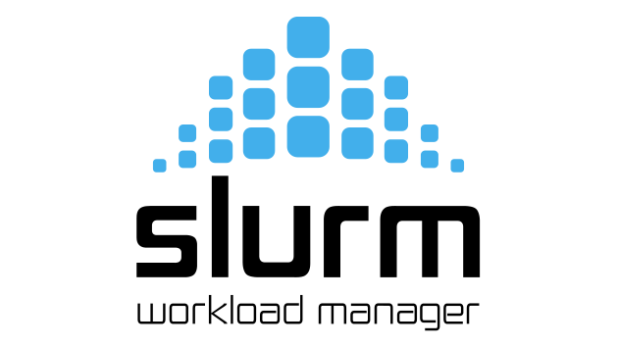
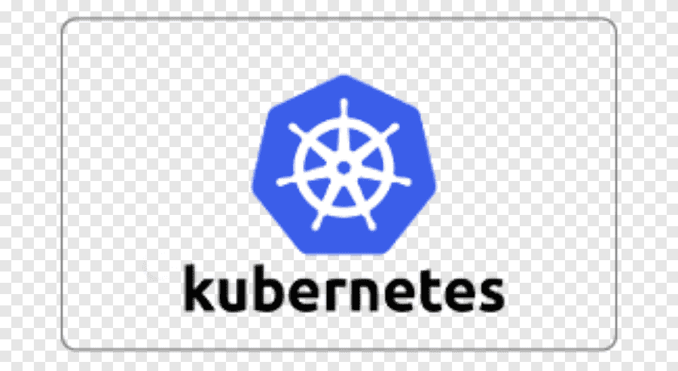
Flux Sunfish Deploying a Data Center
Datacenter-Wide Resource Governance
Flux
Broker 0
(Admin)
Sunfish Services
Resource Inventory
RF tree management
Resource Configuration
Fabric Configuration
Authentication
Data Store
Access Control
Events & Logs
Flux HPC Cluster 1
Slurm HPC Cluster 1
Flux AI/ML Cluster 1
Data Center
Ingress/Egress Cluster 1
Flux AI/ML Cluster 2
Kubernetes HPC Cluster 1

Slide 3

Sunfish Deploying a Data Center
Sunfish Resource Management
Overall Datacenter Workload Scheduler
Knapsack Service

Slide 4
New Flux scheduler plug-in that incorporates multi-agent reinforcement learning
Nash Equilibrium
Bellman Equation
Neural network

Slide 5
A
B
C
D
E
F
H
J
K
L
M
N
P
Compute Node
Compute Node
Compute Node
Compute Node
Knapsack Scheduler
Flux Broker 0
Swordfish
Storage Manager
Sunfish Server
Flux CDC Agent
Sunfish Agent/CDC
Flux DDC Agent
DDC
NVMe Storage Subsystem
1
2
Sunfish Agent (Flux Heartbeat) Registers with Flux Broker 0
Log info goes to the DDC
3
DDC Registers with Flux Broker 0
4
5
Pending Flux Request for Batch and Resources
23
Register SF Manager
DDC detected, CDC gets Discovery Log Page
6
DDC returns DLP f NqN
7
Register Sunifish Agent
Need to capture
Prolog/epilog/housekeeping
8
Upload NVMe Resource
9
Sunfish Event
10
Upload from Sunfish
to Swordfish
11
Trigger Request for Resource Configuration
12
Here is what I want the Resource to look like
13
The resource allocation is complete
14
Asynchronous Resource Changed Event
16
Batch job allocated
15
CDC gets update
17
Sunfish Resource
updated Event
18
Sunfish gets update
19
Distributes workload and storage details, hardware Resources
20
Distributes workload and storage details, hardware Resources
21
Connection made and storage accessed
22
Connection made and storage accessed

Slide 6
A
B
C
D
E
F
H
J
K
L
M
N
P
Compute Node
Compute Node
Compute Node
Compute Node
Knapsack Scheduler
Flux Broker 0
Swordfish
Storage Manager
Sunfish Server
Flux CDC Agent
Sunfish Agent/CDC
Flux DDC Agent
DDC
NVMe Storage Subsystem
19
Distributes workload and storage details, hardware Resources
20
Distributes workload and storage details, hardware Resources
21
22.1
Sends Connect request to NVMe Subsystem, connection created
22.2
Sends Connect request to NVMe Subsystem, connection created
22.3
Validate NVMe Subsystem Volumes and Namespace
Connection made and storage accessed
22
Connection made and storage accessed
Need to capture
Prolog/epilog/housekeeping
Notes:
Prolog and Epilog scripts are created by Flux coders, reside on Compute Node Flux brokers instances
Prolog and Epilog scripts create traffic between Flux 0 and the Host Flux n’s.
Step 19 sends over…..
Namespaces allocated / required, their IP addresses
Size, type of burst buffer, type of file system to build on burst buffer, file ingress and egress details to/from permanent storage
Burst buffer configuration details (to be done by the Host, fed to Prolog scripts)
Workload itself

Slide 7
A
B
C
D
E
F
G
H
J
K
L
M
N
P
Compute Node
Compute Node
Compute Node
Compute Node
Knapsack Scheduler
Flux Broker 0
Flux/Sunfish Adapter
Swordfish
Storage Manager
Sunfish Server
Sunfish Agent Heartbeat
Sunfish Agent/CDC
DDC Flux Agent Heartbeat
DDC
NVMe Storage Subsystem
Need a version of slide 5 dealing with job completion
And resource recovery?

Slide 8
A
B
C
D
E
F
G
H
J
K
L
M
N
P
Compute Node
Compute Node
Compute Node
Compute Node
Knapsack Scheduler
Flux Broker 0
Flux/Sunfish Adapter
Swordfish
Storage Manager
Sunfish Server
Sunfish Agent Heartbeat
Sunfish Agent/CDC
DDC Flux Agent Heartbeat
DDC
NVMe Storage Subsystem
Flow version for other resource types (CXL FAM, …)

Slide 9
Actor Descriptions
Compute Node: Cluster server acting as worker bee
Compute Node : Cluster server acting as worker bee
Compute Node : Cluster server acting as worker bee
Compute Node : Cluster server acting as worker bee
Knapsack Scheduler: AI based scheduler that matches workloads/jobs to compute, memory and storage resources
Flux Broker 0: top level Flux Broker (workload manager) of a cluster
N/A obsolete
Swordfish Storage Manager: a storage manager using the Swordfish API
Sunfish Server: a Sunfish API service providing the Sunfish Core Services
Sunfish Agent Heartbeat: Flux instance running on the Sunfish Agent server providing presence detection and heartbeat exchange with a Flux Broker 0 instance
Sunfish Agent/CDC: A Sunfish NVMe Storage Agent combined with an NVMe Centralized Discovery Controller (CDC)
DDC Flux Agent Heartbeat: Flux instance running on the entity supplying the Direct Discovery Controller (DDC)
DDC (Direct Discovery Controller): Entity running on the NVMe storage subsystem that supplies the Discovery Log Page (DLP) in response to queries
NVMe Storage SubSystem: the entity that controls the NVMe hardware (drive) and provides the NVMe command API

Slide 10
High Level Flow Descriptions
Flux agent (K) registers its presence with Flux Broker 0 (F), indicating the presence of the Sunfish Agent/CDC server (L)
NVMe Subsystem (P) supplies Discovery Log Pages (DLP) to the Direct Discovery Controller (DDC) (N) asynchronously to any client conversations of (P) or (N)
DDC (N) registers its presence with Flux Broker 0 (F), indicating the presence of NVMe subsystems
Flux Broker 0 (F) asynchronously passes along customer requests for workloads to be run with abstracted quality of service and resource descriptions to the Knapsack Scheduler ( E ). The scheduler enters these requests into its optimization processes and eventually selects a set of compute, memory, and storage resources that will form a virtual cluster well suited to running these workloads.
Asynchronously and independently, the Sunfish Agent/CDC (L) locates the DDC (N) and requests the Discovery Log Pages
The DDC (N) responds with the DLPs to the Sunfish Agent (L) which converts the DLP descriptions of Namespaces to appropriate Redfish objects such as fabric Endpoints.
The Sunfish Agent (L) sends a registration event to the Sunfish Server (J) (possibly asynchronously to ‘5’ and ‘6’
Eventually the Sunfish Agent (L) sends an upload event to the Sunfish Server (J), and the Sunfish Server will respond with a series of recursive queries (GETs) to upload all the Redfish objects being used by (L) to represent the NVMe Subsystem(s) discovered by the DDC (L).

Slide 11
High Level Flow Descriptions
Flux age

Slide 12
NVMe-of Endpoints
Endpoint contains the NQN of the NVMeSubsystem
Endpoint might also contain a “ConnectedPorts” property that links to the Fabric Switch Port that places the Endpoint on the Fabric
  The Switch Port identifies a physical attachment point to the fabric, Switch ID:Port#.
  To trace the physical paths between the NVMe (target) Endpoint and any given Host requires Port descriptions of Switches, Host and Target Network Adapter ports.
Endpoint might also contain a “ConnectedEntity” property that links to the Network Adapter which puts the Endpoint on the Fabric
  The Network Adapter ‘ideally’ would also have a unique ID, (MAC Address) , which uniquely identifies that adapter.
  The Network Adapter is expected to be contained within a physical or logical Chassis that must have a physical “Location” property if it is desired to locate Endpoints all within the same Chassis that meet adjacency requirements to selected Hosts.
  The Network Adapter might also have an “AssociatedMACAddresses” property which lists all MAC Addresses the adapter uses.
IF we have NQNs of storage Subsystems and storage Network Adapters’ MACs, and we have the CSM global topological map that lists the NQNs of Hosts, MACs of Network Adapters, and NVMe Subsystems, then either Sunfish or Swordfish can properly link Hosts to NVMe Targets per required Chassis constraints.(?)
Sunfish Project may have to deal with this physical topology for general cases, but for Rabbits and Knapsack systems, we place this burden on Knapsack.
  Sunfish and Swordfish only need the logical addressing and locations
  Sunfish may need to track the ‘same chassis’ properties of individual NQNs for subsystems are within same chassis, and assume this chassis is one Rabbit.
Notes:
Critical assumption:
Knapsack scheduler has access to Cray System Manager’ global topological map that identifies every endpoint on slingshot fabric by physical location.
DDC can identify the chassis or the SS fabric endpoints attached to the NVMe subsystems it is reporting Discovery Log Pages.
CDC/Agent -> Sunfish -> Swordfish tracks the NVMe subsystem <-> SS fabric endpoint mapping by assigning all NVMe subsystems within a Rabbit chassis as being a unique NVMeoF Fabric
CSM’s global topological map will assign global handles (NQN’s?) to all subsystems, which makes each Rabbit chassis’ NVMeoF Fabric a sub-fabric of the global SS fabric namespace.

Slide 13
NVMe-of Endpoints: Questions
What is the format of the Cray System Manager’s global geographical map?
  AI: Michael
Will the Flux Broker 0 have access? Will Knapsack (priority need)?
  Knapsack needs the details to properly assign Rabbit resources
Can we learn the algorithm for assignment of the MAC addresses?
Can we get a ‘mockup’ of one to work with?
What is the native API of the Rabbits storage appliance?
  NVMeoF?, Swordfish (proprietary)? HPE proprietary?
Is the API available to the public?
Notes:
Critical assumption:
Knapsack scheduler has access to Cray System Manager’ global topological map that identifies every endpoint on slingshot fabric by physical location.
DDC can identify the chassis or the SS fabric endpoints attached to the NVMe subsystems it is reporting Discovery Log Pages.
CDC/Agent -> Sunfish -> Swordfish tracks the NVMe subsystem <-> SS fabric endpoint mapping by assigning all NVMe subsystems within a Rabbit chassis as being a unique NVMeoF Fabric
CSM’s global topological map will assign global handles (NQN’s?) to all subsystems, which makes each Rabbit chassis’ NVMeoF Fabric a sub-fabric of the global SS fabric namespace.

Slide 14
Flux Prolog
Flux on Host
  Receives from Flux broker 0 the job allocation details (job ID, workload and storage details) in json format
    CONTROL_DEVICE=`flux job info $FLUX_JOB_ID jobspec | jq -r .attributes.system.cdi_storage`
  Extracts device_type, burst_buffer_capacity from jobspec
    DEVICE_TYPE=`flux job info $FLUX_JOB_ID jobspec | jq -r .attributes.system.type`
    BURST_BUFFER_CAPACITY=`flux job info $FLUX_JOB_ID jobspec | jq -r .attributes.system.burstbuffer_capacity`
    BURST_BUFFER_FILE_STORAGE=`flux job info $FLUX_JOB_ID jobspec | jq -r .attributes.system.burstbuffer_filestorage`
Notes:
Critical assumption:
Knapsack scheduler has access to Cray System Manager’ global topological map that identifies every endpoint on slingshot fabric by physical location.
DDC can identify the chassis or the SS fabric endpoints attached to the NVMe subsystems it is reporting Discovery Log Pages.
CDC/Agent -> Sunfish -> Swordfish tracks the NVMe subsystem <-> SS fabric endpoint mapping by assigning all NVMe subsystems within a Rabbit chassis as being a unique NVMeoF Fabric
CSM’s global topological map will assign global handles (NQN’s?) to all subsystems, which makes each Rabbit chassis’ NVMeoF Fabric a sub-fabric of the global SS fabric namespace.

