Slide 1
Ibutils2 - ibdiagnet
Presentation for ofv-tools group
By: Julia Levin, Dan Ben-Yosef
09/17/2015

Slide 2
Agenda
Short introduction to ibutils2.
New features
Questions

Slide 3
Ibutils2 – short introduction
Ibutils2 is Mellanox closed source package.
Functionality of ibutils2 replaces and extends OFA ibutils package.
Ibutils2 is written in C++, ibutils in TCL.
ibutils2 rpms for RHEL 6.4 and SLES11 SP3 for OFA 3.5 is available on Mellanox website (http://www.mellanox.com/page/products_dyn?product_family=110&mtag=monitoring_debug)
This version is 2014
Latest version can be provided on demand.

Slide 4
Ibutils2 – short introduction continue
The following utilities are available under ibutils2:
dump2psl.pl
dump2slvl.pl
ibcongest
ibdiagnet
ibdiagpath
ibdmchk
ibdmtr
ibgenperm
ibnetsplit
ibnlparse
ibtopodiff
Today we will talk about ibdiagnet.

Slide 5
Ibutils2 - ibdiagnet
Ibdiagnet in ibutils2 supports basic functionalities of ibutils, and more:
Discover
Speed check
Port counters gathering
Port Error counters gathering.
Port counters reseting
Routing and credit loop checks.
Topology compare
Topology write
Duplicated GUIDs test
Pkeys gathering

Slide 6
Ibutils2 - ibdiagnet
Ibutils2’s ibdiagnet extended features:
Support FDR, FDR10, EDR
Improved topology functionality (new IBNLs)
Improved ibdiagnet scalability (parallel MADs sending)
Extended speed counters, Show extended speeds counters per lane
Link health
LLR is used in FDR switches. Ibdiagnet reports high levels of retransmission and this is good diagnostic for bad links

Slide 7
Recent features in ibdiagnet
Generic features
Scope – ability to diagnose only part of the fabric
Node name map file – give different node description to nodes for report sake.
Support virtualization
CX-3 with AGUIDs (supported by upstream SM and MLNX SM)
CX-4 with vPorts (supported by MLNX SM only)
Control MADs timeout for sent/received MADs and MADs retries.
Extended speed counters according to 1.3 IB Spec.
Routing
New sub options to –r option
--r_opt <[vs,][mcast,]>
--sa_dump <file>
Credit loop testing for MC
SendOnly support
FW/HW related features
Cable info
Phy info – presenting grade
Effective BER test

Slide 8
Scope feature
Ibdiagnet flags
--scope <file> : The file with a list of Node-GUIDs and their
ports to be left in the scope.
--exclude_scope <file> : The file with a list of Node-GUIDs and their
ports to be excluded from the scope.
Example of a scope file:
#comment line
version: 1.0
0x298@1/2/17 //take into scope only ports 1,2,17 of the switch with GUID 0x298
0x123 //take into scope all ports of the node with GUID 0x123
Special keywords:
ALL_SWITCHES //include all switches, this line overrides any other lines related to switches GUIDs
ALL_CAS //include all CAs, this line overrides any other lines related to CAs GUIDs.
Notes:
ibdiagnet is used as the main automation tool for network wide diagnostics. As such it queries all the network devices and analyzes their response. In several conditions it advisable not to perform a “complete network” diagnostics. For example, during system bring-up where parts of the network are cleaned gradually or deeper and time consuming query and analysis is required on specific set of nodes or ports.

Slide 9
Scope - example
ibdiagnet
Scope_file file:
ALL_SWITCHES
Ibdiagnet –scope scope_file
Scope_ex file:
0x0002c9030006ba5a
Ibdiagnet --exclude_scope scope_ex → r_ufm101 is no longer there.

Slide 10
Node name map file
Similar to node name map option in ibnetdiscover and opensm
Main use: providing meaningful names for unmanaged switches in ibdiagnet reports
Ibdiagnet flag
-m|--map <map-file> : Specifies mapping file, that maps node guid
to name (format: 0x[0-9a-fA-F]+ "name").
Mapping file can also be specified by environment
variable "IBUTILS_NODE_NAME_MAP_FILE_PATH".
File Format:
<Node GUID> “<node name (user given string)>”
Example:
0x2c903003421b0 “Host15”
Notes:
The node description in the ibdiagnet output files would be “user given string”.
The node name in ibdiagnet output files would be would be S<system guid>/”user given string”.
If the <user given string> is in mellanox node description format (ex. for switch: “MF0;switch-540ea8:CS7500/L04/U2”, for HCA “r-ufm126 HCA-1”), then the name would be extracted as from usual node description.

Slide 11
Node name map file – example 1
Ibdiagnet
Node_name_file.txt:
0xe41d2d030003e470 "MySwitch“
Ibdiagnet –m node_name_file.txt
In ibdiagnet2.pm file

Slide 12
Node name map file – example 2
Node name map file with mellanox format of the node description
0xe41d2d030003e470 "MF0;MySwitch:MSB77/U1"
In ibdiagnet2.pm file:

Slide 13
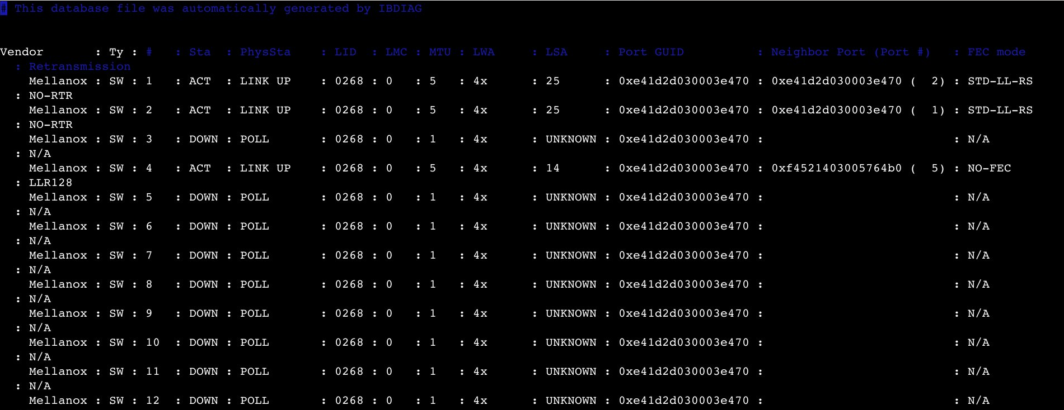
Net dump file
Presenting FEC mode and retransmission mode in iblinkinfo like format.
Helps in understanding the current link status.

Slide 14
PHY Info
Presenting low level link information for switches and HCA ports (EDR)
GRADE Info
Effective BER
ibdiagnet --get_phy_info
In ibdiagnet2.db_csv

Slide 15
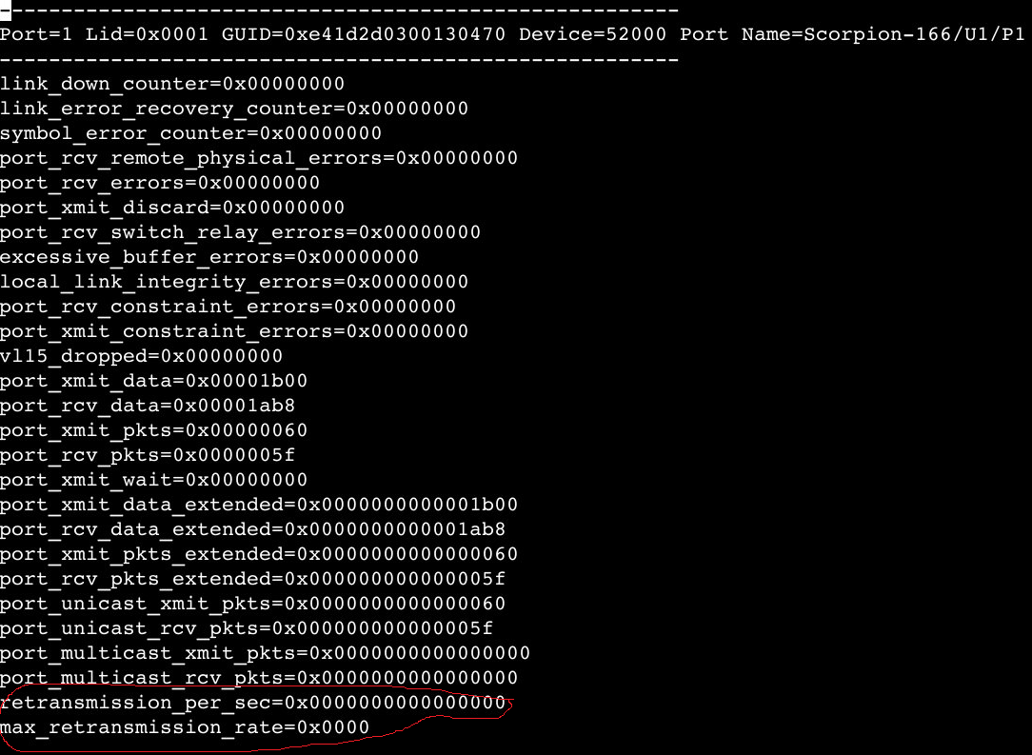
PHY – link quality diagnostics
FDR links: LLR retransmissions
Links with counter > 500, considered bad link

Slide 16
PHY – link quality diagnostics, continue
EDR links: GRADE info and Effective BER
Grade Thresholds (from our HW team)
Below 5000 – Bad link. Please approach Mellanox support.
5000 – 17,000 – Stable link – FEC may be required for handling possible correctable errors.
Above 17,000 – Link has high margin
Effective BER
Ibdiagnet reports bad links, when BER > threshold (default 10^-12)
User can change threshold (ibdiagnet –get_phy_info –ber_thresh <number>)

Slide 17
Cable Info
Ibdiagnet –get_cable_info
The ibdiagnet2.cables gives info of the cable connectors in the fabric.
Recently we have improved dramatically performance, by sending MADs in parallel.
below is an example of cable connector data:
-------------------------------------------------------
Port=27 Lid=0x010c GUID=0xe41d2d030003e470 Port Name=Se41d2d030003e470/Ne41d2d030003e470/P27
-------------------------------------------------------
Vendor: Mellanox
OUI: 0x2c9
PN: MFA1A00-E005
SN: MT1510FT00001
Rev: A7
Length: 5 m
Type: 850 nm VCSEL
SupportedSpeed: SDR/DDR/QDR/FDR/EDR
Temperature: 39C

Slide 18
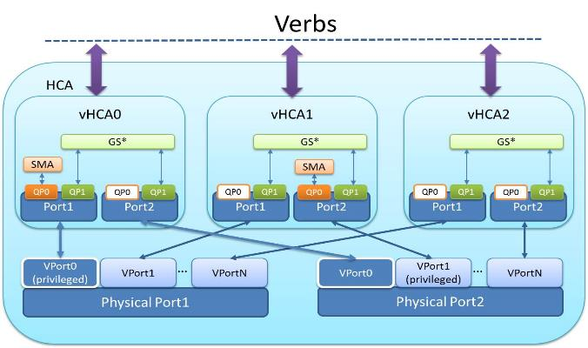
ConnectX4 Virtualization
Connectx4 virtualization module is different from the SRIOV module provided by Connectx3 cards.
Alias GUIDs are replace now by virtual HCA ports.
Each virtual port has its own GUID, PKEY table, port state and capabilities.
Added new flag in ibdiagnet “--virtual”
ibdiagnet will discover the vports and the related vnodes(vHCAs).The vports and the related vnode will be presented in the ibdiagnet2.vports file
Moreover ibdiagnet will present vport and vnodes info that includes name-description, guid, capability-mask, state and more, in the ibdiagnet2.db_csv file

Slide 19
Routing validation
There is an option in ibdiagnet routing check that provides verification of the resulting routing for connectivity (all CA to CA are well connected), routing loops or credit loops.
ibdiagnet –r Collect fdbs and mcfdbs. Run linear and MC connectivity and loop check.
Run credit loop check without MC
Mellanox devices expose several vendor specific features that can be used for better fabric utilization.
These features include Adaptive Routing, Private LFT and VL2VL.
These features are used by OpenSM to provide advanced routing solution for Fat-Tree and Dragonfly+.
Ibdiagnet collects VS info (AR, PLFT, VL2VL) and use this info for connectivity and credit loop check.
ibdiagnet –r --r_opt=vs
In order to perform credit loop test with multicast
ibdiagnet –r --r_opt=vs,mcast --sa_dump opensm-sa.dump
Notes:
Dan to present here

Slide 20
Ibdiagnet generic plugins interface
Ibdiagnet provides generic plugin interface for developers to extend ibdiagnet functionalities
Available API
receive fabric topology
Send MADs via ibdiagnet to collect additional data
Dump plugin’s output data in ibdiagnet2.db_csv file

Slide 21
Thank You

